Slide 1
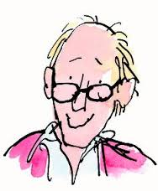
The Landlady
By Roald Dahl

Slide 2
First response:
Notes:
In class, talk about the characters.
Billy and the Landlady → what do we know about these characters?
The landlady. The landlady is middle aged with a friendly and welcoming manner.
Billy Weaver, a young man arriving in an unfamiliar city and looking for accommodation. Billy is 17 years old, optimistic and innocent.

Slide 3
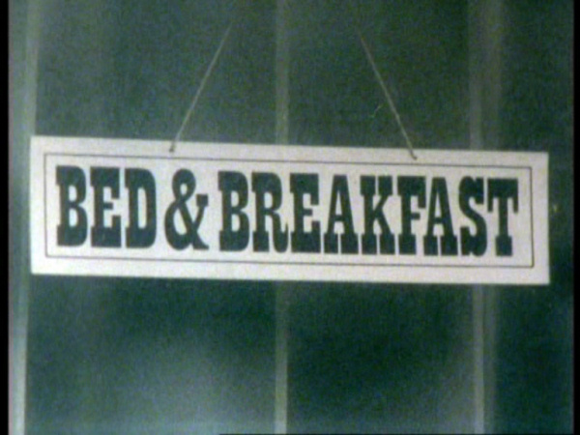
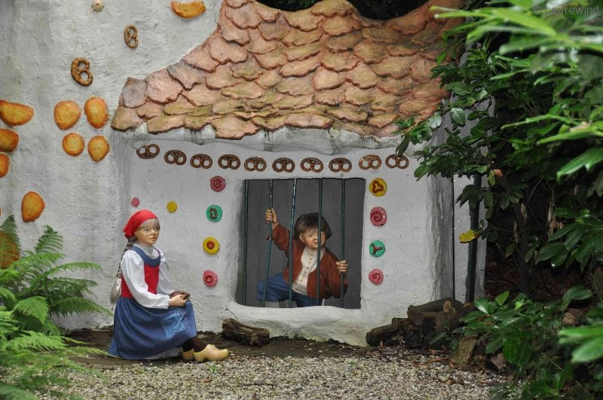
Any similarities with certain European folk tales?
Is the house where Billy sees the sign 'Bed and Breakfast' enchanted? Does the landlady have magical, witch-like powers?
Hansel and Gretel
Notes:
Hansel and Gretel' or 'Babes in the Wood'

Slide 4
Questions – Reading Comprehension:
Why does Billy Weaver walk “briskly” down the street?
A. He wants to act like a successful businessman.
What seems inviting to Billy when he looks through the window of the old house?
C. He sees a dachshund lying in front of the fireplace.
Why didn’t Billy go to the pub? Explain and give examples from the text.
Billy was magically drawn to the Bed and Breakfast.
Each word was like a large black eye staring at him through the glass, holding him, compelling him, forcing him to stay where he was and not to walk away from that house, and the next thing he knew, he was actually moving across from the window to the front door of the house, climbing the steps that led up to it, and reaching for the bell.

Slide 5
Questions – Reading Comprehension:
What was unusual about the way the landlady responded to the doorbell? Explain and give examples from the text.
She opened the door as if she was already waiting behind the door. This was too fast.
..it must have been at once because he hadn’t even had time to take his finger from the bell-button – the door swung open and a woman was standing there. Normally you ring the bell and you have 120 at least a half-minute’s wait before the door opens. But this dame was a like a jack-in-the-box. He pressed the bell – and out she popped!
What evidence is there that the landlady had been expecting a guest? Explain and give examples from the text.
She already prepared the room for Billy.
“It's all ready for you, my dear,”. “But I’m always ready. Everything is always ready day and night in this house just on the off-chance that an acceptable young gentleman will come along.

Slide 6
Questions – Reading Comprehension:
What are the first signs that the landlady is very odd? Explain and give examples from the text.
That she was expecting Billy (she popped up) and she also made some peculiar remarks.
E.g. “We have it all to ourselves,” ‘and just exactly right.’
Billy doesn’t finish his sentence about Christopher Mulholland. What was he about to say? (line 204) Explain, why do you think so?
Probably that the boy was missing. He remembered seeing the name somewhere, in a newspaper or something…
Why is it frightening when the landlady says Mr Temple had perfect skin "just like a baby's"? (line 245). Explain and give examples from the text.
This means that our landlady saw and felt Mr Temple’s skin. She was able to see his whole body..
E.g. There wasn’t a blemish on his body.”

Slide 7
Questions – Reading Comprehension:
What do you think the landlady means when she says "I stuff all my little pets myself when they pass away?" (line 267). Explain and give examples from the text.
Literal mean: she stuffs all her pets when they die.
It also foreshadows the outcome of this story. The boys are seens as her pets and they will be stuffed as well.
What do you think makes Billy’s tea taste strange?
C. Poison
The point at which the reader can predict what will happen to Billy is when the landlady says:
Mulholland and Temple haven’t left the Bed and Breakfast.
Notes:
The scent of bitter almonds is typical for a cyanide poisoning

Slide 8
Question – Technical Elements:
How is the climax of the story resolved?
C. Readers can only assume that Billy will meet the same fate as Temple and Mulholland.
Which of these elements of “The Landlady” are realistic: the setting? The characters? The story events? Explain your answers.
All elements are realistic except the Landlady and the events + explanation.

Slide 9
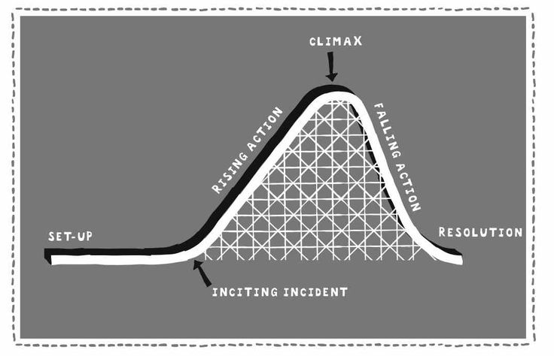
Roller Coaster Diagram:
Climax:
"Wait just a minute. Mul­holland . . Christopher Mulholland . . . wasn't that the name of the Eton schoolboy who was on a wal­king­tour through the West Country, and then all of a sudden . “
Exposition:
Billy Weaver had travelled down from London
Inciting Incident:
Suddenly, in a downstairs window that was brilliantly illuminated by a street lamp not six yards away..
Exposition
Denoument
Denouement:
“I stuff all my little pets myself when they pass away.
“No, my dear,” she said. “Only you.”
Notes:
Explain…

Slide 10
Question – Technical Elements:
This conflict is best described as internal/external (circle one) because....
Man vs (Wo)Man, Billy vs the Landlady
Explain what the theme of this story is. Ensure you are providing specific examples from the story to support your choice.
E.g. appearances versus reality + explanation
Or deception and the naivety of Billy.
What do you think will happen to Billy? Explain why you think so.
Billy will suffer the same consequence as the two other boys. He will be stuffed and the landlady will treat him like a doll.

Slide 11
Vocabulary:
A new 15 brown trilby hat.
Gleufhoed
They had been very swanky residences
Verwaand
Blotchy from neglect
Vlekkerig
Rapacious landladies
roofzuchtig

Slide 12
Vocabulary:
After dithering about like this in the cold for two or three minutes.
Getreuzel
And now a queer thing happened to him.
vreemd, eigenaardig
There is nothing more tantalizing than a thing like this.
tergend, treiterig
It seemed to emanate directly from her person.
uitstralen

