Slide 1
Reptielen

Slide 2
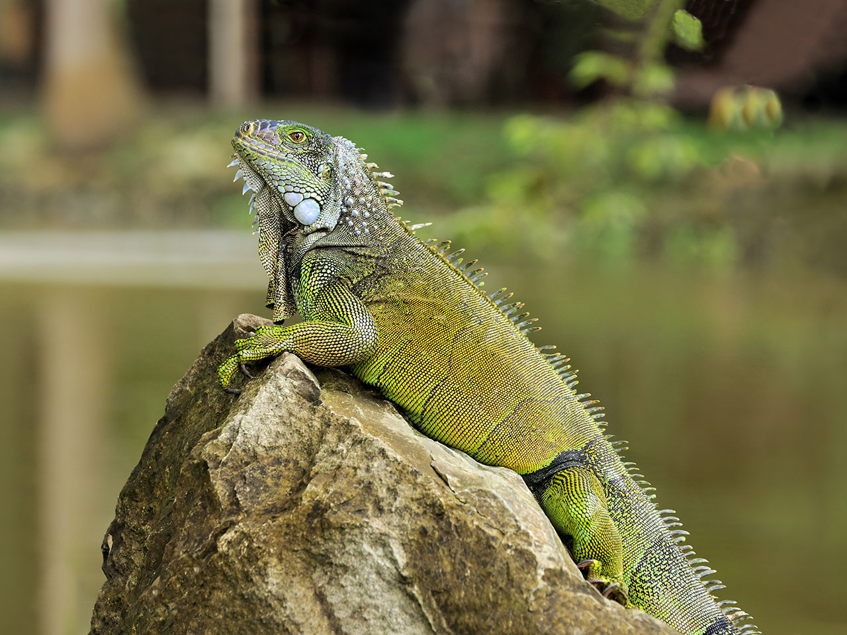
Groene leguaan

Slide 3
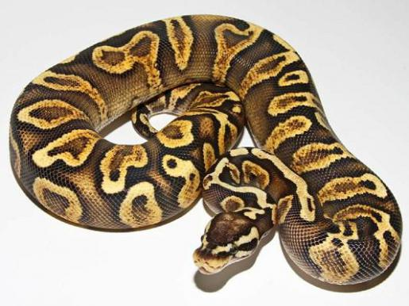
Koningspython

Slide 4
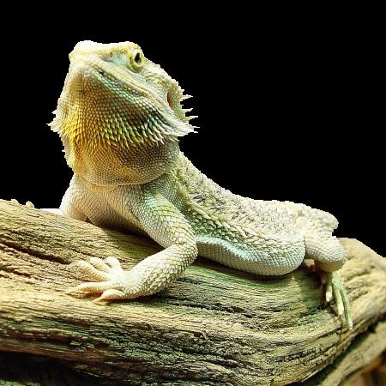
Baardagame

Slide 5
Boa constrictor

Slide 6
Jemen

Slide 7
kameleon

Slide 8
Adder

Slide 9
Ratelslang

Slide 10
Rode Rattenslang

Slide 11
Kousenbandslang

