Slide 1
Parallel - schikking
Integrale opdracht
Schaalschikking in stijl

Slide 2
Parallelschikking

Slide 3
Parallelschikking

Slide 4
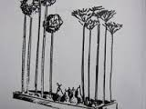
Parallelschikking

Slide 5
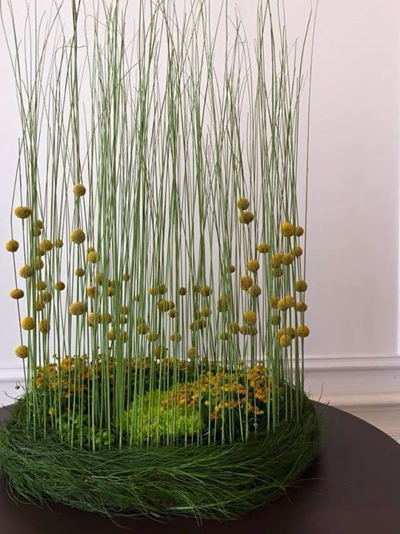
Parallelschikking

Slide 6
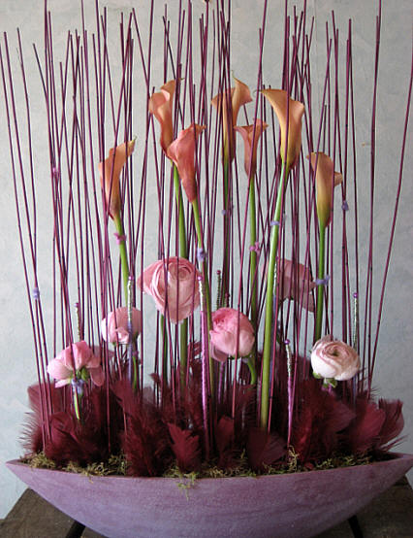
Parallelschikking

