Slide 1
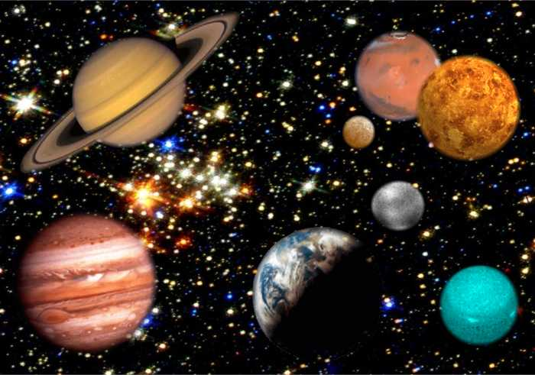
Space idioms

Slide 2
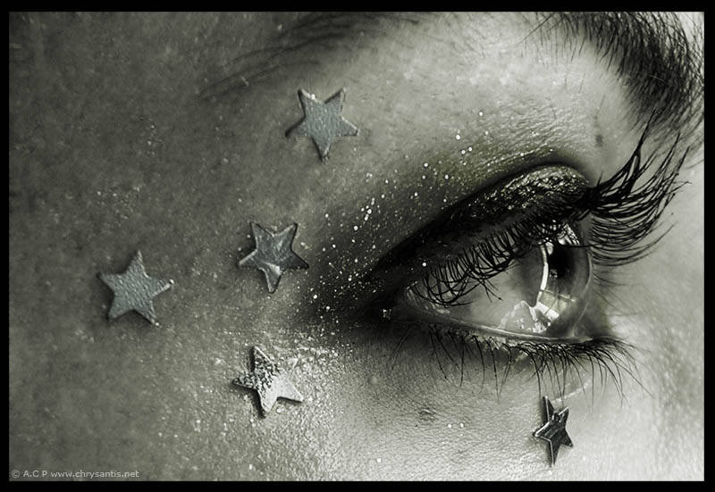
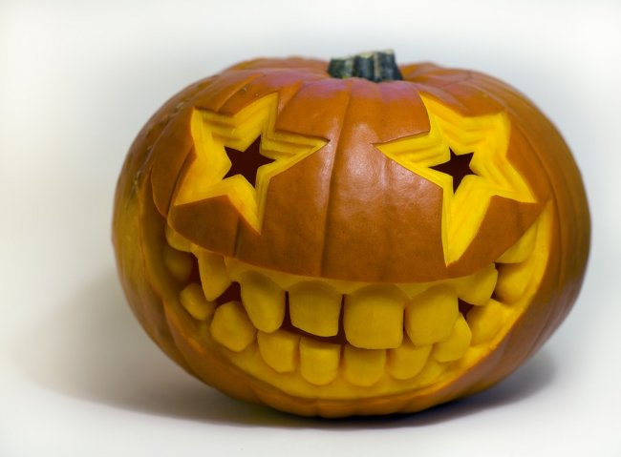
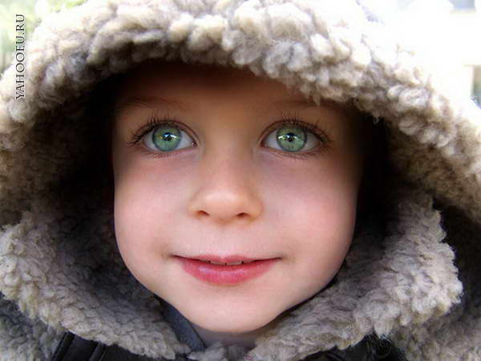
Starry-eyed / stars in your eyes
full of emotion, hopes or dreams
She was too starry-eyed about her future.

Slide 3
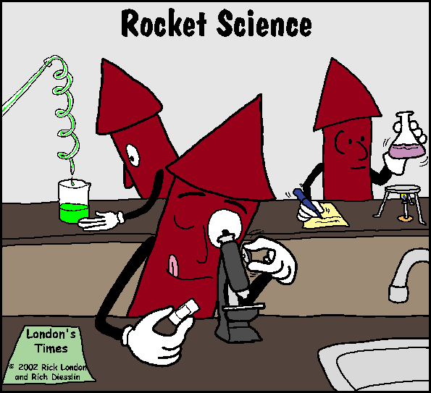
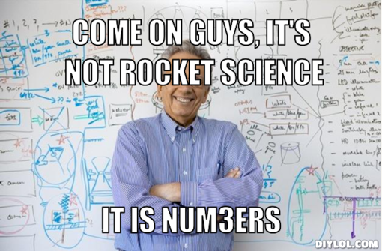
it's not rocket science
is easy to do or understand
Come on Rob, it's not rocket science, all you have to do is open the tin and heat it up.

Slide 4
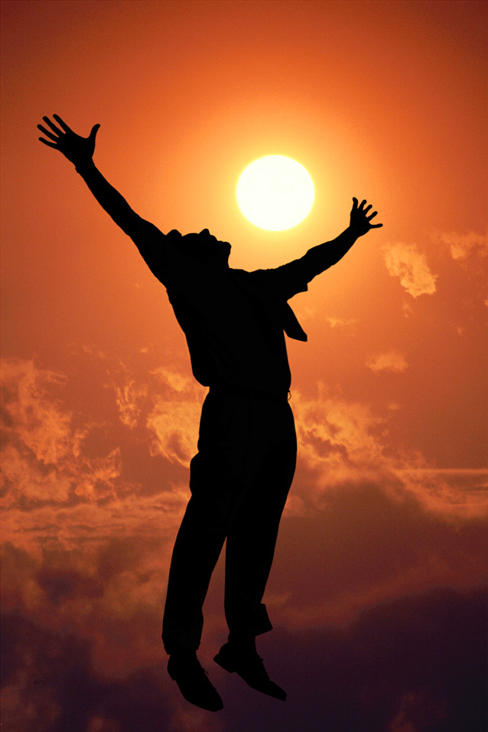
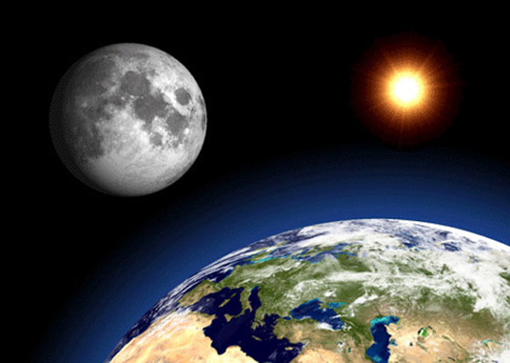
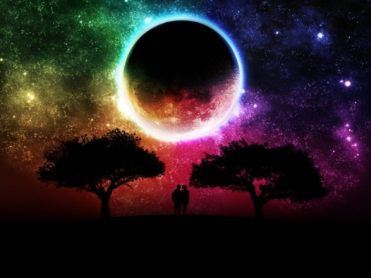
Under the sun
Everything that exists
Or possible
I've been called all the names under the sun!

Slide 5
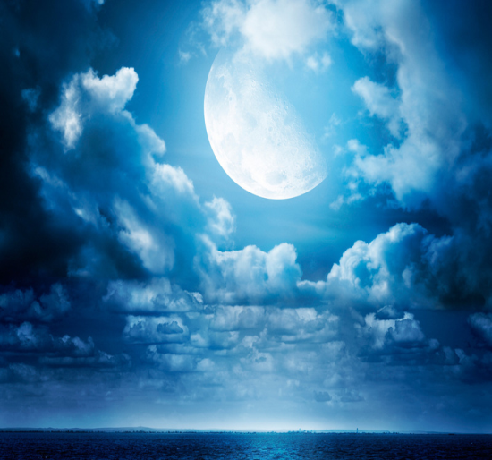
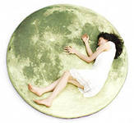


Over the moon
extremely happy and excited
They're over the moon about their trip to Japan.

Slide 6
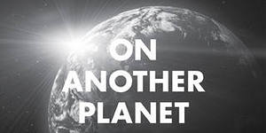
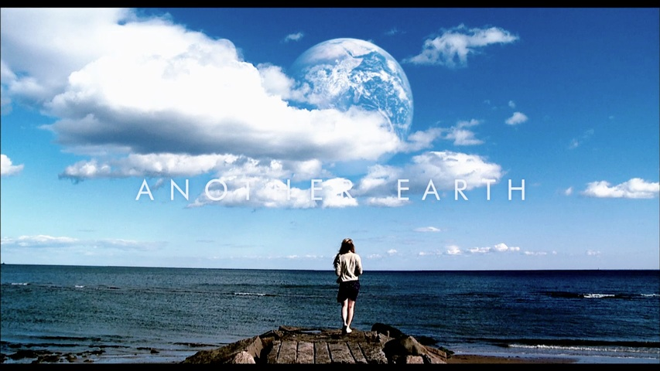
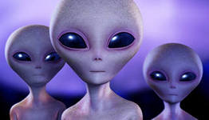
(Living) on another planet what planet are you on?
somebody's ideas are not realistic or practical
He thinks being a father is easy. What planet is he on?

Slide 7
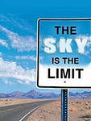
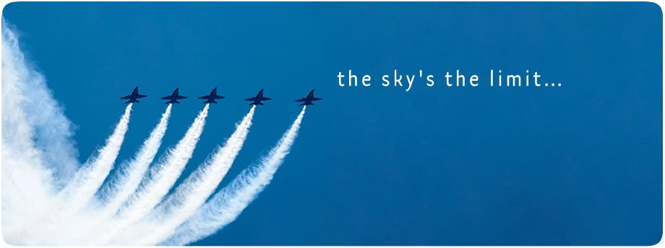
the sky is the limit
there is no limit to what somebody can achieve, earn, do
With a talent like his, the sky's the limit.

Slide 8
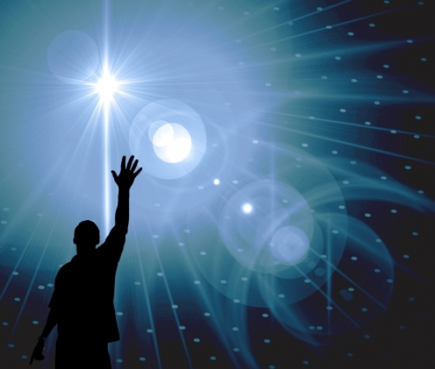
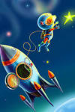
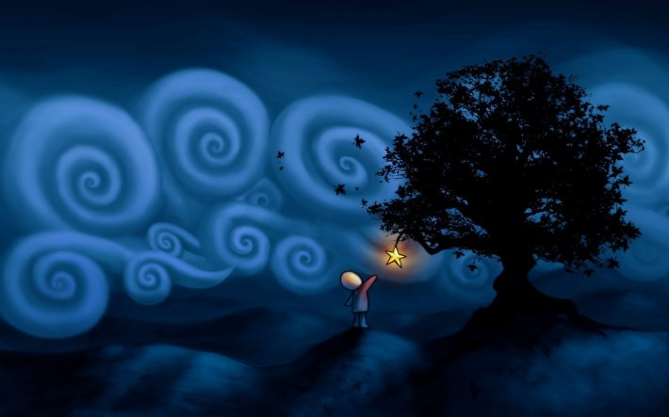
Reach for the stars / moon
try to be successful at something that is difficult
Her father always wanted Sylvia to reach for the stars, but Sylvia just wanted to play with her pets.

Slide 9
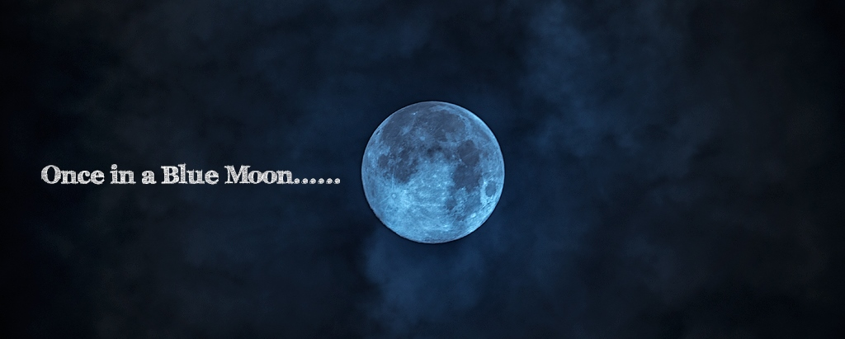
once in a blue moon
Very rarely
We hardly ever go out these days, though once in a blue moon we might go and see a movie.

Slide 10
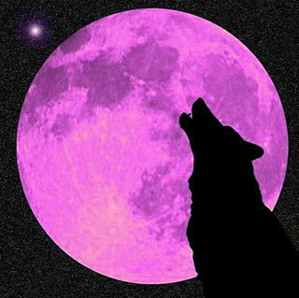
Ask/cry for the moon
to ask for something that is difficult or impossible to get or achieve
The striking workers say they just want to be paid what they're worth. They're not asking for the moon.

