Slide 1
KRUIDEN

Slide 2
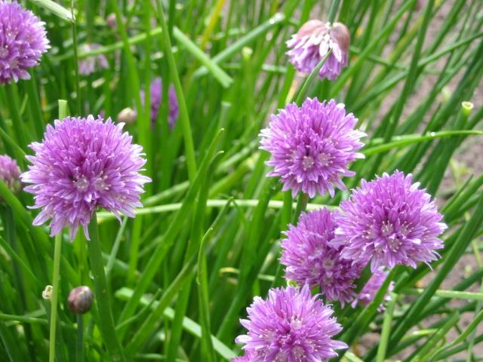
1. Allium schoenoprasum. Bieslook

Slide 3
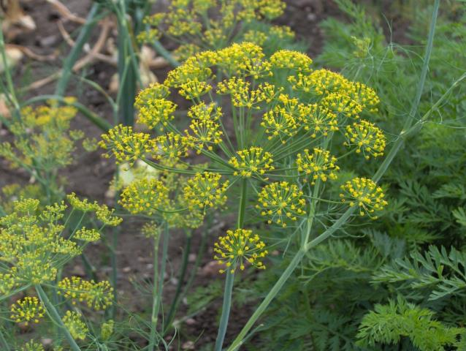
2. Anethum graveolens. Dille

Slide 4
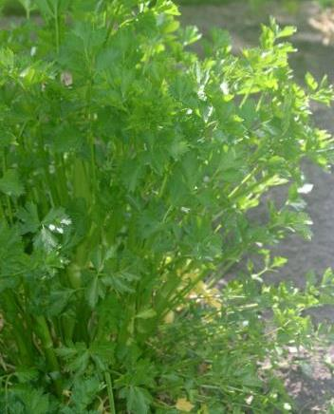
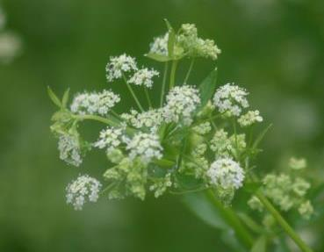
3. Apium graveolens var. secalium. Snijselderij

Slide 5
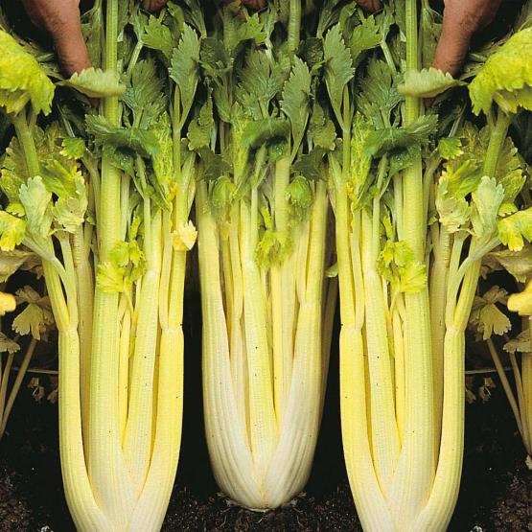
4. Apium graveolens var. dulce. Bleekselderij

Slide 6
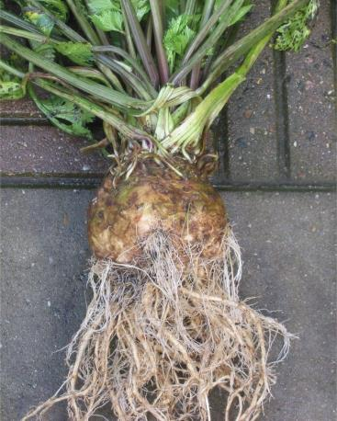
5. Apium graveolens var. rapaceum. Knolselderij

Slide 7
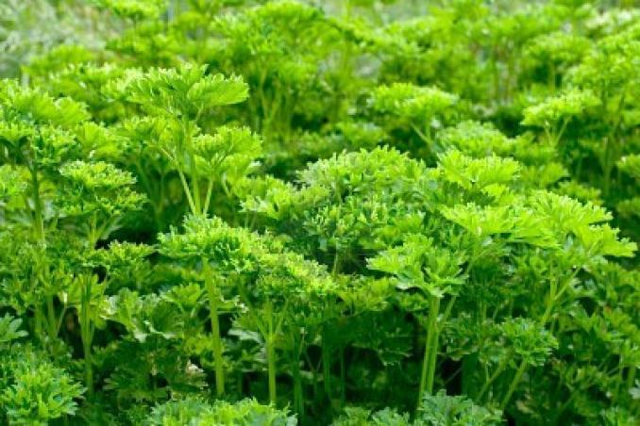
6. Petroselium crispum -krulpeterselie

Slide 8
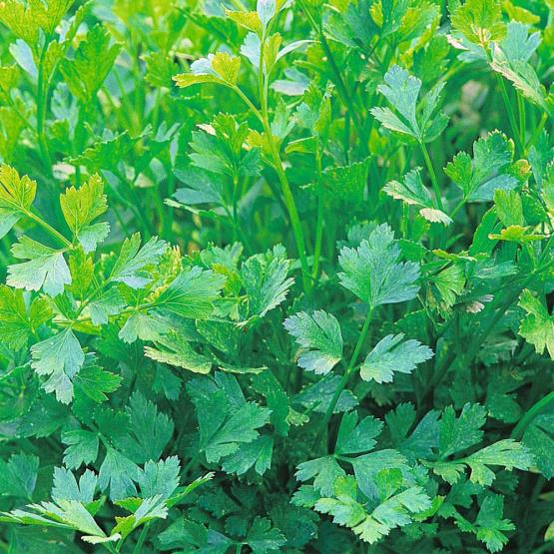
7. Petroselium crispum var. neapolitanum. Gladde peterselie

Slide 9
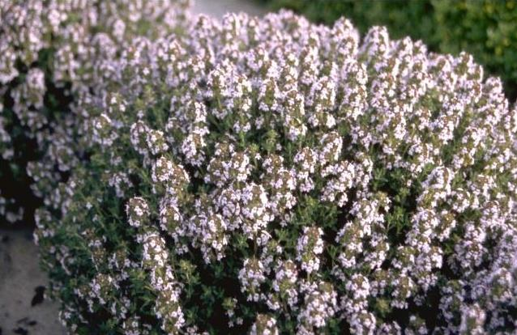
8. Thumus vulgaris ‘Compactus’ Tijm

