Slide 1
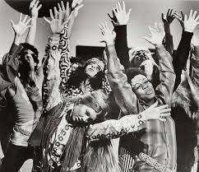
Hippies
Jaren 60

Slide 2
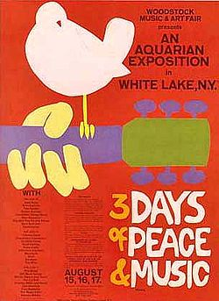
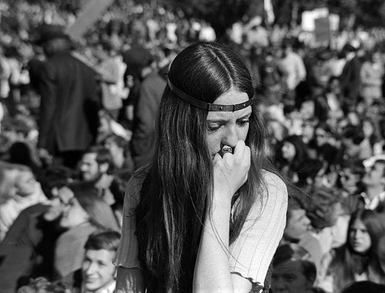
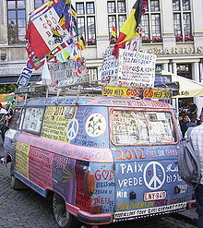
Love and Peace
Hippies
Woodstock 1969
Protestsong – Bob Dylan
Psychedelische rock
http://www.youtube.com/watch?v=-L9MENtut7g
https://www.youtube.com/watch?v=RuSUpqdYV-I
https://www.youtube.com/watch?v=WANNqr-vcx0

Slide 3
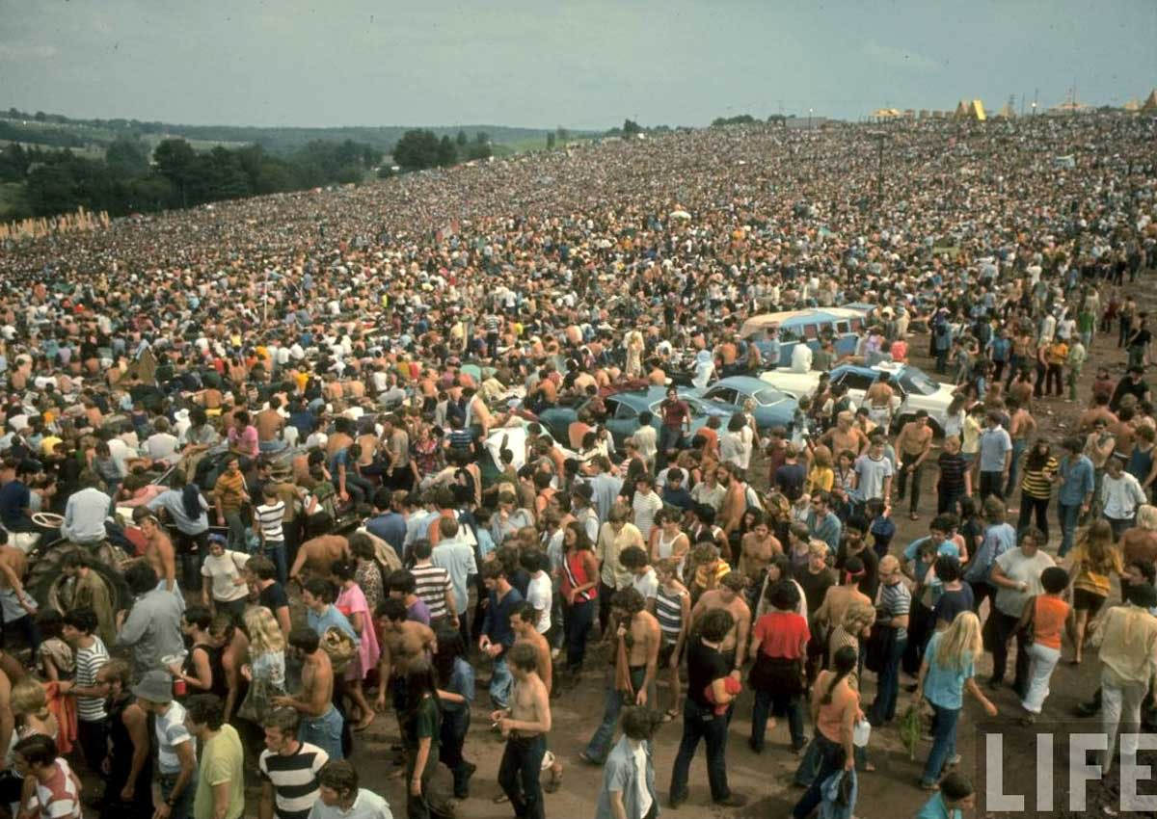
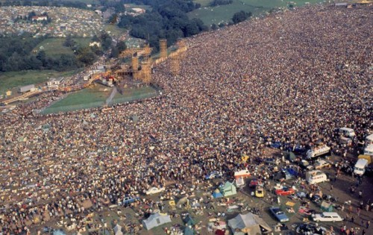
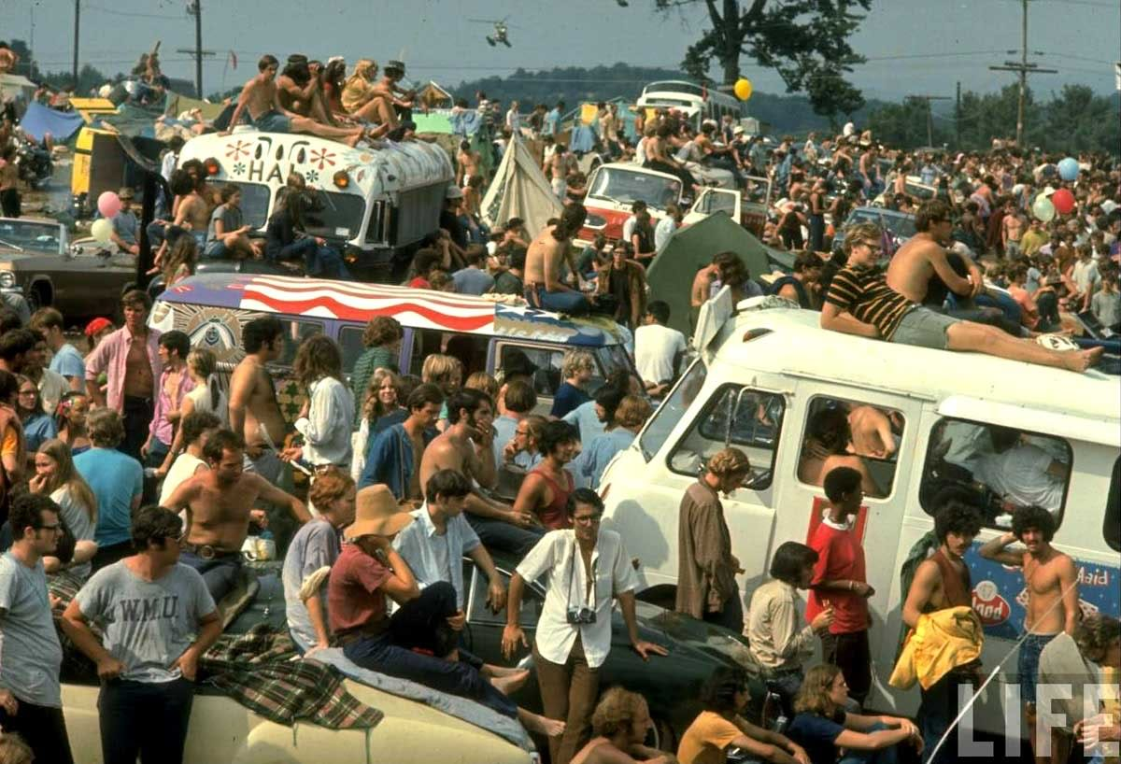
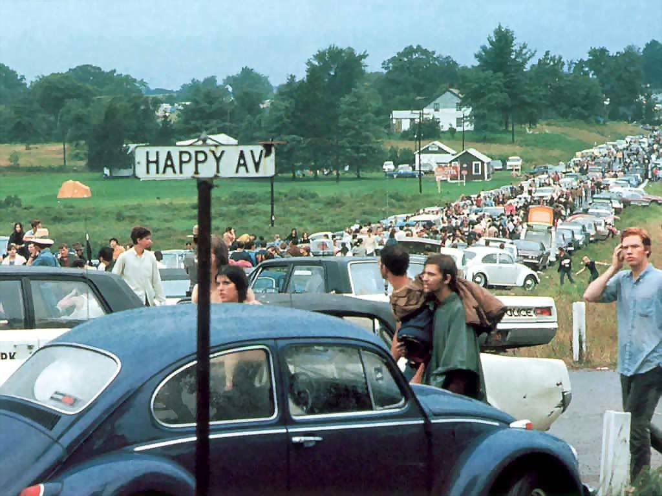
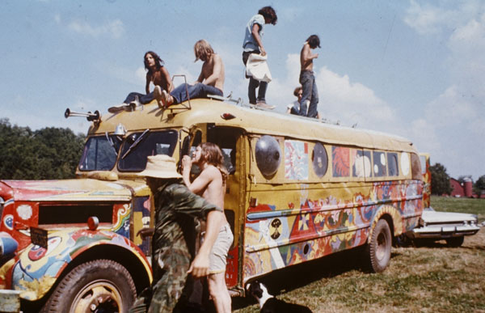
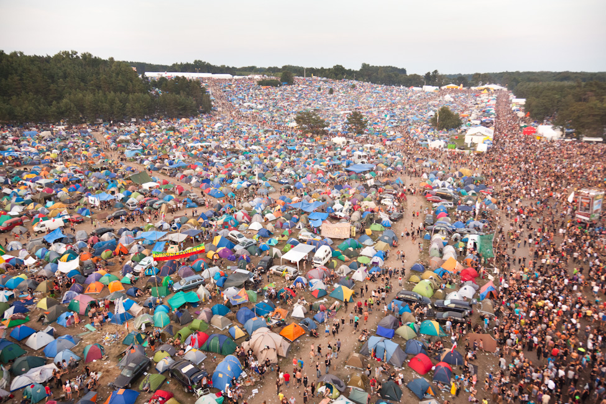

Slide 4
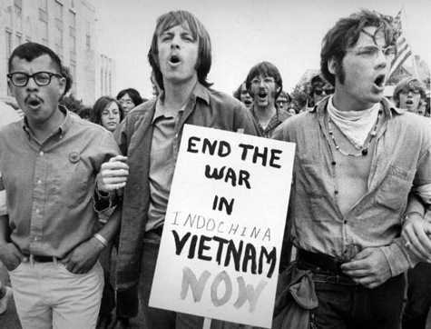
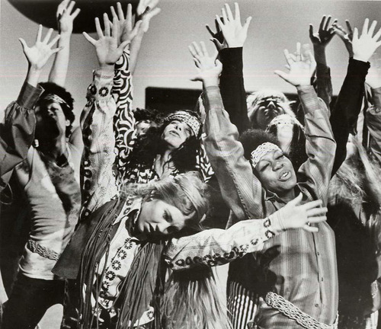
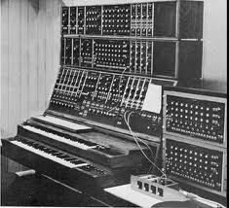
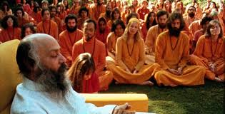
Free your mind and the rest will follow....
Inspiratiebronnen eind jaren ‘60
Drugs
Oosterse mystiek
Politieke stellingname
Sound en (aparte) instrumenten (experimenteren)

Slide 5
Sitar
https://www.youtube.com/watch?v=hTPxqUtlLdo
https://www.youtube.com/watch?v=y__Zs3e6BdA

Slide 6
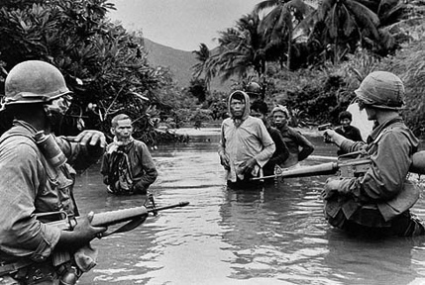
Protest
https://www.youtube.com/watch?v=MKvnQYFhGCc
Jimi Hendrix
Boudewijn de Groot
https://www.youtube.com/watch?v=zxYXLcy6WP8

