Slide 5
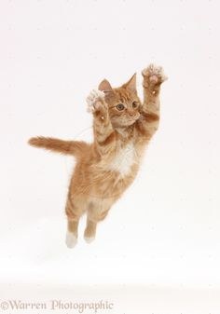
In een actieve zin doet het onderwerp iets
The cat jumped

Slide 6
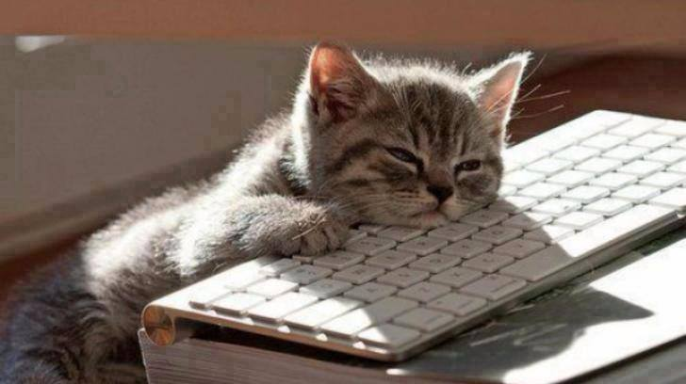
In een passieve zin doet het onderwerp niets.
The keyboard was slept on (by the cat)

Slide 8
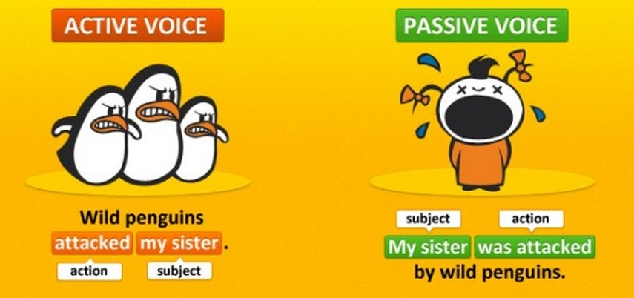

Slide 9
Tegenwoordige tijd: Am, are, is + voltooid deelwoord
I am mentioned in the newspaper.
Verleden tijd: was/were + voltooid deelwoord
I was mentioned in the newspaper.
Voltooide tijd: Have/has been + voltooid deelwoord
I have been mentioned in the newspaper.
Future: will be/shall be + voltooid deelwoord
I will be mentioned in the newspaper.

Slide 10
Passieve zin met ‘er’ en ‘men’
Er wordt gezegd dat hun advocaten erg slim zijn.
It is said their lawyers are very clever.
Er werd gezegd…
It was said….
Men vindt dat hun manager heel slim is
It is thought that their manager is very smart
Their manager is thought to be very smart

