Slide 1
Lesson 6 Antibacterial Effect of Nanoproducts

Slide 2
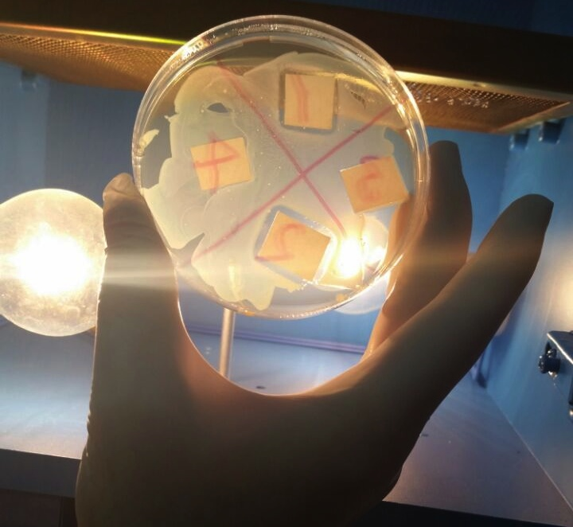
The Result of the Experiment “Testing the Antibacterial Effect of Silver Nanoparticles” (Photo)

Slide 3
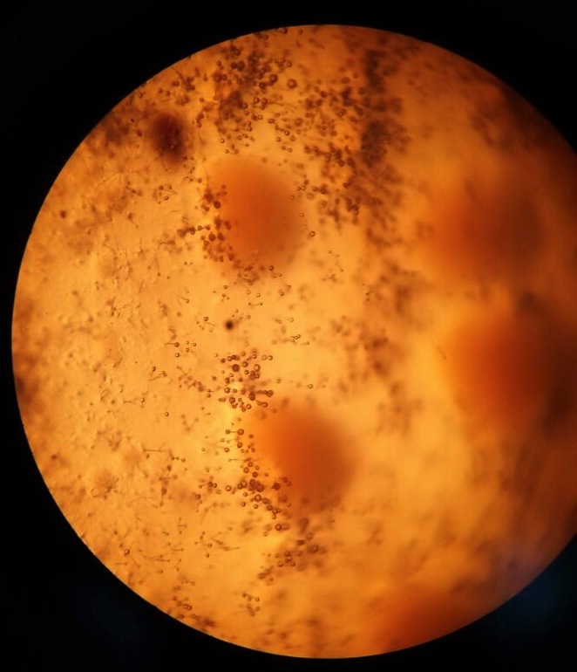
The Result of the Experiment “Testing the Antibacterial Effect of Silver Nanoparticles” (Light microscope Image)

Slide 4
The Result of the Experiment “Testing the Antibacterial Effect of Silver Nanoparticles” (SEM Image)

Slide 5
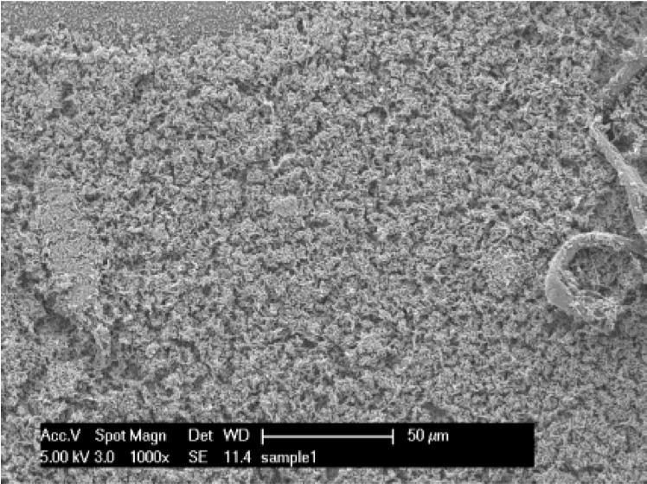
Healthy E. Coli Bacteria Cells 1000x (50µm)
(Muskin et al., 2008)

Slide 6
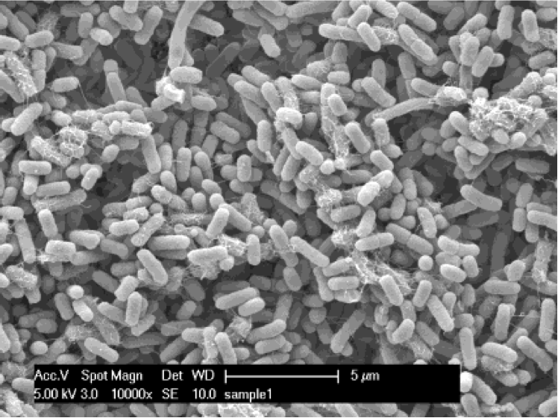
Healthy E. Coli Bacteria Cells 10000x (5µm)
(Muskin et al., 2008)

Slide 7
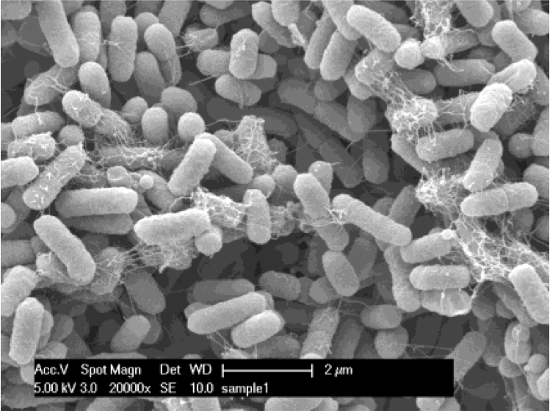
Healthy E. Coli Bacteria Cells 20000x (2µm)
(Muskin et al., 2008)

Slide 8
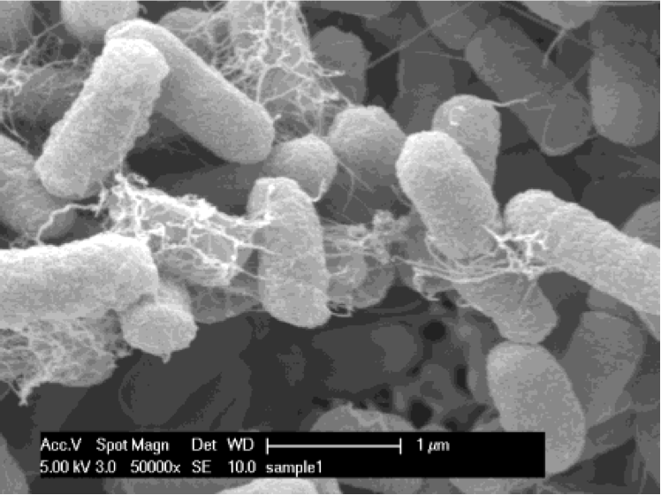
Healthy E. Coli Bacteria Cells 50000x (1µm)
(Muskin et al., 2008)

Slide 9
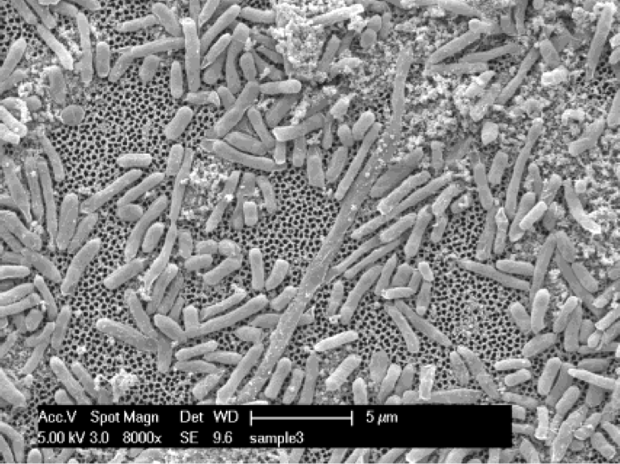
Unhealthy E. Coli Bacteria Cells 8000x (5µm)
(Muskin et al., 2008)

Slide 10
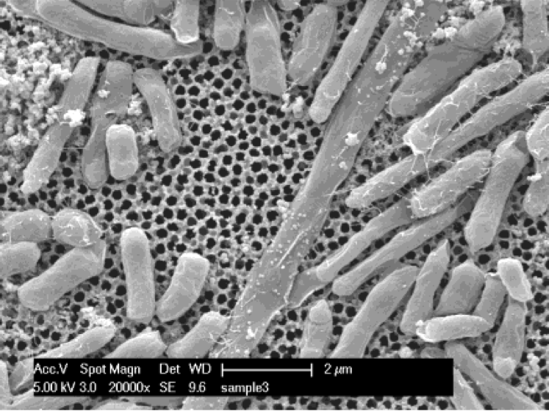
Unhealthy E. Coli Bacteria Cells 20000x (2µm)
(Muskin et al., 2008)

Slide 11
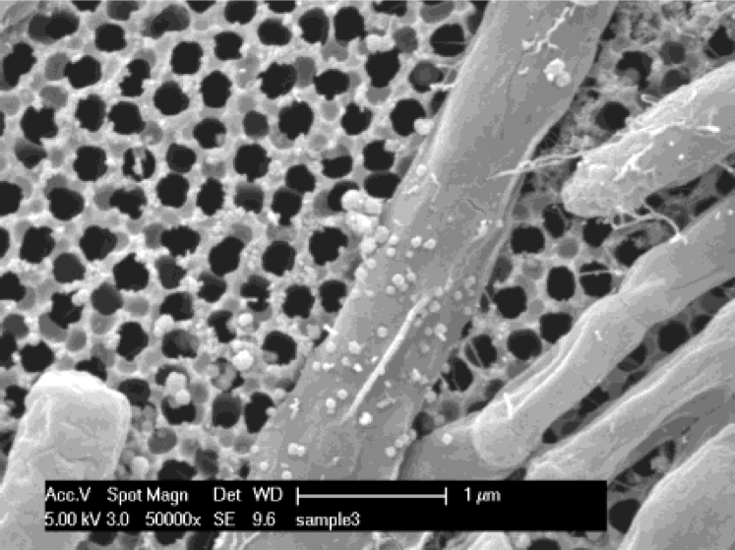
Unhealthy E. Coli Bacteria Cells 50000x (1µm)
(Muskin et al., 2008)

Slide 12
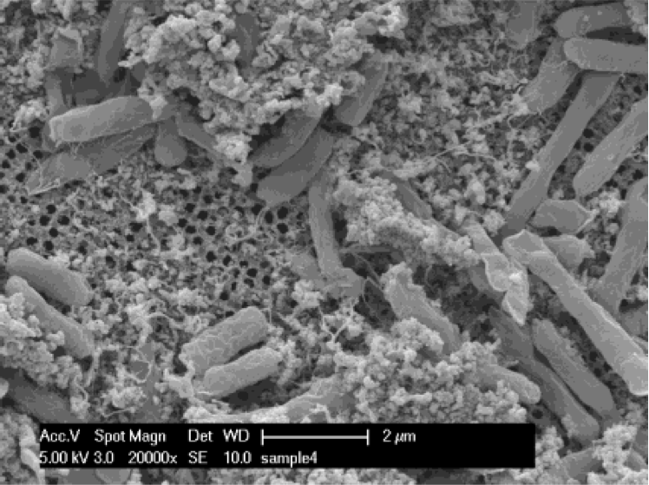
Unhealthy E. Coli Bacteria Cells 20000x (2µm)
(Muskin et al., 2008)

Slide 13
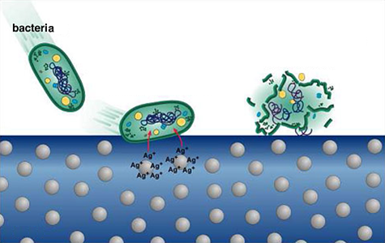
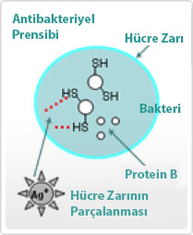
How the Antibacterial Effect Occurs
CF: http://www.isern.tv/news/
http://www.nanomark.org.tw/Eng/License/12/

Slide 14
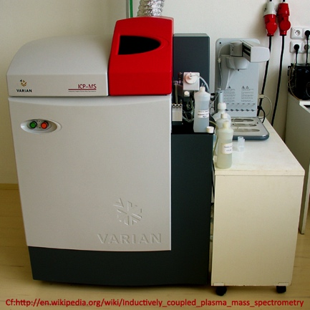
The ICPMS Device

Slide 15
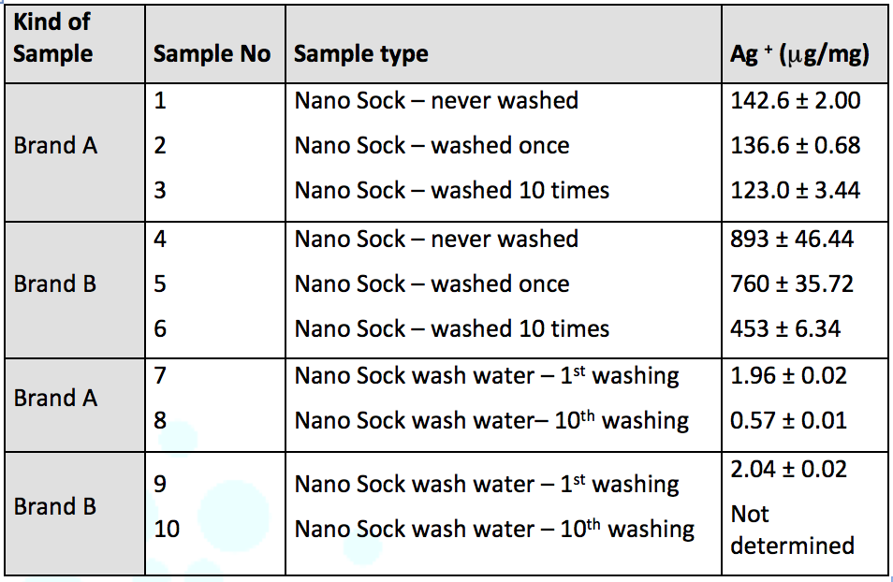
The ICPMS Analysis – The analysis results of the amount of Ag⁺ (in μg/mg)
(This analysis was carried out at the Central Laboratory of the Yildiz Technical University Science and Technology Research and Application Center, January 2015.)

Slide 16
References
Muskin, J., Wattnem, J., Ragusa, M. and Hug, B. (2008). Real Science or Marketing Hype: Student-Designed Experiments Test the Antimicrobial Effects of Silver Nanoparticles. The Science Teacher, 75(4), 57-61.
http://www.isern.tv/news/
http://www.nanomark.org.tw/Eng/License/12/
https://en.wikipedia.org/wiki/Inductively_coupled_plasma_mass_spectrometry

