Slide 1



Lesson 4
Imaging Bacteria

Slide 2


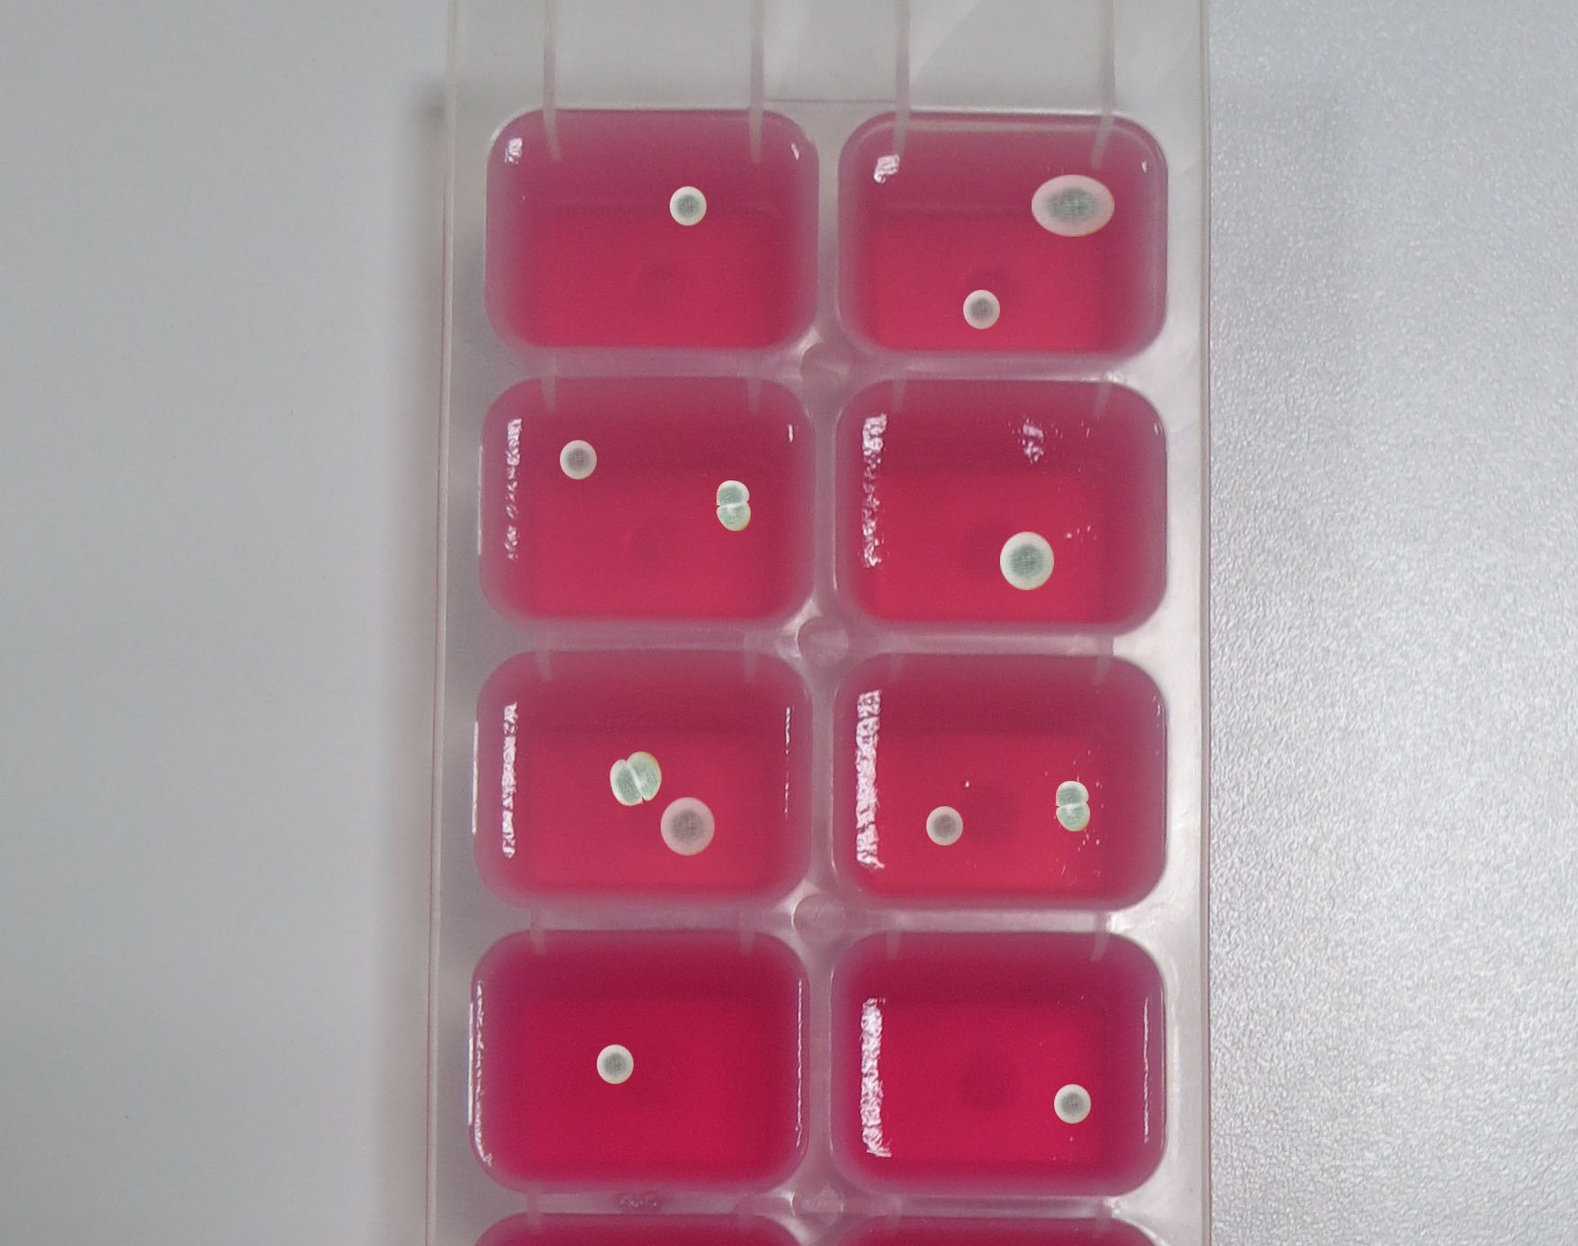
The organisms that have formed
on the agar cubes

Slide 3
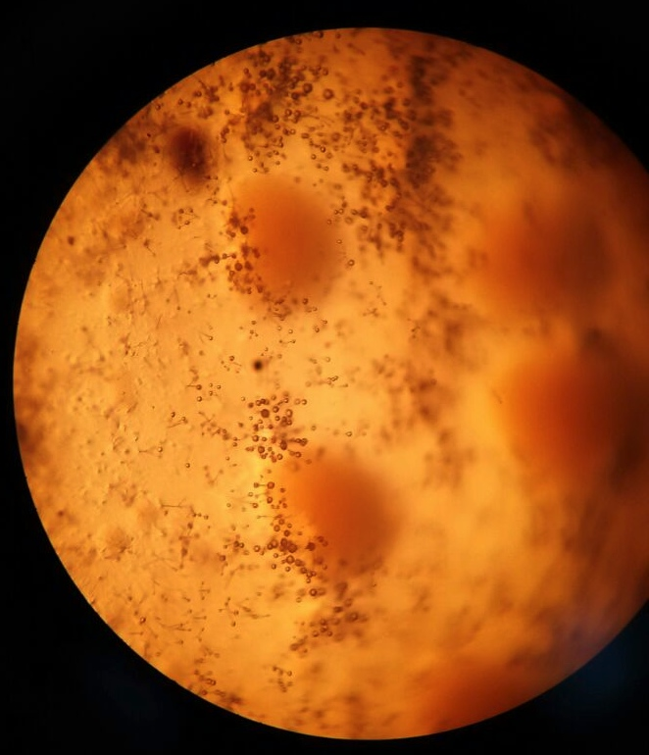
Light Microscope

Slide 4
SEM
1000x (20µm)

Slide 5
SEM
2400x (10µm)

Slide 6
SEM
5000x (5µm)

Slide 7
SEM
5000x (5 µm)

Slide 8
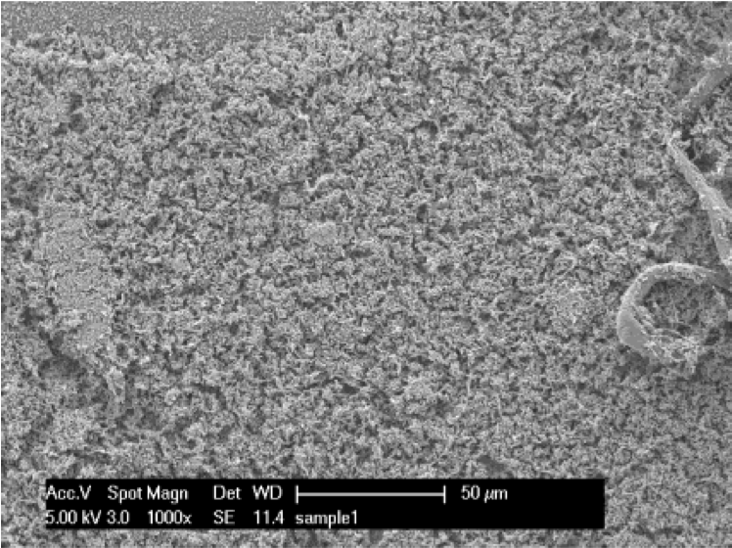
Healthy E. Coli Bacteria Cells
1000x (50µm)
(Muskin et al., 2008)

Slide 9
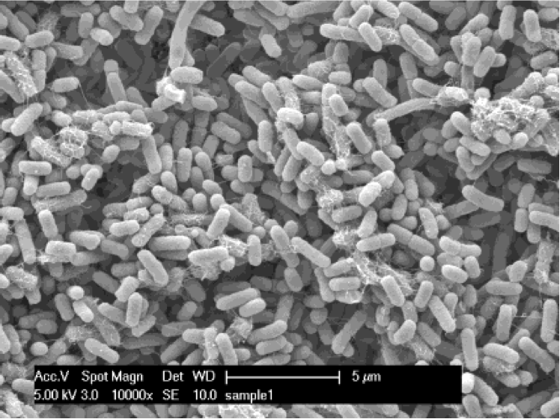
Healthy E. Coli Bacteria Cells
10000x (5µm)
(Muskin et al., 2008)

Slide 10
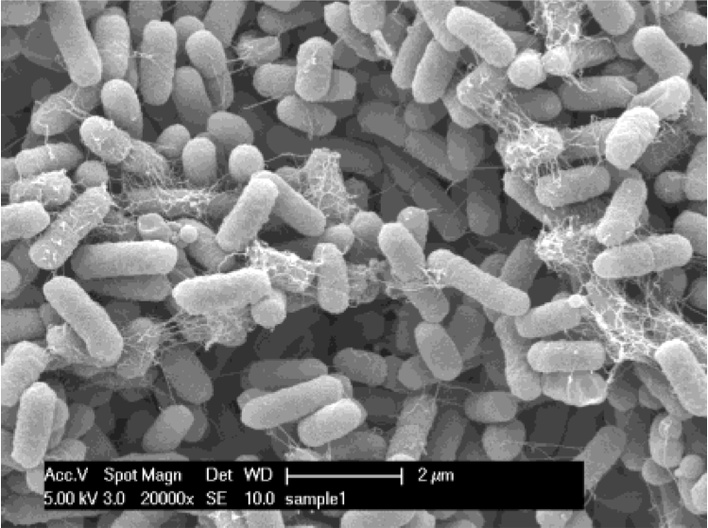
SEM: E. Coli Bacteria Cells
20000x (2µm)
(Muskin et al., 2008)

Slide 11
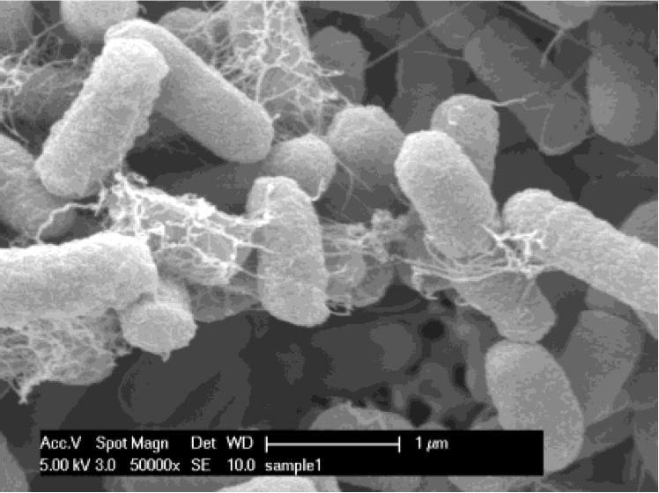
Healthy E. Coli Bacteria Cells
50000x (1µm)
(Muskin et al., 2008)

Slide 12
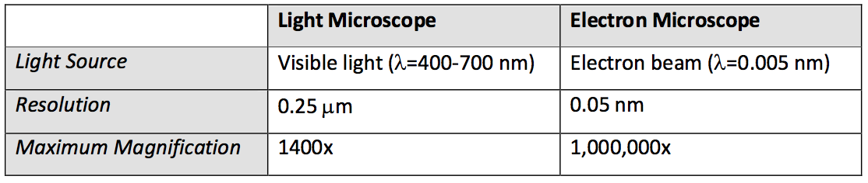
Light Microscope vs.
Electron Microscope

Slide 13
Imaging Limit of the Light Microscope

Slide 14
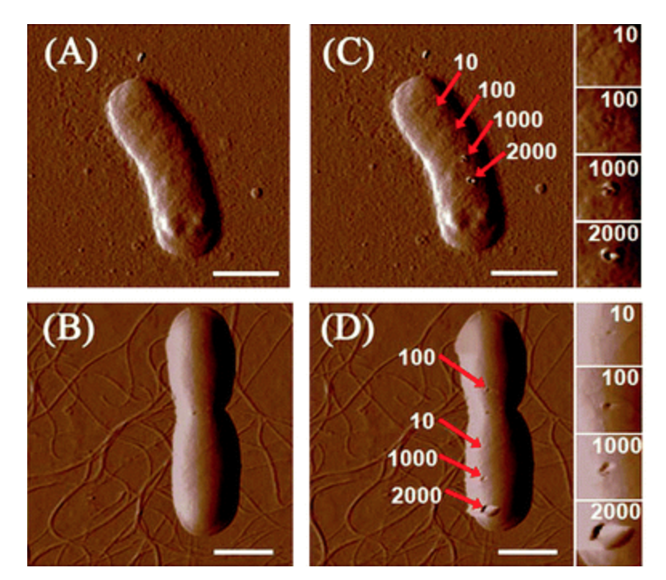
AFM Images of Bacteria
(Liu et al., 2010).

Slide 15
References:
Liu, S., Ng, A. K., Xu, R., Wei, J., Tan, C. M., Yang, Y., & Chen, Y. (2010). Antibacterial action of Dispersed single-walled carbon nanotubes on Escherichia coli and Bacillus subtilis investigated by atomic force microscopy. Nanoscale, 2(12), 2744-2750.
Muskin, J., Wattnem, J., Ragusa, M. and Hug, B. (2008). Real Science or Marketing Hype: Student-Designed Experiments Test the Antimicrobial Effects of Silver Nanoparticles. The Science Teacher, 75(4), 57-61.

