Slide 1
PRESENT SIMPLE

Slide 2
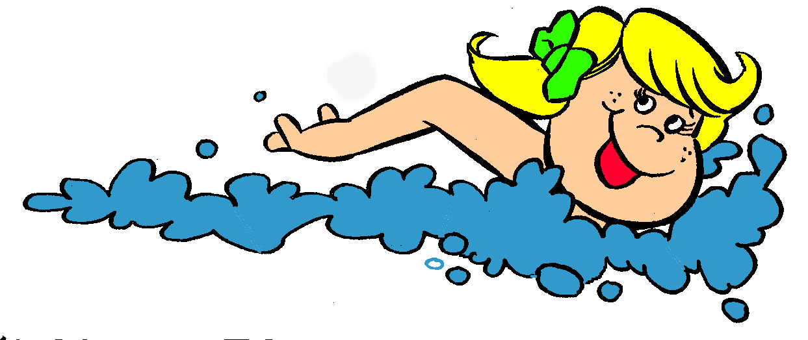
swim
I swim everyday.
She swims everyday.

Slide 3
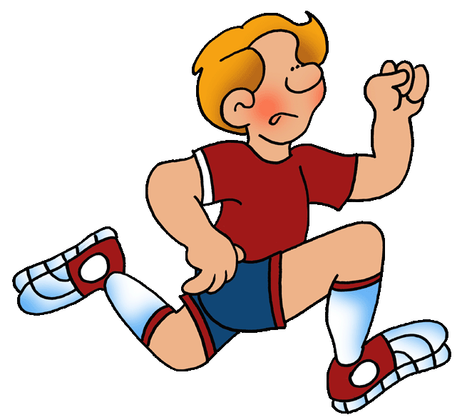
Now, it’s your turn :
Run
I run every day.
He runs everyday.

Slide 4
Verb : play the piano on Mondays
AFFIRMATIVE
I play the piano on Mondays.
You play the piano on Mondays.
We play the piano on Mondays.
You play the piano on Mondays.
They play the piano on Mondays.
FORM :
Subject +Verb
He plays the piano on Mondays.
He /she /it + Verb + S

Slide 5
I don’t swim everyday.
She doesn’t swim everyday.

Slide 6
Now, it’s your turn :
I don’t run everyday.
He doesn’t run everyday.

Slide 7
Verb : play the piano on Mondays
NEGATIVE
I don’t play the piano on Mondays.
You don’t play the piano on Mondays.
We don’t play the piano on Mondays.
You don’t play the piano on Mondays.
They don’t play the piano on Mondays.
FORM :
Subject + DON’T + Verb
He doesn’t play the piano on Mondays.
He /she /it + DOESN’T + Verb

Slide 8
Do you swim everyday ? Yes, I do. / No, I don’t.
Does she swim everyday?
Yes, she does. / No, she doesn’t.

Slide 9
Now, it’s your turn :
Do you run everyday ? Yes, I do. / No, I don’t.
Does he run everyday?
Yes, he does. / No, he doesn’t.

Slide 10
Verb : play the piano on Mondays
INTERROGATIVE
Do I play the piano on Mondays?
Do you play the piano on Mondays?
Do we play the piano on Mondays?
Do you play the piano on Mondays?
. Do they play the piano on Mondays?
FORM :
DO + subject + Verb +?
Does he play the piano on Mondays?
DOES + he /she / it + Verb
+ ?

Slide 11
When do we use the present simple?
To talk about things in general, to say that something happens all the the time or repeatedly, or that something is true in general.
Examples :
They usually go to London at weekends.
The Earth goes round the sun.
To say how often we do things.
Example :
Mary often washes her car.

Slide 12
Spelling rules
The ending is –es when the verb ends in –s/ -ss / -sh / -ch / -x / -o
Wash washes
Miss misses
Go goes
If a verb ends in a consonant + y (-by / -ry / -sy …) , « y » changes to –ie before the ending « s »
Hurry hurries
Try tries
play plays
« a » isn’t a consonant, it’s a vowel !

Slide 13
Pronunciation
The final « s » is pronounced /s/ when the verbs end with these sounds : /p/ , /t/ ,/k/ ,/f/ and /θ/
She makes her bed.
He likes playing video games.
The final « s » is pronounced /z/ when the verbs end with these sounds :/b/, /d/, /g/, /v/, /ð/, /l/, /m/, /n/ , /ŋ/,/eɪ/ and /aɪ/
Tom plays football on Tuesdays.
She loves animals.
The final « s » is pronounced /iz/ when the verbs end with these sounds : /s/, /z/, /ʃ/, /tʃ/ and /dʒ/
Mary watches T.V everyday.
Jerry often washes his car.

