Slide 1
Comparisons
Trappen van vergelijking

Slide 2
What do you think of these movies?

Slide 3
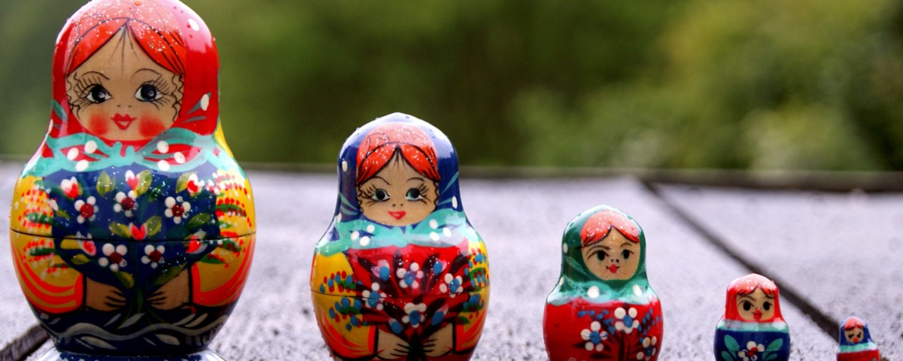
Trappen van vergelijking
Klein Kleiner dan Het kleinst
Logisch Logischer dan Het meest
logisch

Slide 4
In het Engels
Is het aantal lettergrepen belangrijk
Small = 1 lettergreep
Beautiful = 3 lettergrepen

Slide 5
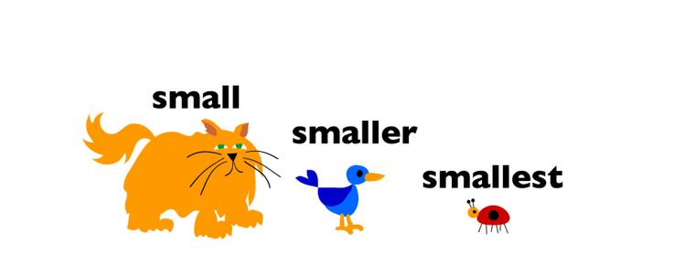
Woorden met 1 lettergreep of 2 lettergrepen eindigend op –y, -er, -le, -ow
Positive form comparative form superlative form
Small Smaller than The smallest
Pretty Prettier than The prettiest
Narrow Narrower than The narrowest

Slide 6
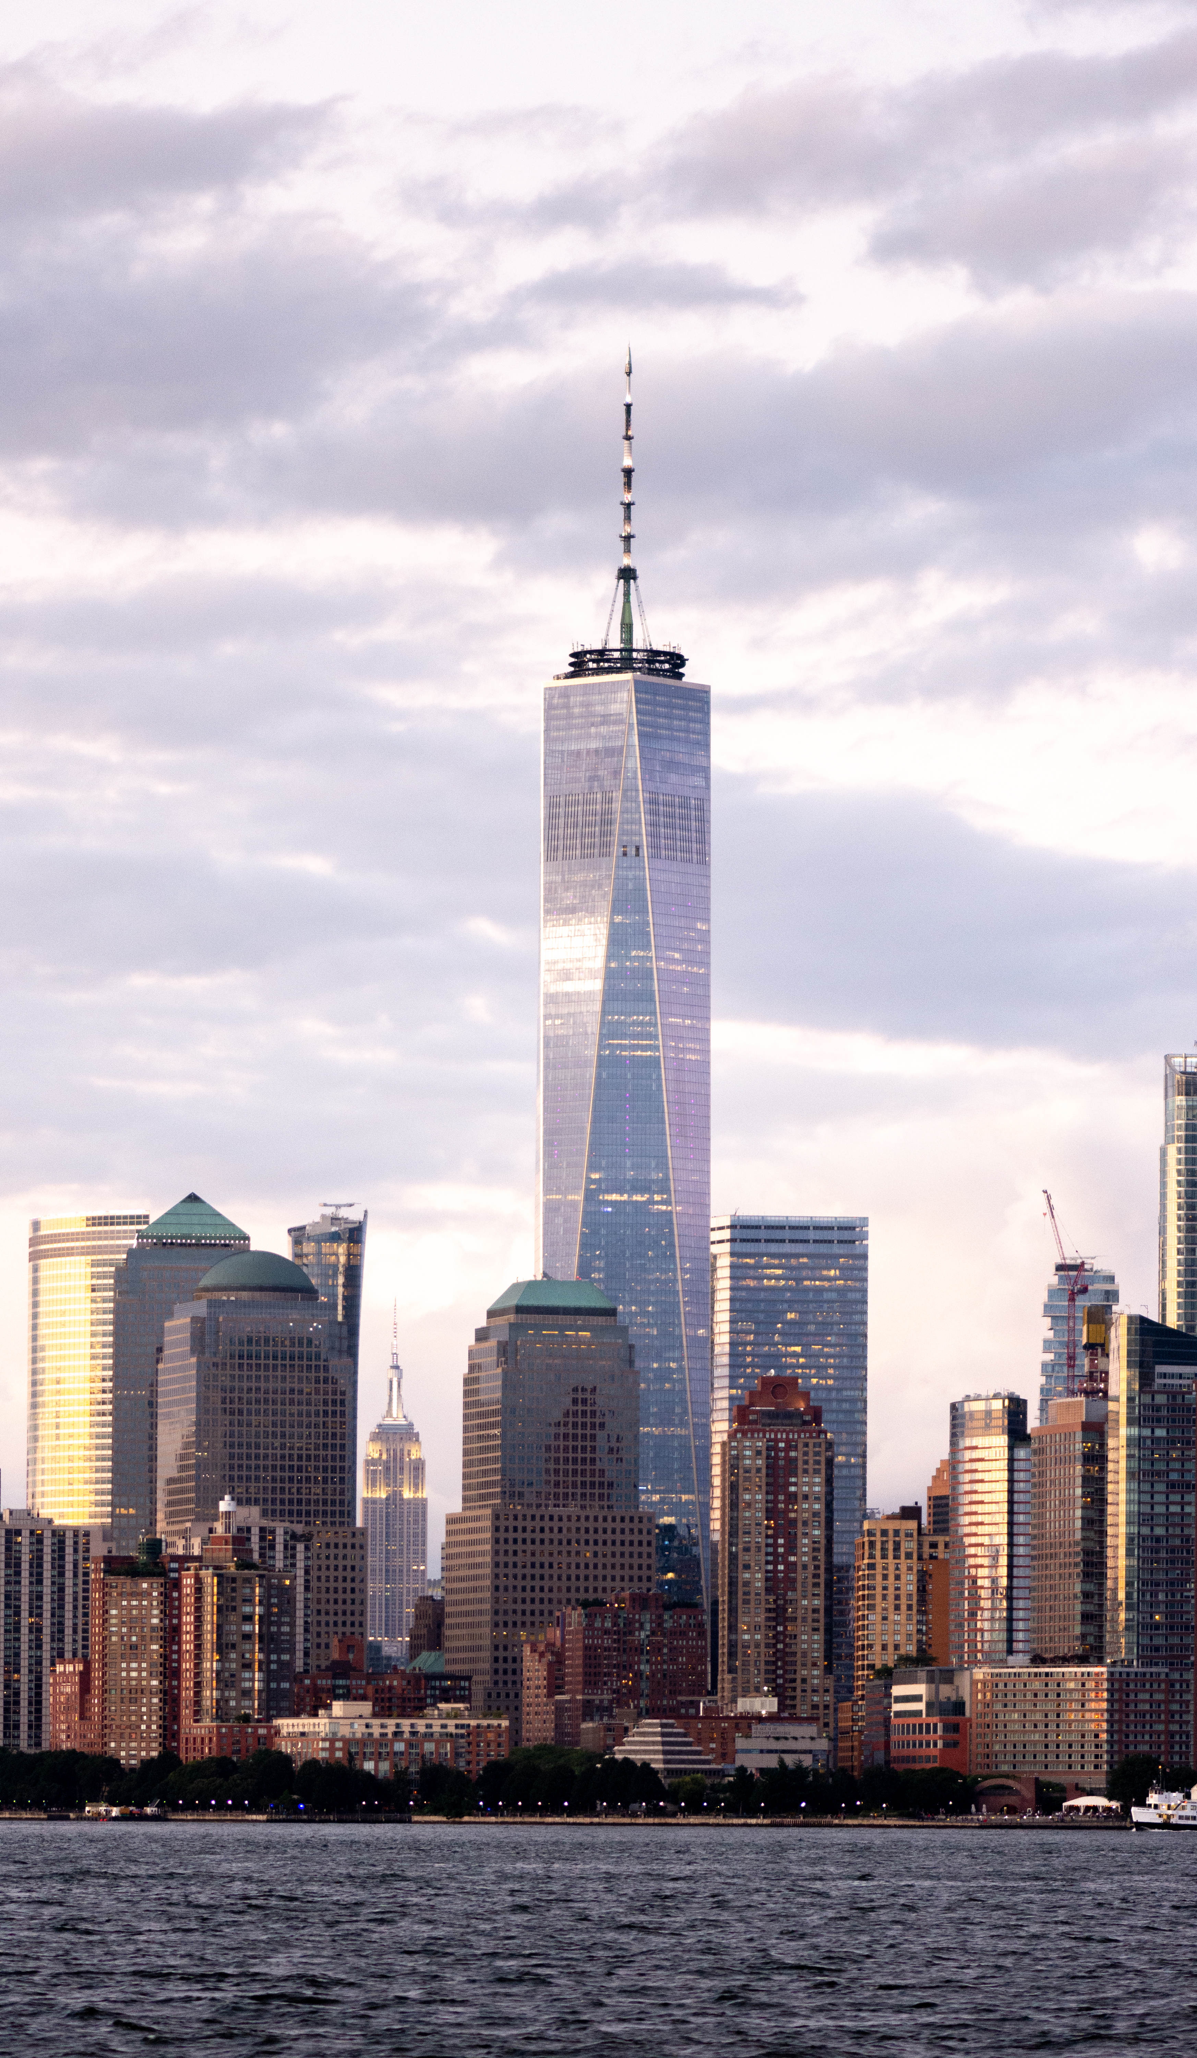
Examples
My blouse is prettier than yours.
That is the tallest building in the U.S.A
This corridor is narrower than the other one.
He is the most relaxed teacher ever.
You have to be more careful next time.
Notes:
One world trade centre, NY, 2012, 541 meter hoog

Slide 7
Woorden met 2 of meer lettergrepen
Positive form comparative form superlative form
difficult More difficult than The most difficult
Careful More careful than The most careful

Slide 8
Examples
Deze toets was moeilijker dat ik had verwacht.
This test was more difficult than I expected.
De krokodil is het gevaarlijkste dier in de Amazone.
The crocodile is the most dangerous creature in the Amazone
Notes:
One world trade centre, NY, 2012, 541 meter hoog

Slide 9
Uitzonderingen
Good better than the best
Bad worse than the worst
Far further than the furthest
Little less than the least
Much
/many more than the most

Slide 10
Even mooi als
This ring is as pretty as my ring.

Slide 11
Create sentences
Mouse – cat (kleiner dan)
My house – your house (even leuk als)
Ring (mooi)
That ring (het mooist)
Homework – I – You (minder)

Slide 12
These words can be used with or without more/most
Positive form | Comparitive | Superlative
Clever | Cleverer (than) More clever (than) | (the) cleverest (the) most clever
Stupid | Stupider (than) More stupid (than) | (the) stupidest (the) most stupid
Cruel
Handsome
Pleasant
Quiet

Slide 13
Stepping Stones
1. coolest
2. biggest
3. smartest
4. nicest
5. longest
6. happiest
7. easiest
8. most beautiful
9. most difficult
10. best

Slide 14
Opdr. 2
Smaller
Cheaper
Fatter
Wider
Stricter
Bigger
Funnier
Happier
More interesting
More popular
Better
worse

