Slide 1
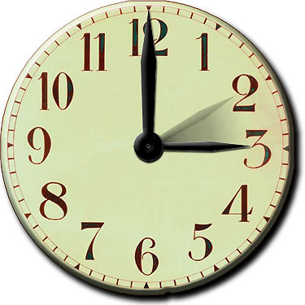
around the clock
minute hand
second hand
hour hand

Slide 2
0
24
23
13
22
14
15
21
20
16
19
17
18
night
day
a.m. = ante meridiem
p.m. = post meridiem

Slide 3
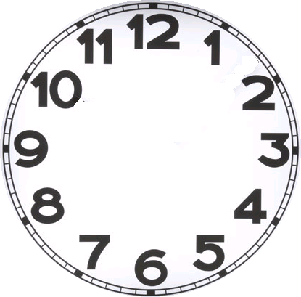
full hour
the hour hand is
exactly at one figure
1 o’clock

Slide 4
one hour later
it points out
next figure
2 o’clock

Slide 5
every hour the
minute hand
turns
around the dial
60 minutes later

Slide 6
each hour the
minute hand
turns around
the clock
3 hours later
the hour hand moves per round
only 1 figure

Slide 7
each half hour the
minute hand
turns half
around the clock
30 minutes later

Slide 8
the hour hand
half away from
3 to(werds) 4
the minute hand
half the dial (6)
half past 3

Slide 9
full hour
on this dial
quarter to
quarter past
you see the quarters
half

Slide 10
The minute hand
is a quarter (3)
past the full hour
a quarter past 10

Slide 11
the minute hand
now is a quarter (9)
to the next hour (2)
a quarter to 2

Slide 12
the hour hand
has just passed 2
the minute hand is five minutes past 2
five past 2

Slide 13
the hour hand
is a bit to the 2
the minute hand is 10 minutes to the full hour
ten (minutes) to 2

Slide 14
Full hour
5 to
5 past
10 to
10 past
a quarter to
a quarter past
20 to
20 past
25 to
25 past
half past

Slide 15
