Slide 1
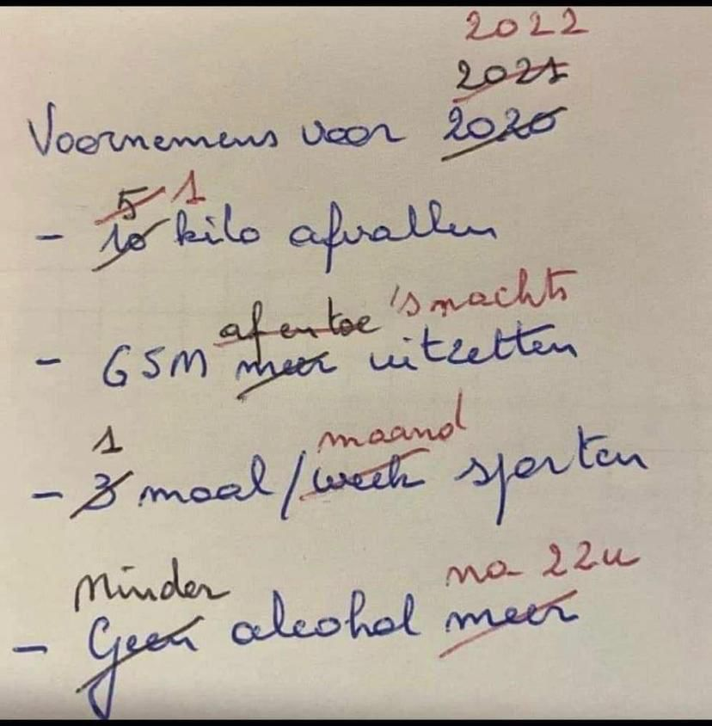
Timeline
Planning rest of the period
Tomorrow: Food!
Grammar: Future
Work on your own

Slide 2
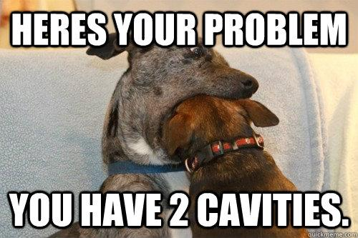
Preparation Oral Exam
Main information
Time
Level 2: 4 – 6 minutes
Level 3: 5 – 7 minutes
Level 4: 6 – 8 minutes
Topic: Your choice
Materials
Powerpoint
Pictures
Other things
When
Choose a date
Delayed = resit
What to do
Make mind map
Make powerpoint
Create wordlist
Ask each other for help

Slide 3
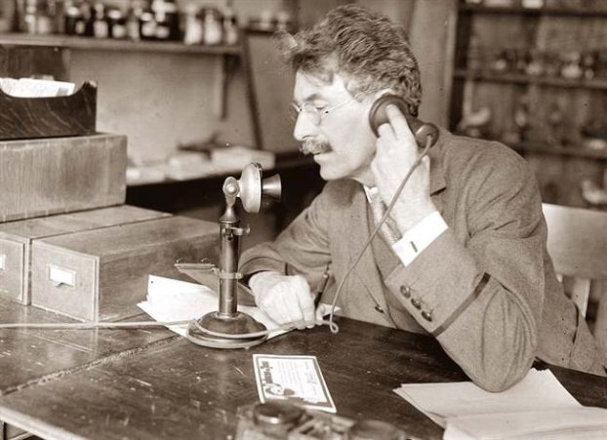
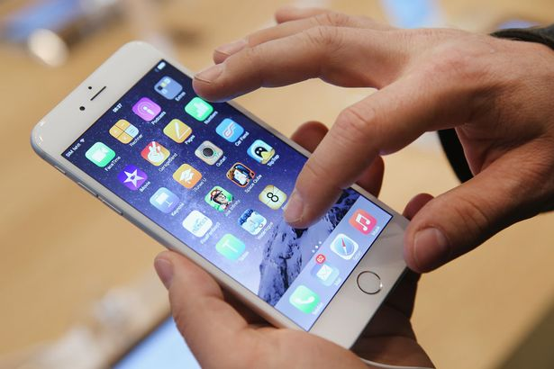
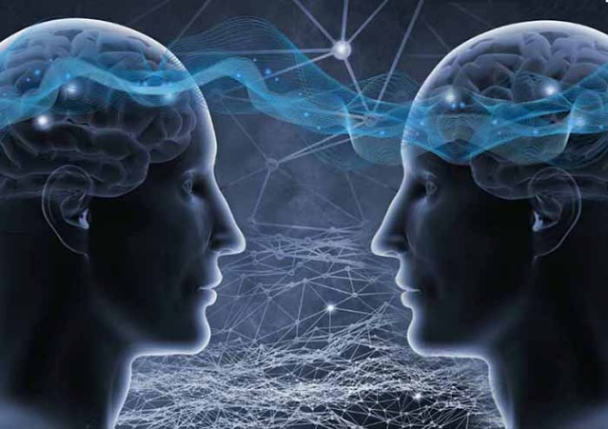
Future tense
Past Present Future

Slide 4
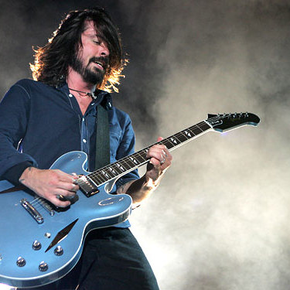
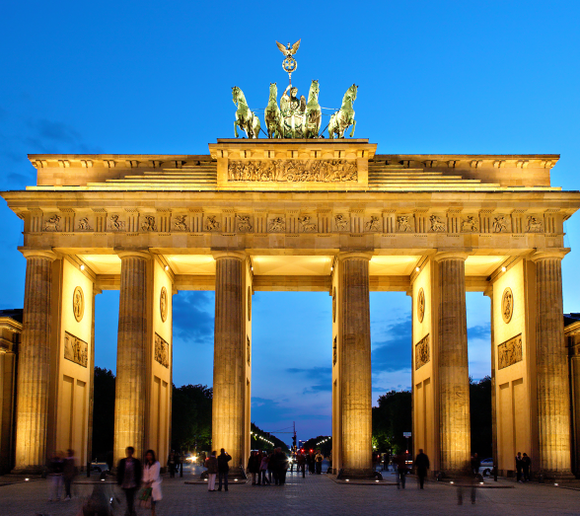
Future tense
Two examples
Next year, I'm going to take up the guitar. It will possibly be very difficult for me, but I love music.
I am going to fly to Berlin this afternoon to attend a congress . While I’m in Berlin, the weather will probably be good...

Slide 5
Future tense
Two examples
Next year, I'm going to take up the guitar. It will possibly be very difficult, but I love music.
I am going to fly to Berlin this afternoon to attend a congress . While I’m in Berlin, the weather will probably be good...

Slide 6
Future tense
Two examples
Next year, I'm going to take up the guitar. It will possibly be very difficult, but I love music.
I am going to fly to Berlin this afternoon to attend a congress . While I’m in Berlin, the weather will probably be good.

Slide 7
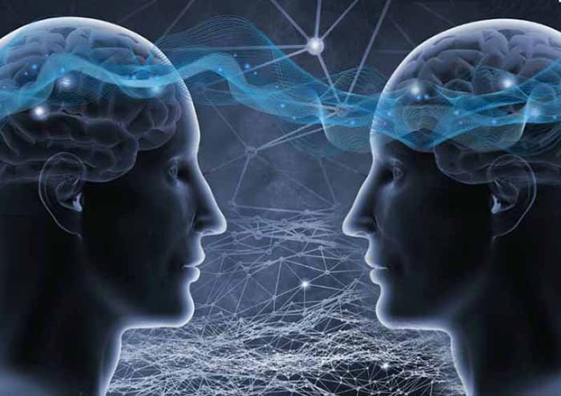
Future tense
Going to
Will
Future

Slide 8
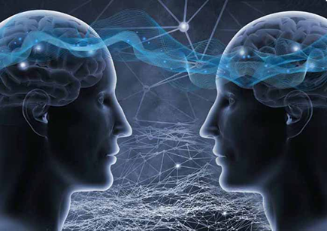
Am / Are / Is going to
When
Staat vast. Gaat zeker gebeuren.
Indicator
Certainly
No doubt
Sure to happen
Definitely
Absolutely
Rule
Am / Are / Is going to
How
I am going to work
You are going to work
She/ He/ It is going to work
We are going to work
They are going to work

Slide 9
Am / Are / Is going to
Assignment A
Make the assignment on your own
You have 3 minutes
Do this in English
We are going to check the answers

Slide 10
Will or Shall
When
Will: Van plan. Onzeker of het zal gebeuren.
Shall: Alleen bij vragende zinnen en alleen als ‘I’ of ‘We’ het onderwerp is.
Indicator
I think...
Probably
Sometime
Once
Maybe
Rule
Will / Shall + ww
How
I will work
You will work
She/ He/ It will work
We will work
They will work
Shall I work tomorrow?
Will you work tomorrow?
Will she/he/it work tomorrow?
Shall we work tomorrow?
Will they work tomorrow?

Slide 11
Will or Shall
Assignment B
Make the assignment on your own
You have 3 minutes
Do this in English
We are going to check the answers

Slide 12
Am / Are / Is going to or Will / Shall
Assignment C
Choose the correct future form between the brackets
Assignment D
Fill in the gaps
On your own
Take 5 minutes
We will discuss together

Slide 13
Work on your own

