Slide 1
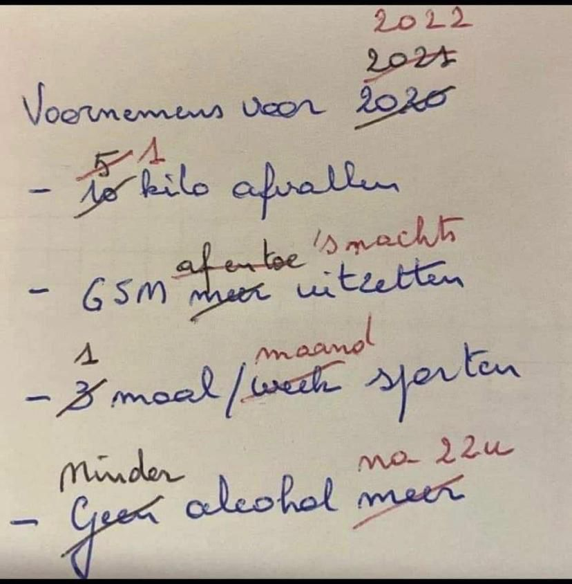
Timeline
Planning rest of the period
Grammar: Future
Work on your own

Slide 2
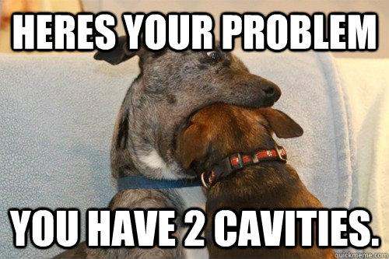
Preparation Oral Exam
Main information
Time
  Level 2: 4 – 6 minutes
  Level 3: 5 – 7 minutes
  Level 4: 6 – 8 minutes
Topic: Your choice
Materials
  Powerpoint
  Pictures
  Other things
When
Choose a date
Delayed = resit
What to do
Make mind map
Make powerpoint
Create wordlist
Ask each other for help

Slide 3
Oral exams DV21A
Planning oral exams
Week Date Name
3 - -
4 15-12 Arjan, Huub, Yessie
5 21-12 Amir, Luuk, Arjan
6 12-01 TEST VOCAB + GRAMMAR UNIT 2
7 19-01 Amir, Indy, Sem, Paola
8 24/25-01 Sem, Rik, Britt, Rens, Zenja
9 1-02 Rochelle, Meyke, Myrthe, Anouk, Femke
10 8/9-02 Luuk, TEST VOCAB + GRAMMAR UNIT 3 + LISTENING

Slide 4
Oral exams HO21
Planning oral exams
Week Date Name
3 - -
4 - -
5 - -
6 12-01 Bart
7 19-01 Lars, Ronnie
8 26-1 Rens, Jop
9 2-02 No class studiedag
10 9-02 Sam, Ryan + TEST VOCAB + GRAMMAR UNIT 2

Slide 5
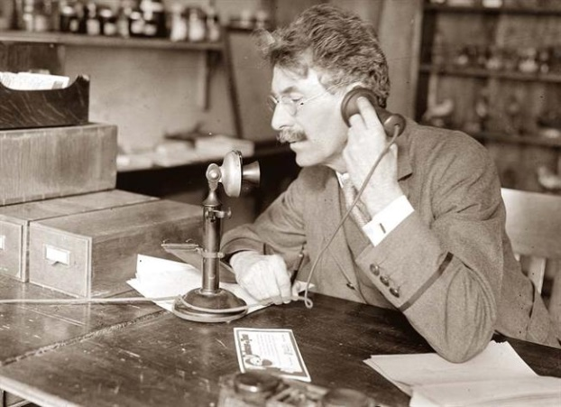
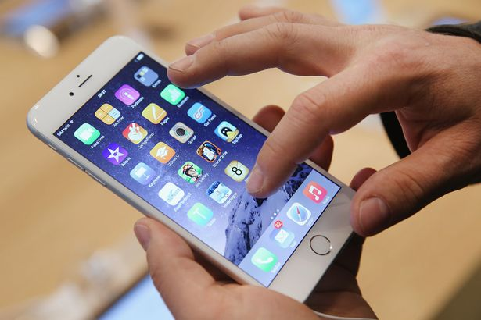
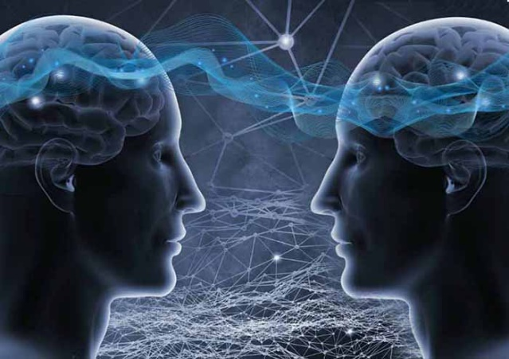
Future tense
Past Present Future

Slide 6
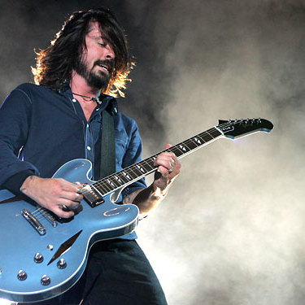
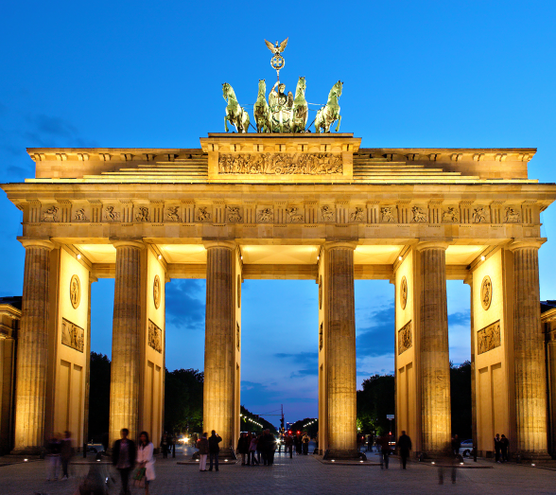
Future tense
Two examples
Next year, I'm going to take up the guitar. It will possibly be very difficult for me, but I love music.
I am going to fly to Berlin this afternoon to attend a congress . While I’m in Berlin, the weather will probably be good...

Slide 7

Future tense
Two examples
Next year, I'm going to take up the guitar. It will possibly be very difficult, but I love music.
I am going to fly to Berlin this afternoon to attend a congress . While I’m in Berlin, the weather will probably be good...

Slide 8
Future tense
Two examples
Next year, I'm going to take up the guitar. It will possibly be very difficult, but I love music.
I am going to fly to Berlin this afternoon to attend a congress . While I’m in Berlin, the weather will probably be good.

Slide 9
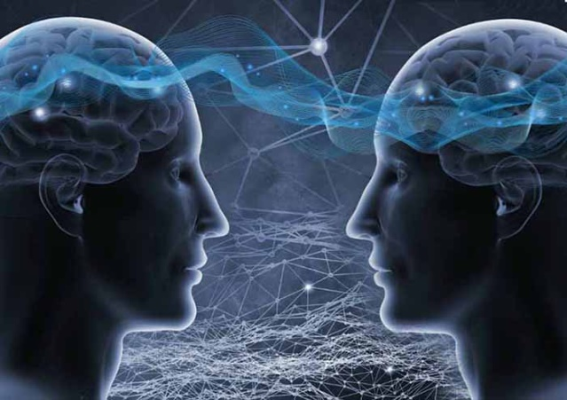
Future tense
Going to
Will
Future

Slide 10
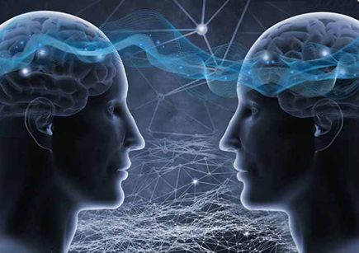
Am / Are / Is going to
When
Staat vast. Gaat zeker gebeuren.
Indicator
Certainly
No doubt
Sure to happen
Definitely
Absolutely
Rule
Am / Are / Is going to
How
I am going to work
You are going to work
She/ He/ It is going to work
We are going to work
They are going to work

Slide 11
Am / Are / Is going to
Assignment A
Make the assignment on your own
You have 3 minutes
Do this in English
We are going to check the answers

Slide 12
Will or Shall
When
Will: Van plan. Onzeker of het zal gebeuren.
Shall: Alleen bij vragende zinnen en alleen als ‘I’ of ‘We’ het onderwerp is.
Indicator
I think...
Probably
Sometime
Once
Maybe
Rule
Will / Shall + ww
How
I will work
You will work
She/ He/ It will work
We will work
They will work
Shall I work tomorrow?
Will you work tomorrow?
Will she/he/it work tomorrow?
Shall we work tomorrow?
Will they work tomorrow?

Slide 13
Will or Shall
Assignment B
Make the assignment on your own
You have 3 minutes
Do this in English
We are going to check the answers

Slide 14
Am / Are / Is going to or Will / Shall
Assignment C
Choose the correct future form between the brackets
Assignment D
Fill in the gaps
On your own
Take 5 minutes
We will discuss together

Slide 15
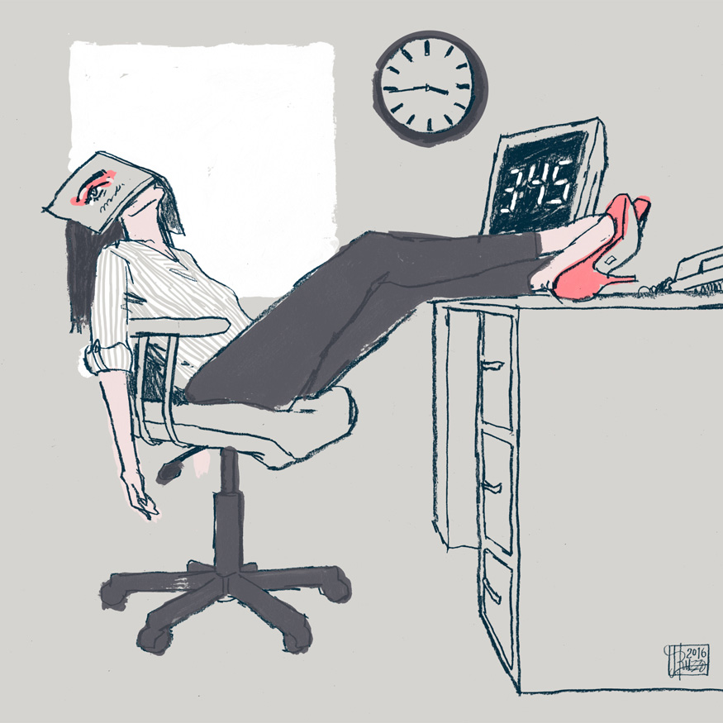
Work on your own

