Slide 1
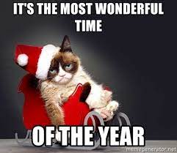
Timeline
Preparation Oral Exam
Oral exams
Grammar: Comparisson
Work from book

Slide 2
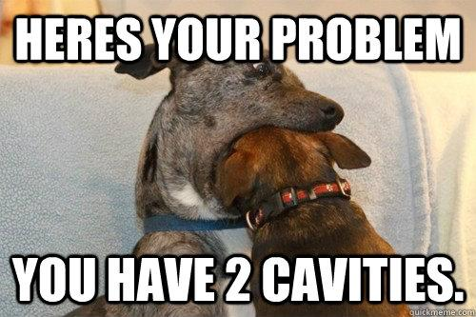
Preparation Oral Exam
Main information
Time
Level 2: 4 – 6 minutes
Level 3: 5 – 7 minutes
Level 4: 6 – 8 minutes
Topic: Your internship
Materials
Powerpoint
Pictures
Other things
When
Choose a date
Delayed = resit
What to do
Make mind map
Make powerpoint
Create wordlist
Ask each other for help

Slide 3
Oral Exam DV22A
Planning
Week Date Person
3 7-12 Lars A., Demi, Indy
4 14-12 Oliwia, Gijs, Iris
5 21-12 Romy, Sanne
6 11-1 Roos, Floortje Mind this: Listening test!
7 18-1 Lars, Roksana, Kimberly

Slide 4
Oral Exam DV22B
Planning
Week Date Person
3 7-12 Lars A., Demi, Indy
4 14-12 Oliwia, Gijs, Iris
5 21-12 Romy, Sanne
6 11-1 Roos, Floortje Mind this: Listening test!
7 18-1 Lars, Roksana, Kimberly

Slide 5
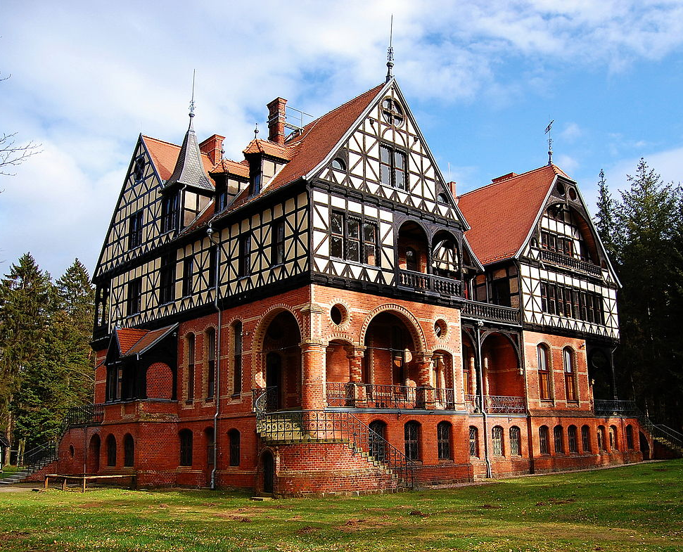
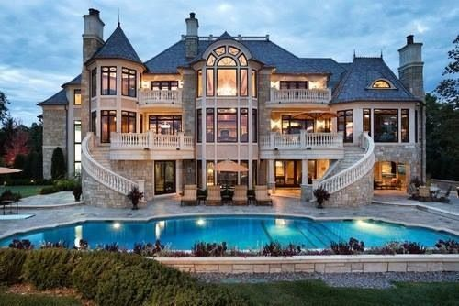
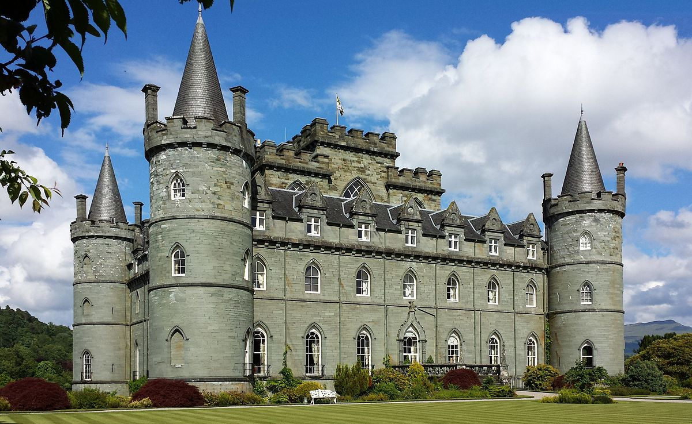
Grammar: Comparisson
BIG BIGGER BIGGEST
Comparisson: Vergelijken
Mostly very easy (Voor het grootste deel heel makkelijk)
Just a few exceptions (Maar een paar uitzonderingen)

Slide 6
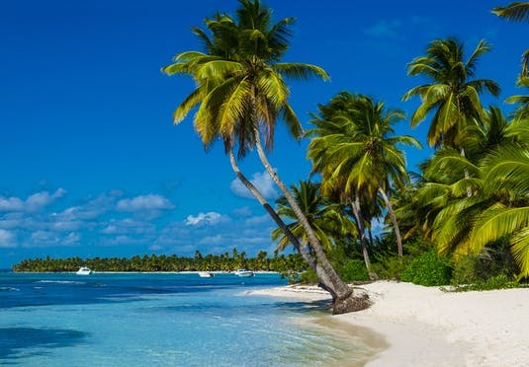
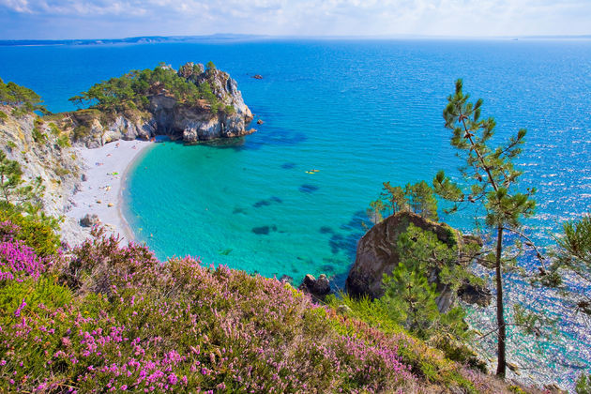
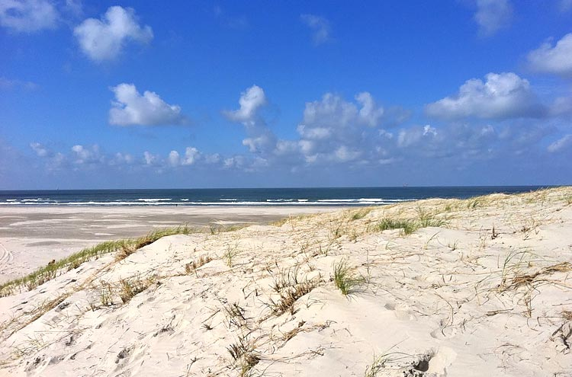
Grammar: Comparisson
Mooist
Overtreffende trap
Mooier Superlative degree
Vergrotende trap
Mooi Comparative degree
Basis (stellende) trap
Positive degree

Slide 7
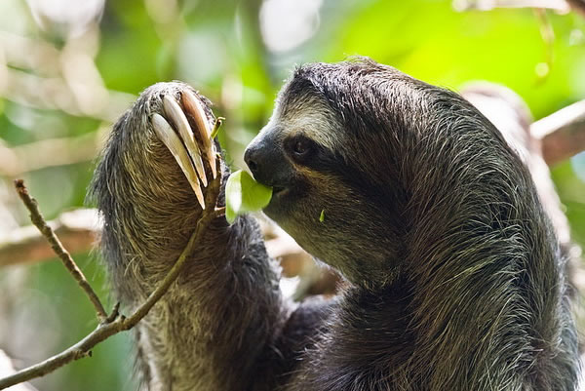
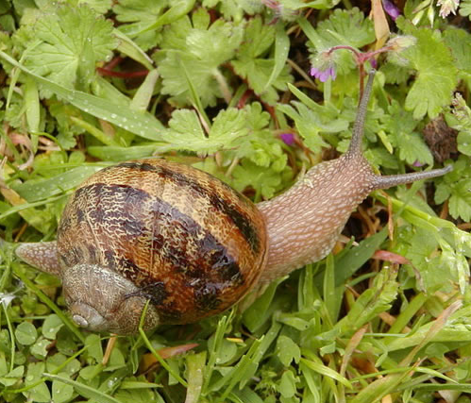
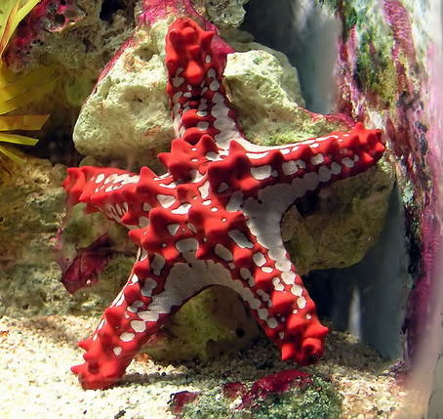
Grammar: Comparisson
Slow Sloth (o.003 m/h)
Garden snail (0,03 m/h)
Starfish (o,o6)
Overtreffende trap
Superlative degree
Vergrotende trap
Comparative degree
Basis (stellende) trap
Positive degree
Slow Slower Slowest

Slide 8
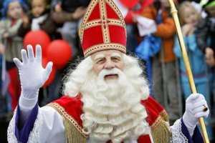
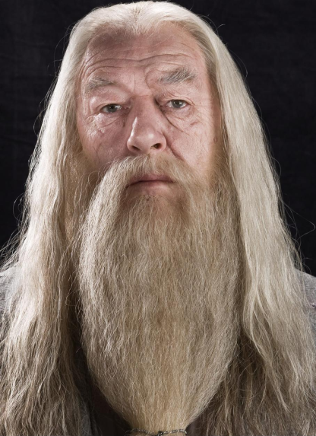
Grammar: Comparisson
Old
Overtreffende trap
Superlative degree
Vergrotende trap
Comparative degree
Basis (stellende) trap
Positive degree
Old Older Oldest

Slide 9
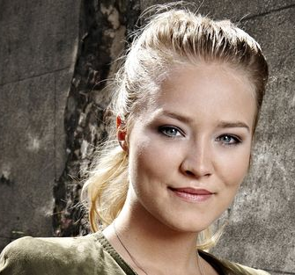
Grammar: Comparisson
Pretty
(according to 50 Cent)
Overtreffende trap
Superlative degree
Vergrotende trap
Comparative degree
Basis (stellende) trap
Positive degree
Pretty Prettier Prettiest

Slide 10
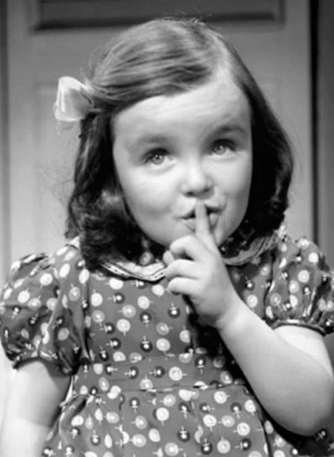
Grammar: Comparisson
Quiet
Overtreffende trap
Superlative degree
Vergrotende trap
Comparative degree
Basis (stellende) trap
Positive degree
Quiet Quieter / More Quiet Quietest / Most Quiet

Slide 11
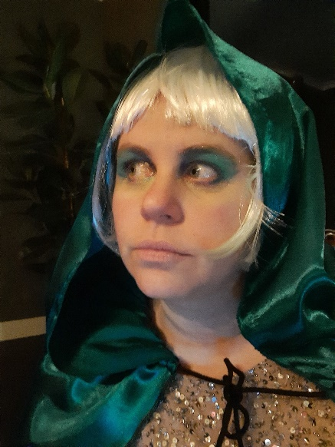
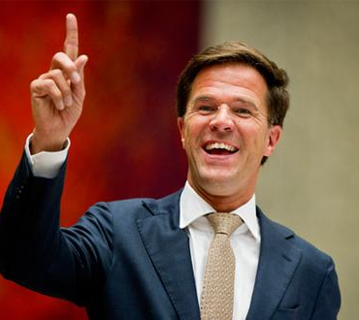
Grammar: Comparisson
Powerful
Overtreffende trap
Superlative degree
Vergrotende trap
Comparative degree
Basis (stellende) trap
Positive degree
Powerful More powerful Most powerful

Slide 12
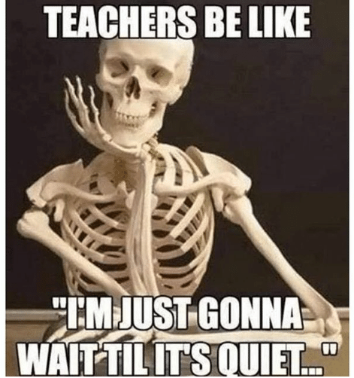
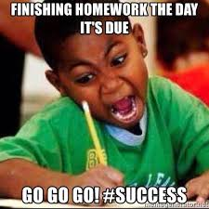
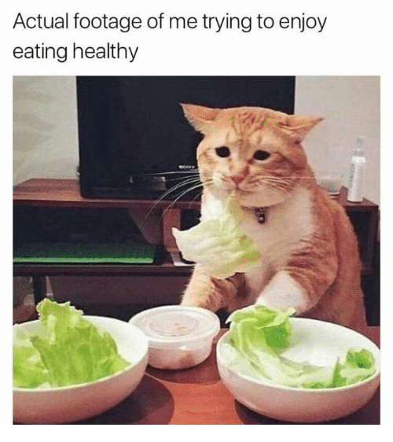
Grammar: Comparisson
Difficult
Overtreffende trap
Superlative degree
Vergrotende trap
Comparative degree
Basis (stellende) trap
Positive degree
Difficult More difficult Most difficult

Slide 13
Grammar: Comparisson
Degrees of comparison
Oldest / Prettiest / Most powerful
Older / Prettier / More powerful Overtreffende trap
Superlative degree
Vergrotende trap
Old / Pretty / Powerful Comparative degree
Basis (stellende) trap
Positive degree
3(+) Lettergrepen | word | more + word | the + most + word
2 Lettergrepen | word | more + word / word + er | the + most + word / the word + est
1 Lettergreep | word | word + er | the + word + est

Slide 14
Grammar: Comparisson
Exceptions to the rule
Uitzonderingen op de regel
good – better – the best
bad – worse – the worst
far – farther – the farthest
little – less – the least
many – more – the most

Slide 15
Grammar: Comparisson
Worksheet
Make assignments A + B
Make assignment C = only for level 3 + 4
Let’s check the answers
Make assignment D
Let’s check the answers
Need more practice? Check the video on Wikiwijs

Slide 16
Work on your own

