Slide 1

Timeline
Recap SO and Reading test
Introduction Period 2
Preparation oral test
Notes:
Afbeelding: https://www.flickr.com/photos/studiodxavier/6063335422

Slide 2
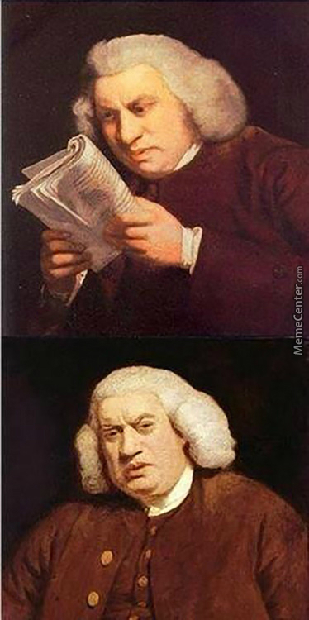
Recap SO and Reading test
2nd Chance and resits
  Week 5 (week before Christmas)
  Mail with link
Check your grades
  I’m only human
  Count the points
  Do the math
    Points : Maximum points = grade
Discuss the test?
  Let me know what you need explained

Slide 3

Introduction Period 2
Wikiwijs
Hand outs
  Planner
  Worksheets
Planner
What to learn for the test
  Vocab
  Expressions
  Oral test
  Listening test

Slide 4


Preparation Oral Test
Assignment
Requirements
Subjects
Planning
In class or One on one?
Choose a date
Let’s get to work
Use interglot.nl
Each other
Make powerpoint

