Slide 1
Timeline
Recap SO and Reading test
Introduction Period 2
Preparation oral test
Notes:
Afbeelding: https://www.flickr.com/photos/studiodxavier/6063335422

Slide 2
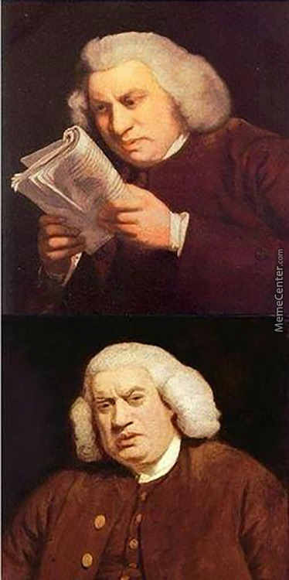
Recap SO and Reading test
2nd Chance and resits
Week 5 (week before Christmas)
Mail with link
Check your grades
I’m only human
Count the points
Do the math
Points : Maximum points = grade
Discuss the test?
Let me know what you need explained

Slide 3
Introduction Period 2
Wikiwijs
Hand outs
Planner
Worksheets
Planner
What to learn for the test
Vocab
Expressions
Oral test
Listening test

Slide 4
Preparation Oral Test
Assignment
Requirements
Subjects
Planning
In class or One on one?
Choose a date
Let’s get to work
Use interglot.nl
Each other
Make powerpoint

