Slide 1
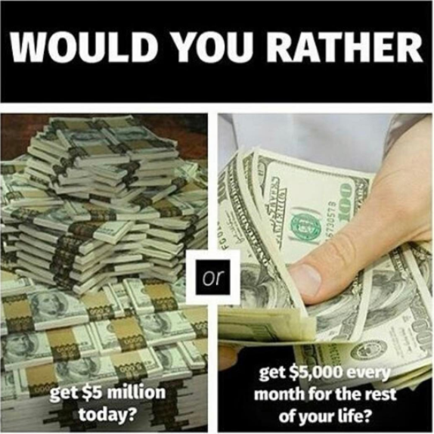
Timeline
Grammar: Could, Should, Would
Vocab exercise
Work from your book
Skill: Reading

Slide 2

Things you wouldn’t hear on a survival show

Slide 3
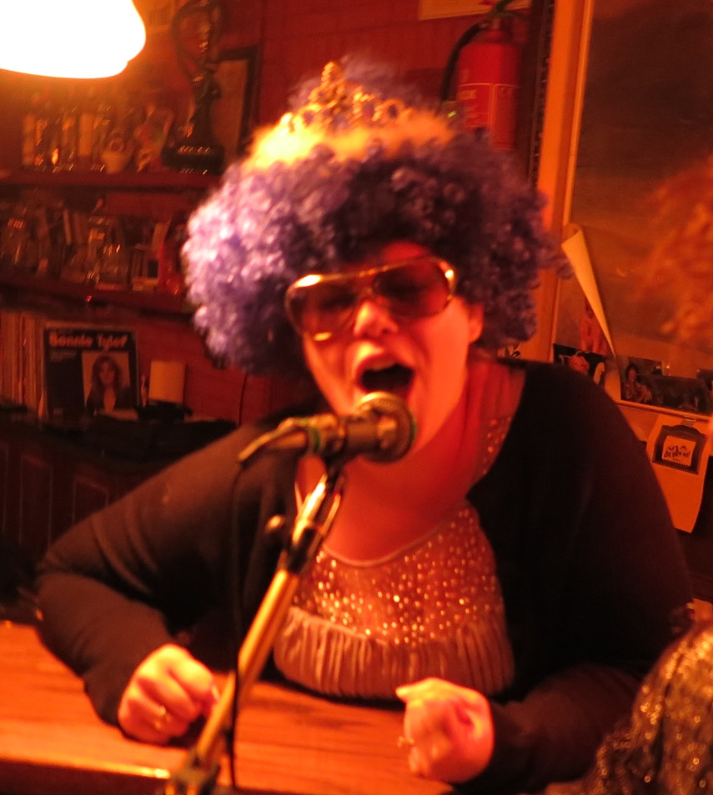
Grammar: Could, Would, Should
Maybe I should be ashamed of myself,
but I’m not!

Slide 4
Grammar: Could, Would, Should
What do these words mean?
Could
Zou kunnen
Would
Zou willen
Should
Zou moeten
When do we use them?
To be polite
Om beleeft te zijn

Slide 5
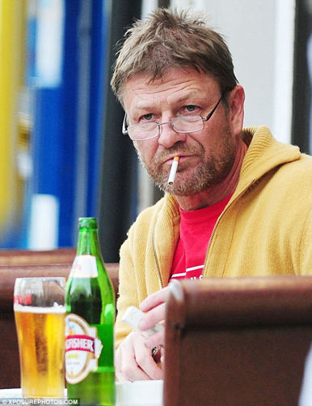

Grammar: Could, Would, Should
Impolite (Onbeleefd) Polite (Beleefd)
Gimme beer!
Could you give me a beer please?

Slide 6
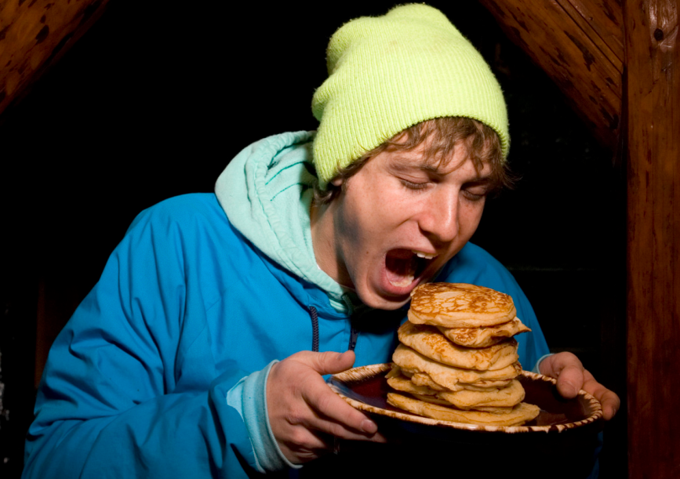
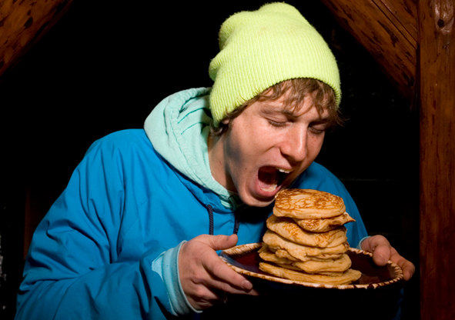
Grammar: Could, Would, Should
Impolite (Onbeleefd) Polite (Beleefd)
I want more pancakes !
I would like some more pancakes.

Slide 7
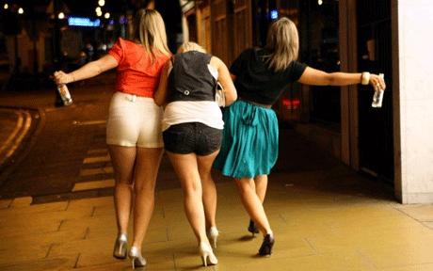

Grammar: Could, Would, Should
Impolite (Onbeleefd) Polite (Beleefd)
Go home!
You should go home now.

Slide 8
Grammar: Could, Would, Should
Assignments from the book to practice Could, Would, Should
Opdrachten 93 + 94 (Blz. 100)
Check the answers
When you’re finished
Finish the TOA test if still need to
Work from your book according to planner
Check your assignments

Slide 9
Vocab exercise
The longest list
Groups of four maximum
60 seconds a group
How many items can you think of in your category
The group with the longest list wins
Topics
Vegetables
Fruit
Animal
Candy

Slide 10
Skill: Reading
Pointers for acing a reading test
Before you read
  Analyse type text
  Look at pictures
  Read title and headings
  Quickly scan questions
Whilst reading
  First line paragraph is statement
  Rest explanation + examples
  Last line summation paragraph
  Skimming text: quickly reading
  Don’t use dictionary too much
Answering questions
  First read question then text
  Find the paragraph belonging to question
  Scan for key words
  When in doubt: Cross out definite wrong answers
Tips voor een top cijfer voor lezen
Voordat je start lezen
  Analyseer tekstsoort
  Bekijk de foto’s
  Lees titel en tussenkopjes
  Scan de vragen
Tijdens het lezen
  Eerste zin alinea is statement
  Rest is uitleg en voorbeelden
  Laatste zin samenvatting alinea
  Skimmen tekst: snel lezen
  Gebruik woordenboek niet teveel
Beantwoorden van vragen
  Lees eerst vraag dan pas tekst
  Vind alinea dit hoort bij vraag
  Scan voor belangrijke woorden
  Als je twijfelt: Streep foute antwoorden weg

