Slide 1
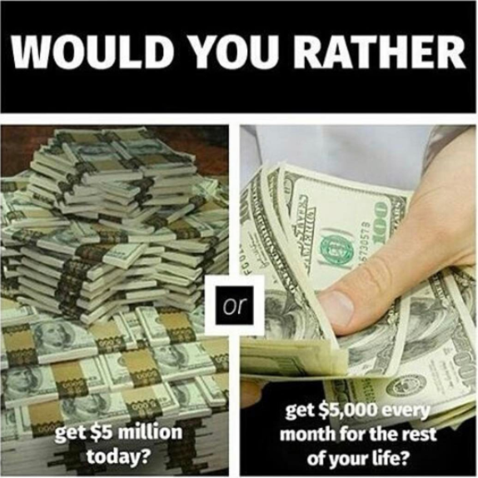
Timeline
Vocab exercise
Grammar: Could, Should, Would
Work from your book
Skill: Reading

Slide 2
Vocab exercise
The longest list
Groups of four maximum
60 seconds a group
How many items can you think of in your category
The group with the longest list wins
Topics
Vegetables
Fruit
Animal
Candy

Slide 3
Grammar: Could, Would, Should
Maybe I should be ashamed of myself,
but I’m not!

Slide 4
Grammar: Could, Would, Should
What do these words mean?
Could
Zou kunnen
Would
Zou willen
Should
Zou moeten
When do we use them?
To be polite
Om beleeft te zijn

Slide 5
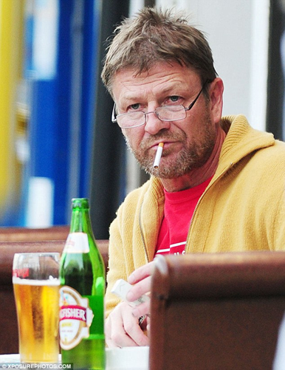
Grammar: Could, Would, Should
Impolite (Onbeleefd) Polite (Beleefd)
Gimme beer!
Could you give me a beer please?

Slide 6
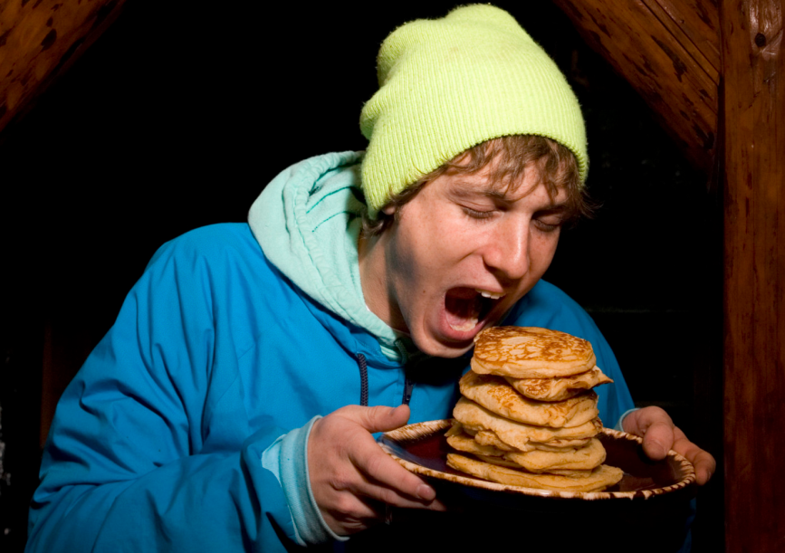
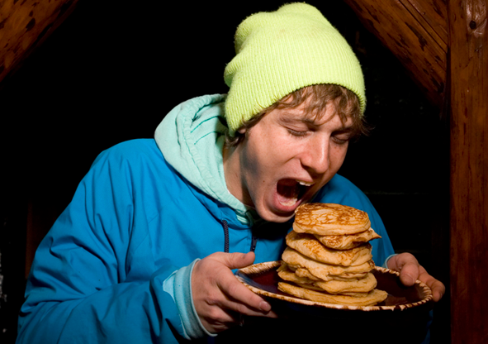
Grammar: Could, Would, Should
Impolite (Onbeleefd) Polite (Beleefd)
I want more pancakes !
I would like some more pancakes.

Slide 7
Grammar: Could, Would, Should
Impolite (Onbeleefd) Polite (Beleefd)
Go home!
You should go home now.

Slide 8
Grammar: Could, Would, Should
Assignments from the book to practice Could, Would, Should
Opdrachten 93 + 94 (Blz. 100)
Check the answers
When you’re finished
Finish the TOA test if still need to
Work from your book according to planner
Check your assignments

Slide 9
Skill: Reading
Pointers for acing a reading test
Before you read
Analyse type text
Look at pictures
Read title and headings
Quickly scan questions
Whilst reading
First line paragraph is statement
Rest explanation + examples
Last line summation paragraph
Skimming text: quickly reading
Don’t use dictionary too much
Answering questions
First read question then text
Find the paragraph belonging to question
Scan for key words
When in doubt: Cross out definite wrong answers
Tips voor een top cijfer voor lezen
Voordat je start lezen
Analyseer tekstsoort
Bekijk de foto’s
Lees titel en tussenkopjes
Scan de vragen
Tijdens het lezen
Eerste zin alinea is statement
Rest is uitleg en voorbeelden
Laatste zin samenvatting alinea
Skimmen tekst: snel lezen
Gebruik woordenboek niet teveel
Beantwoorden van vragen
Lees eerst vraag dan pas tekst
Vind alinea dit hoort bij vraag
Scan voor belangrijke woorden
Als je twijfelt: Streep foute antwoorden weg

