Slide 1
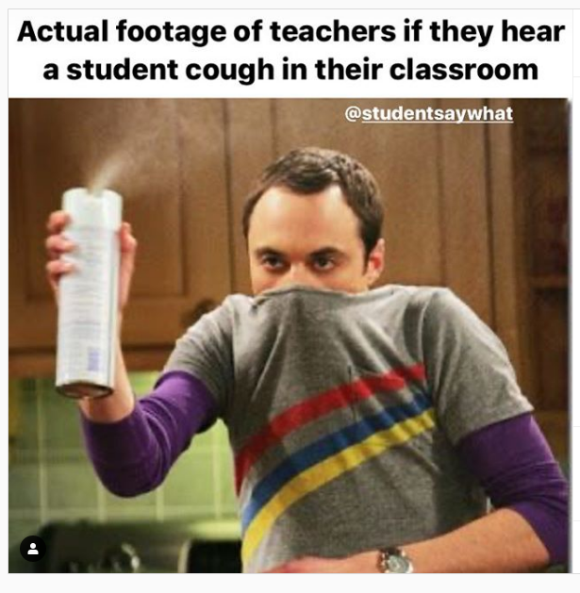
Timeline
Let’s meet
Rules of the classroom
Materials, Tests and Planner
Let’s meet you
TOA

Slide 2

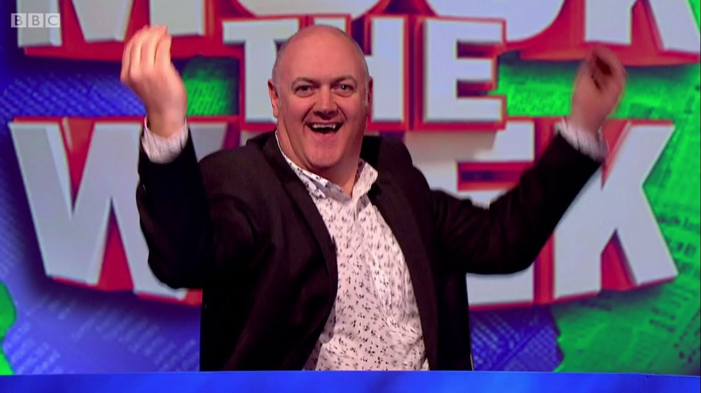
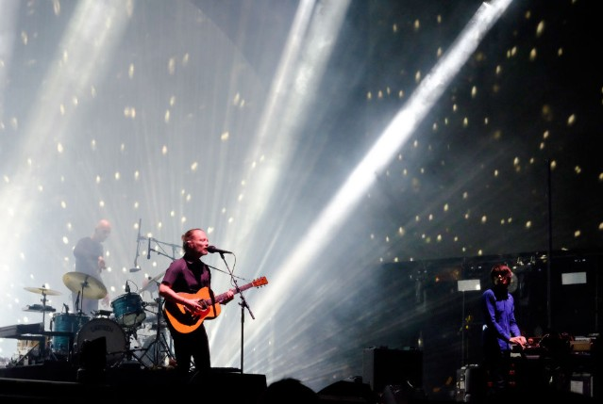


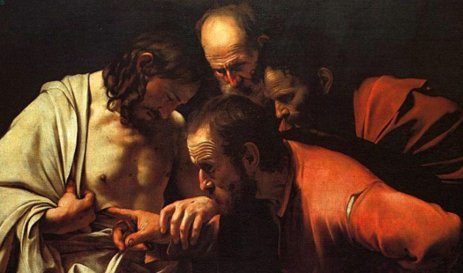
Let’s meet
Name and email
Ellen Kuindersma
E.Kuindersma@yuverta.nl
Who I am
Teacher of English and Art historian
Watch British Comedy
Like books and music
Mum of two girls
Who are you?
Tell me your name
Please take the same seat next time

Slide 3

Rules of the classroom
Share what you like – In English!
Mobile phones only when allowed
You need to bring
  Book: Can Do Mbo-breed A
  Binder
  Pen or pencil
  No book = no help form me
Bring some inspiration

Slide 4
Materials, Tests and Planner
Materials
Book = Old school paper learning
Hand out = During class, On Wikiwijs
Eduarte = Grades
Teams = Communication, Wikiwijs link
Studiemeter = Practice online
Wikiwijs = Planners, Hand Outs, What to learn, Powerpoints of the classes

Slide 5
Materials, Tests and Planner
Tests
Every Period
  1 SO: Vocab + Grammar = 30 %
  1 Skill test = 70 %
Exam at a higher level
  Optional
  Work independently
  You can ask for help naturally

Slide 6
Materials, Tests and Planner
Tests
Exam at level MBO 2:
  Starting at level A2 (= MBO 2): Do all your tests at level A2
  Starting at level A1 (= MBO 1)
    Year 1: Pass your tests at level A1 with an 8 average
    Year 2: Pass your tests at level A2 with a 5,5 average
Exam at level MBO 3:
  Starting at level B1 (= MBO 3): Do all your tests at level B1
  Starting at level A2
    Year 1: Pass your tests at level A2 with an 8 average
    Year 2: Pass your tests at level B1 with a 5,5 average
Exam at lavel MBO 4:
  Starting at level B2 (= MBO 4): Do all your tests at level B1
  Starting at level B1
    Year 1: Pass your tests at level B1 with an 8 average
    Year 2: Pass your tests at level B2 with a 5,5 average

Slide 7
Materials, Tests and Planner
Planner
Different levels
Look at planner period 1
PowerPoints and Hand outs
Studiemeter
Homework
  Planner at Wikiwijs
  To do: All assignments of your level (done before test)
  To learn
    Vocab Unit 1 (depending on your level A2 plus B1/B2)
    Expressions Unit 1 (depending on your level 25/35/50)
    Grammar

Slide 8

Let’s meet you
Discussion wheel
Easy Bit boring topics
Medium Kinda interesting
Hard You have to choose

Slide 9


Easy
Bit boring topics

Slide 10
Medium
Kinda interesting

Slide 11
Hard
You have to choose

Slide 12
TOA
Get to this site:
Google CHROME opstarten
Ga naar: toets.nl
Inloggen > TOA toetsplatform
Inloggen
Gebruikersnaam: Leerlingnummer ZONDER 26cc0 dus b.v. 89343
Wachtwoord: Rgeboortedatum (b.v. R19111983)
Instelling: Heli
Selecteer de toets
  Als je stopt mag je niet meer opnieuw beginnen
  30 minuten per toets

Slide 13
Assignment from your Book
Level 2
Assignment 16 (p. 24-25)
Level 3
Assignment 49 (p. 56-57)
Level 4
Assignment 72 (p. 80-81)

