Slide 1
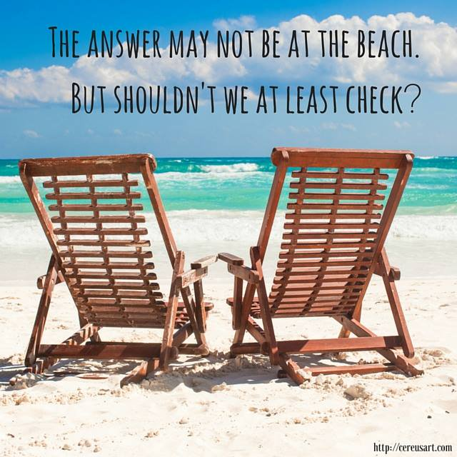
Timeline
Grammar: prepositions

Slide 2
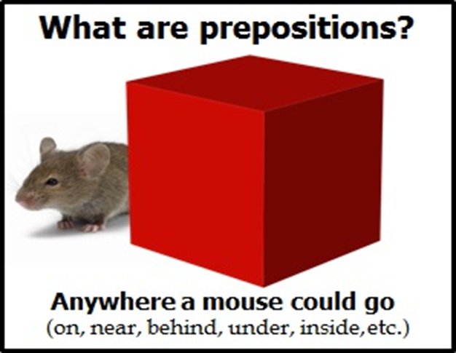
Prepositions - Voorzetsels
Goals for today
Recognise prepositions
Understand the function of prepositions
Learn how to use prepositions

Slide 3
Prepositions - Voorzetsels
Give me examples of prepositions please

Slide 4
Prepositions - Voorzetsels
What are prepositions?
Place
Direction
Time
In andere woorden:
Waar iets is
Welke kant het op gaat
Wanneer iets gebeurd

Slide 5
Prepositions – Voorzetsels
Exercise A
You already know many prepositions
Underline the ones in the sentences
Take 2 minutes then we check them

Slide 6
Prepositions – Voorzetsels
Explanation
Learn by heart
Not always just a translation
Silly mistakes!
Practice online
https://www.ego4u.com/en/cram-up/grammar/prepositions

Slide 7
Prepositions – Voorzetsels
Exercise C: Creative assignment
Photo essay with an instruction on how to do something
Using at least 10 prepositions.
Could be anything, for example: how to take care of an animal, how to use a lawn mower or how to create the perfect sandwich.
Take pictures and write the instructions underneath, all in English of course.
You can use whatever programme you want: word, power point, instagram or don’t take pictures but make a vlog.
Either way, you have to hand it in next week.

