Slide 1
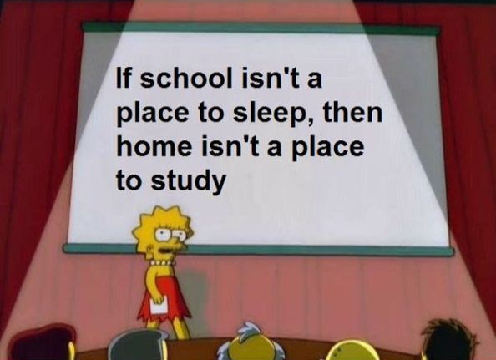
Timeline
Planning Orals
Grammar: Future
Work on your own on assignments from the book

Slide 2
Planning oral exams
Week | DV21 A – 1 | DV 21 A – 2 | DV 21 C | HO 21
3 | Demi, Indy | Ties
4 | Steffie, Gijs | Dennis
5 (8/9 Dec.) | Test: Vocab + Grammar Gijs | Test: Vocab + Grammar | Chelsey Angela Floortje
6 (15/16 Dec) | Steffie Demi Indy Lynn | Lisa |  | Ilja Yoeri Sofie Lars
7 (5/6 Jan) | Naomi Lana | Jaimy | Roksana Romy Noa
8 (12/13 Jan) |  | Pim, Alicia |  | Niels Martijn Sander Thijs
9 (19/20 Jan) |  |  | Oliwia Anouk Rosa

Slide 3
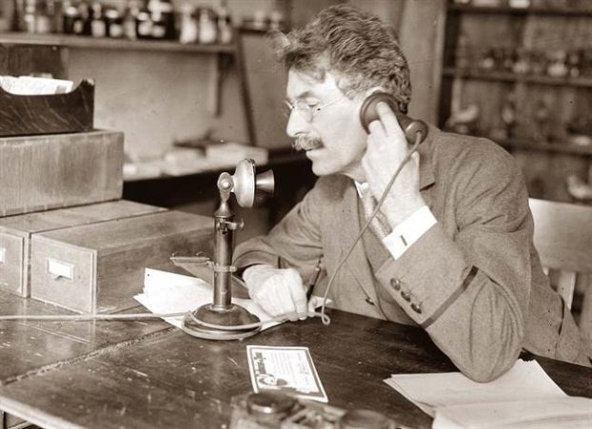
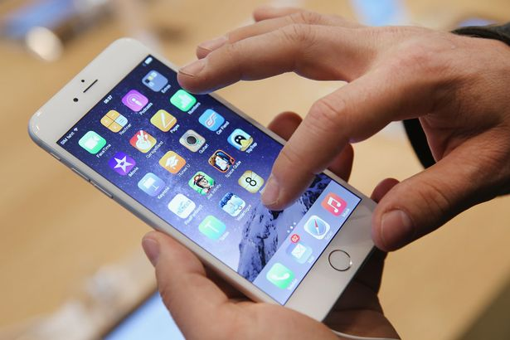
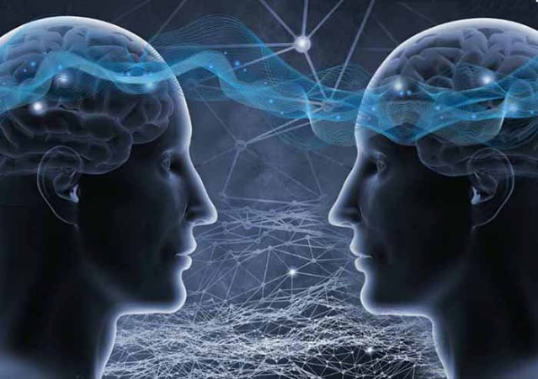
Future tense
Past Present Future

Slide 4
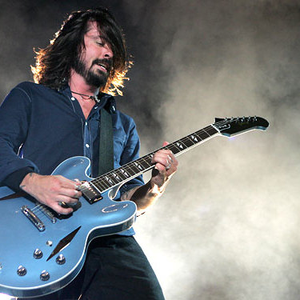
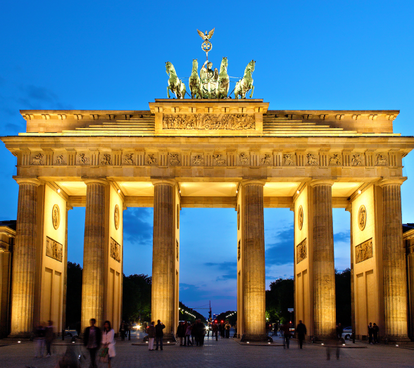
Future tense
Two examples
Next year, I'm going to take up the guitar. It will possibly be very difficult for me, but I love music.
I am going to fly to Berlin this afternoon to attend a congress . While I’m in Berlin, the weather will probably be good...

Slide 5
Future tense
Two examples
Next year, I'm going to take up the guitar. It will possibly be very difficult, but I love music.
I am going to fly to Berlin this afternoon to attend a congress . While I’m in Berlin, the weather will probably be good...

Slide 6
Future tense
Two examples
Next year, I'm going to take up the guitar. It will possibly be very difficult, but I love music.
I am going to fly to Berlin this afternoon to attend a congress . While I’m in Berlin, the weather will probably be good.

Slide 7
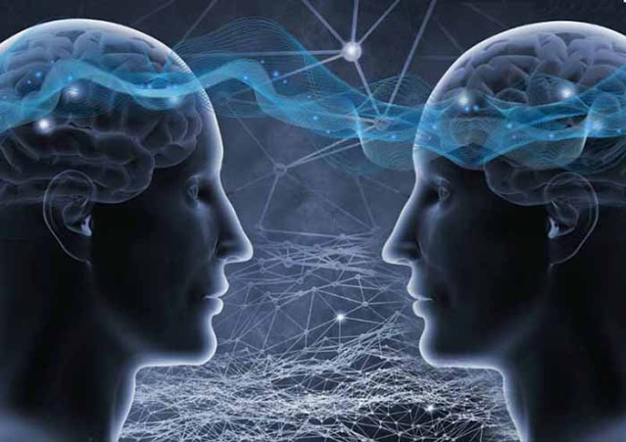
Future tense
Going to
Will
Future

Slide 8
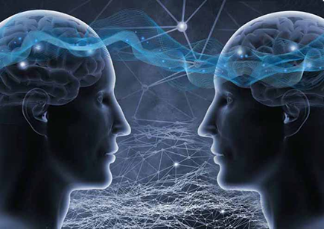
Am / Are / Is going to
When
Staat vast. Gaat zeker gebeuren.
Indicator
Certainly
No doubt
Sure to happen
Definitely
Absolutely
Rule
Am / Are / Is going to
How
I am going to work
You are going to work
She/ He/ It is going to work
We are going to work
They are going to work

Slide 9
Will or Shall
When
Will: Van plan. Onzeker of het zal gebeuren.
Shall: Alleen bij vragende zinnen en alleen als ‘I’ of ‘We’ het onderwerp is.
Indicator
I think...
Probably
Sometime
Once
Maybe
Rule
Will / Shall + ww
How
I will work
You will work
She/ He/ It will work
We will work
They will work
Shall I work tomorrow?
Will you work tomorrow?
Will she/he/it work tomorrow?
Shall we work tomorrow?
Will they work tomorrow?

Slide 10
Am / Are / Is going to or Will / Shall
Assignment A
In pairs quickly talk about these topics
You have 3 minutes
Do this in English
Your arrangements for this evening
Your intentions for the rest of the year
Your predictions for the planet for 2020

Slide 11
Am / Are / Is going to or Will / Shall
Assignment B
Look at the situations
Decide what form to use
Going to (GT)
Will/ Shall (WS)
In pairs
Take 3 minutes
We will discuss together

Slide 12
Am / Are / Is going to or Will / Shall
Assignment C
Choose the correct future form between the brackets
Assignment D
Fill in the gaps
On your own
Take 5 minutes
We will discuss together
If assignments A and B where too easy you can do assignments C and D on your own. Then work on your own.

Slide 13
Work on your own

