Slide 1
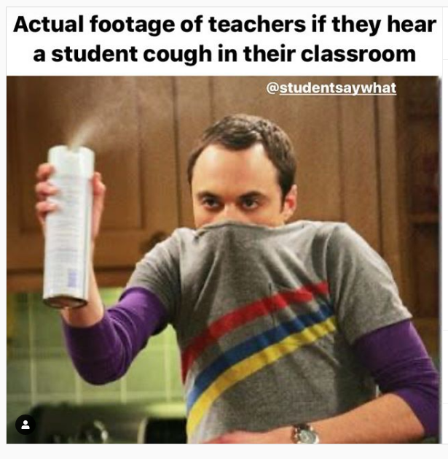
Timeline
Let’s meet (again)
Rules of the classroom
Materials, Tests and Planner
What’s next?
Let’s meet you

Slide 2
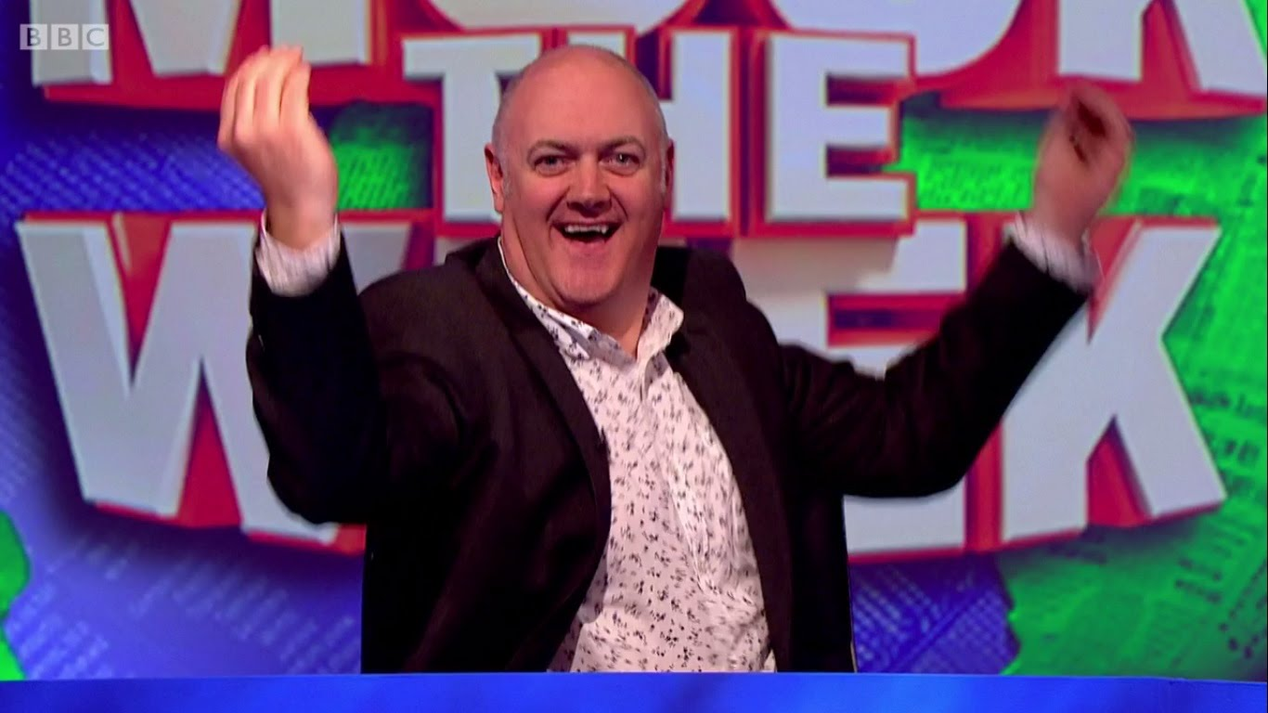
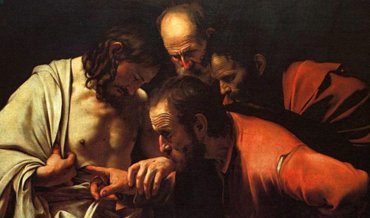
Let’s meet
Name and email
Ellen Kuindersma
E.Kuindersma@yuverta.nl
Who I am
Teacher of English and Art historian
Watch British Comedy
Like books and music
Mum of two girls
Who are you?
Tell me your name
Please take the same seat next time

Slide 3
Rules of the classroom
Share what you like – In English!
Mobile phones only when allowed
You need to bring
Book: Can Do Mbo-breed B
Binder
Pen or pencil
No book = no help form me
Bring some inspiration

Slide 4
Materials, Tests and Planner
Materials
Book = Old school paper learning
Hand out = During class, On Wikiwijs
Eduarte = Grades
Teams = Communication, Wikiwijs link
Studiemeter = Practice online
Wikiwijs = Planners, Hand Outs, What to learn, Powerpoints of the classes

Slide 5
Materials, Tests and Planner
Tests
Every Period
1 SO: Vocab + Grammar = 30 %
1 Skill test = 70 %
Exam at a higher level
Optional
Work independently
You can ask for help naturally

Slide 6
Materials, Tests and Planner
Tests
Exam at level MBO 2:
Starting at level A2 (= MBO 2): Do all your tests at level A2
Starting at level A1 (= MBO 1)
Year 1: Pass your tests at level A1 with an 8 average
Year 2: Pass your tests at level A2 with a 5,5 average
Exam at level MBO 3:
Starting at level B1 (= MBO 3): Do all your tests at level B1
Starting at level A2
Year 1: Pass your tests at level A2 with an 8 average
Year 2: Pass your tests at level B1 with a 5,5 average
Exam at lavel MBO 4:
Starting at level B2 (= MBO 4): Do all your tests at level B1
Starting at level B1
Year 1: Pass your tests at level B1 with an 8 average
Year 2: Pass your tests at level B2 with a 5,5 average

Slide 7
Materials, Tests and Planner
Planner
Different levels
Look at planner period 1
PowerPoints and Hand outs
Studiemeter
Homework
Planner at Wikiwijs
To do: All assignments of your level (done before test)
To learn
Vocab Unit 5 (depending on your level A2 plus B1/B2)
Expressions Unit 5 (depending on your level 25/35/50)
Grammar

Slide 8
Let’s meet you
Discussion wheel
Easy Bit boring topics
Medium Kinda interesting
Hard You have to choose

Slide 9
Easy Bit boring topics

Slide 10
Medium Kinda interesting

Slide 11
Hard You have to choose

Slide 12
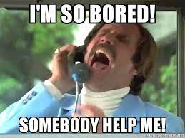
What’s next
Make up for missed tests
Let’s make a list
3 separate classes mixed into 2
Individual
NO SO UNIT 4
Your average = not important for exam grade
= important for exam level
Week 5 + 6 exam time
Week 5: Listening for all
Check Wikiwijs for all grammar topics
Check Studiemeter for testing vocab, grammar and skills

