Slide 1
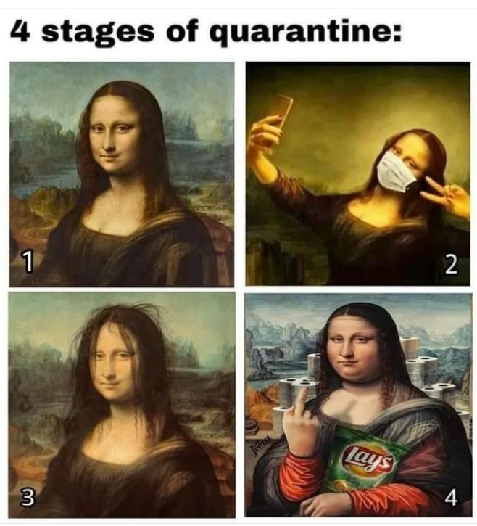
Timeline
Planning period 4
Grammar: Future
Work on your own
Planning periode 4
Grammatica: Toekomst
Zelfstandig werken

Slide 2
Planning period 4
Wikiwijs Period 4
Planner on paper?
Tests
Week 4/5: SO Unit 3 (Vocab and Grammar) + Listening
Week 9/10: SO Unit 4 (Vocab and Grammar) + Writing
Wikiwijs Periode 4
Planner op papier?
Toetsen
Week 4/5: SO Unit 3 (Vocab and Grammar) + Luisteren
Week 9/10: SO Unit 4 (Vocab and Grammar) + Schrijven

Slide 3
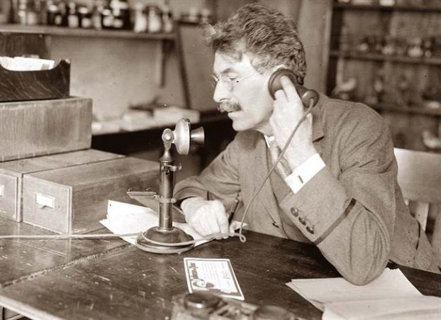
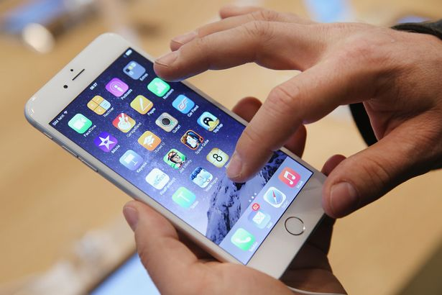
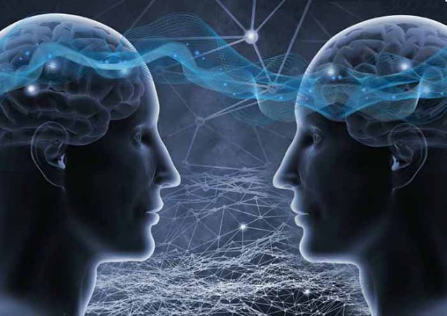
Future tense
Past Present Future

Slide 4
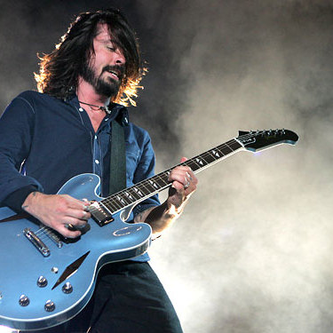
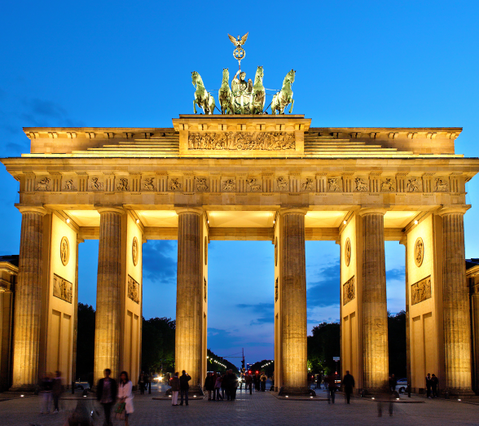
Future tense
Two examples
Next year, I'm going to take up the guitar. It will possibly be very difficult for me, but I love music.
I am going to fly to Berlin this afternoon to attend a congress . While I’m in Berlin, the weather will probably be good...

Slide 5
Future tense
Two examples
Next year, I'm going to take up the guitar. It will possibly be very difficult, but I love music.
I am going to fly to Berlin this afternoon to attend a congress . While I’m in Berlin, the weather will probably be good...

Slide 6
Future tense
Two examples
Next year, I'm going to take up the guitar. It will possibly be very difficult, but I love music.
I am going to fly to Berlin this afternoon to attend a congress . While I’m in Berlin, the weather will probably be good.

Slide 7
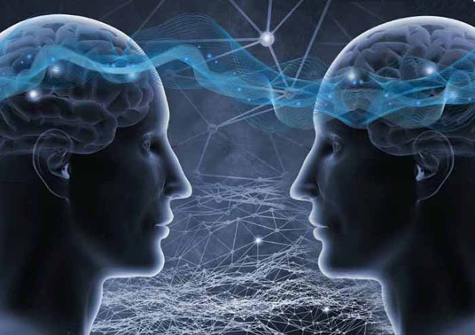
Future tense
Going to
Will
Future

Slide 8
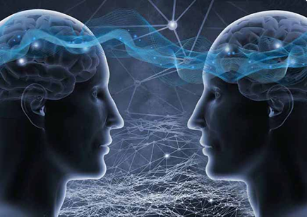
Am / Are / Is going to
When
Staat vast. Gaat zeker gebeuren.
Indicator
Certainly
No doubt
Sure to happen
Definitely
Absolutely
Rule
Am / Are / Is going to
How
I am going to work
You are going to work
She/ He/ It is going to work
We are going to work
They are going to work

Slide 9
Will or Shall
When
Will: Van plan. Onzeker of het zal gebeuren.
Shall: Alleen bij vragende zinnen en alleen als ‘I’ of ‘We’ het onderwerp is.
Indicator
I think...
Probably
Sometime
Once
Maybe
Rule
Will / Shall + ww
How
I will work
You will work
She/ He/ It will work
We will work
They will work
Shall I work tomorrow?
Will you work tomorrow?
Will she/he/it work tomorrow?
Shall we work tomorrow?
Will they work tomorrow?

Slide 10
Am / Are / Is going to or Will / Shall
Assignment A
In pairs quickly talk about these topics
You have 3 minutes
Do this in English
Your arrangements for this evening
Your intentions for the rest of the year
Your predictions for the planet for 2020

Slide 11
Am / Are / Is going to or Will / Shall
Assignment B
Look at the situations
Decide what form to use
Going to (GT)
Will/ Shall (WS)
In pairs
Take 3 minutes
We will discuss together

Slide 12
Am / Are / Is going to or Will / Shall
Assignment C
Choose the correct future form between the brackets
Assignment D
Fill in the gaps
On your own
Take 5 minutes
We will discuss together
If assignments A and B where too easy you can do assignments C and D on your own. Then work on your own.

Slide 13
Work on your own

