Slide 1
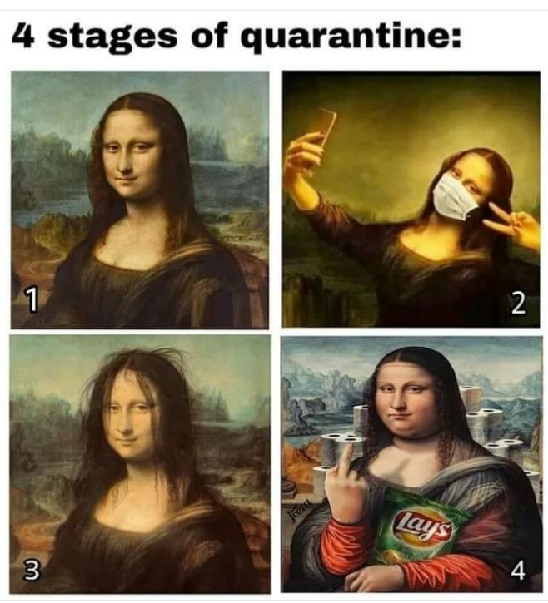
Timeline
Planning period 4
Grammar: Comparison
Writing
Writing exercise
Letter of complaint
Planning periode 4
Mondelingen
Schrijven
Schrijfopdracht
Klachtenbrief

Slide 2
Planning period 4
Wikiwijs Period 4
Planner on paper?
Tests
Listening Period 2 – When?
SO Unit 4 Vocab and Grammar
Writing
Wikiwijs Periode 4
Planner op papier?
Toetsen
Luisteren Periode 2 – Wanneer?
SO Hoofdstuk 4 Woorden en Grammatica
Schrijven

Slide 3
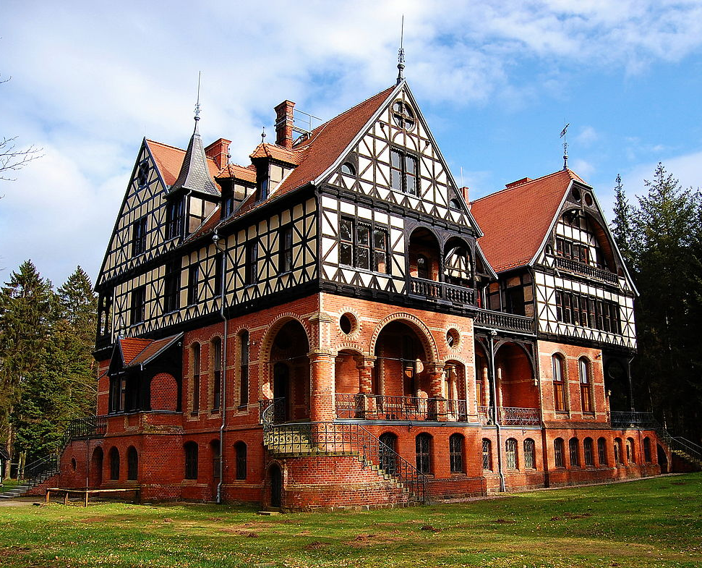
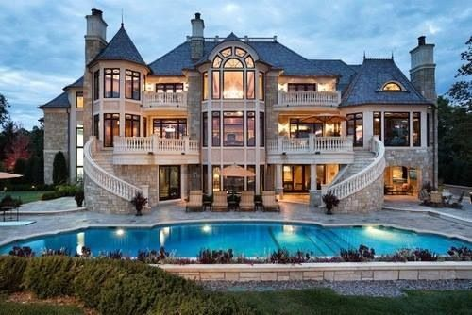
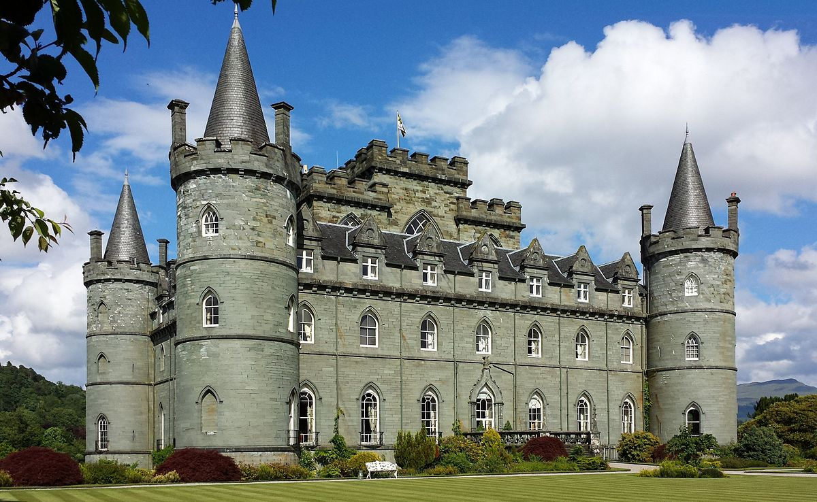
Grammar Comparisons
BIG BIGGER BIGGEST
Comparison = Vergelijken
Explanation on the next slides
Practice on Studiemeter
For additional practice: Watch the clip on YouTube

Slide 4
Grammar Comparisons
BIG BIGGER BIGGEST
Comparison = Vergelijken
Uitleg op de volgende slides
Oefenen op Studiemeter
Voor extra oefening: kijk de clip op YouTube

Slide 5
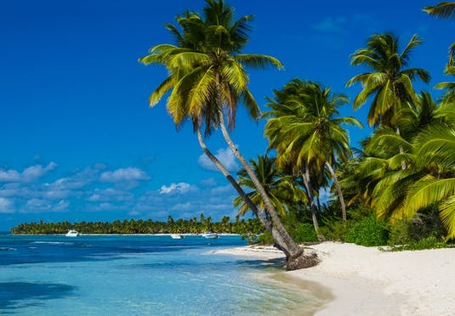
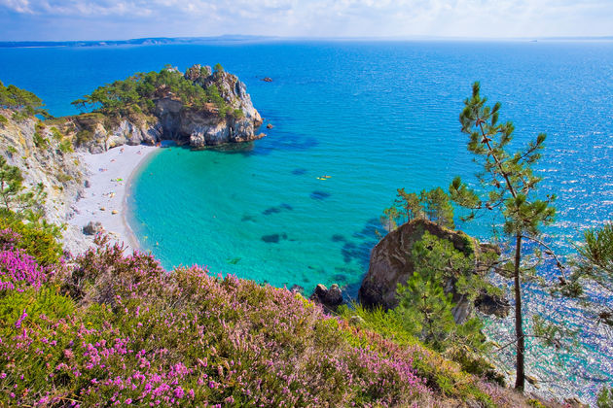
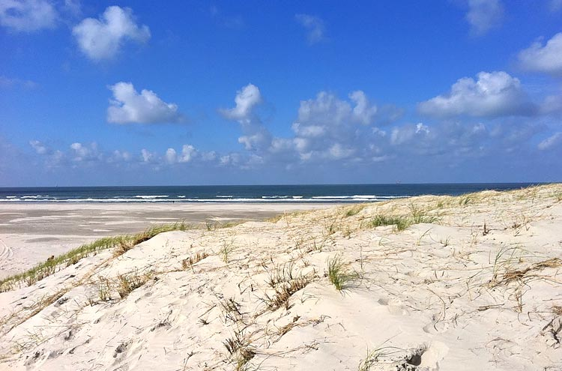
Grammar Comparisons
Mooist
Overtreffende trap
Mooier Superlative degree
Vergrotende trap
Mooi Comparative degree
Basis (stellende) trap
Positive degree

Slide 6
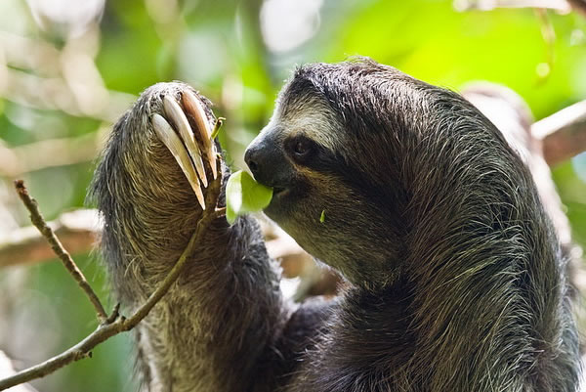
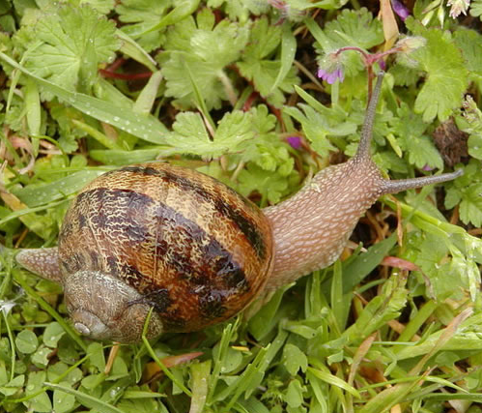
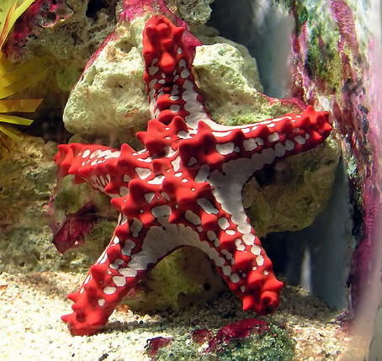
Grammar Comparisons
Slow
Sloth (o.003 m/h)
Garden snail (0,03 m/h)
Starfish (o,o6)
Overtreffende trap
Superlative degree
Vergrotende trap
Comparative degree
Basis (stellende) trap
Positive degree
Slow Slower Slowest

Slide 7
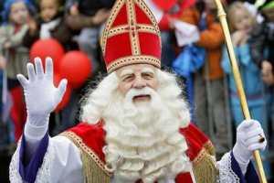
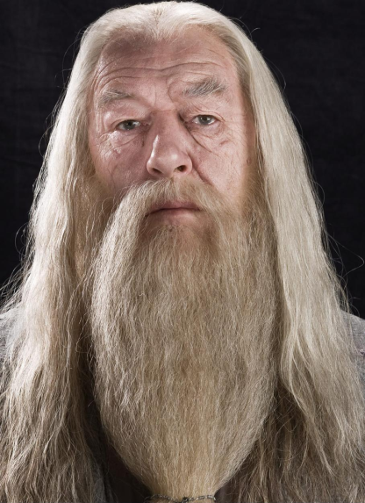
Grammar Comparisons
Old
Overtreffende trap
Superlative degree
Vergrotende trap
Comparative degree
Basis (stellende) trap
Positive degree
Old Older Oldest

Slide 8
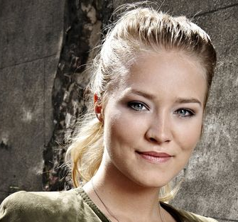
Grammar Comparisons
Pretty
(according to 50 Cent)
Overtreffende trap
Superlative degree
Vergrotende trap
Comparative degree
Basis (stellende) trap
Positive degree
Pretty Prettier Prettiest

Slide 9
Grammar Comparisons
Quiet
(according to 50 Cent)
Overtreffende trap
Superlative degree
Vergrotende trap
Comparative degree
Basis (stellende) trap
Positive degree
Quiet Quieter / More Quiet Quietest / Most Quiet

Slide 10
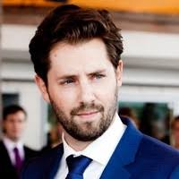
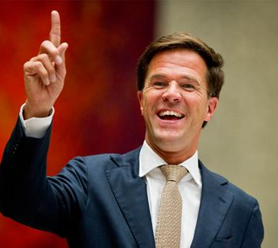
Grammar Comparisons
Powerful
Overtreffende trap
Superlative degree
Vergrotende trap
Comparative degree
Basis (stellende) trap
Positive degree
Powerful More powerful Most powerful

Slide 11
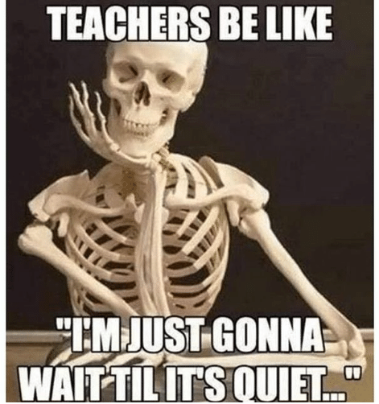
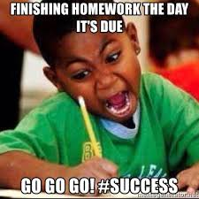
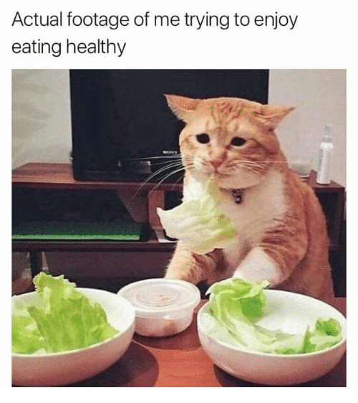
Grammar Comparisons
Difficult
Overtreffende trap
Superlative degree
Vergrotende trap
Comparative degree
Basis (stellende) trap
Positive degree
Difficult More difficult Most difficult

Slide 12
Grammar Comparisons
Degrees of comparison
Trappen van vergelijking
Woorden met 1 lettergreep + er +est
Woorden met 2 lettergrepen + er / more + est/ most
Woorden met 3 (+) lettergrepen + more + most
Oldest / Prettiest / Most powerful
Older / Prettier / More powerful Overtreffende trap
Superlative degree
Vergrotende trap
Old / Pretty / Powerful Comparative degree
Basis (stellende) trap
Positive degree

Slide 13
Grammar Comparisons
Exceptions to the rule
Uitzonderingen op de regel
Good – Better – Best
Bad – Worse – Worst

Slide 14
Grammar Comparisons
Practice
Studiemeter.nl
First Aid Course English
Vergelijken
Niveau 1 kiest Vergelijken A1
Niveau 2 kiest Vergelijken A2
Niveau 3 en 4 kiezen Vergelijken B1
Make 3 ‘Oefeningen’
More practice: watch the YouTube Video
More explaining: read your book B pages 318-319

Slide 15
Writing assignment
Description and comparison
Write a short text describing your internship (5 lines)
Make 5 comparisons about things you encounter at work. For instance:
Size of animals/ plants
Colleagues
Salary
Beschrijving en vergelijking
Schrijf een korte tekst over je stageplaats (5 regels)
Maak 5 vergelijkingen over dingen die je tegenkomt op je werk. Bijvoorbeeld:
Afmetingen van dieren/ planten
Collega’s
Salaris

Slide 16
Writing

Slide 17
 | Voorbeeld Formele Brief
1. Letterhead (Briefhoofd) | Ellen Kuindersma Gagelboschplein 351 5654 KX Eindhoven Nederland www.ikhebgeenwebsitemaardiekanjehiervermelden.nl
2. Reference (Kenmerk) | Bijvoorbeeld een bestelnummer. Als je dat hebt anders niets
3. Date (Date) | 4th May 2020
4. Inside address (Adres ontvanger) | The Manager Modern Restaurant 23 Old Street London, W11 4BN United Kingdom
5. Subject (Onderwerp) | Subject: Complaint about the meal
6. Salutation (Aanhef) | Dear Sir / Madam,
7. Body (Tekst) | I am writing to complain about a meal we had in your restaurant yesterday. We had booked a table for six but when we arrived there were no free tables and we had to wait for more than 45 minutes to sit down. From a menu of 12 dishes, only four were available and their quality was poor. The fish, in particular, tasted awful and the waiter was rude when we told him about this. We have eaten in your restaurant several times in the past but this is the forst time we have received such bad treatment. I am not asking for a refund but I would like you to improve the quality of your dishes and service.
8. Close (Afsluiting) | Yours faithfully, Handtekening Ellen Kuindersma

Slide 18
 | Voorbeeld Informele Brief
6. Salutation (Aanhef) | Hi Lucas,
7. Body (Tekst) | How are you doing? How is the weather in the Netherlands? Here it’s been raining cats and dogs. I am in London right now and I’ve had the best time ever! I really want to share with you what I’ve done up till now. So far I went to the Tate Modern. A museum of modern art where the have the coolest paintings and sculptures. We went to a musical at the West End. But right now I’m looking forward to next week. We are going to Glastonbury. An awesome music festival. I will tell you all about it next week!
8. Close (Afsluiting) | Lots of love, Ellen

Slide 19
Writing
Rules
Date
Subject
Salutation
Close
Date
4th May 2020
May 4th, 2020
May 4, 2020
Subject (only in formal letters)
Subject:
Re:
When you know the name | When you don’t know the name
Dear Mr Jones, | Dear Sir,
Dear Mrs Jones, | Dear Madam,
Dear Ms Jones, | Dear Sir / Madam,
Informal (Informeel)
Dear Lucas,
Hi Lucas,
When you know the name | When you don’t know the name
Yours sincerely, | Yours faithfully,
Kind regards, | Kind regards,
Informal (Informeel)
Love,
Hugs and Kisses / XOXO,
Bye!

Slide 20
Things to mind when writing
Spelling
Capital letters (= Hoofdletters)
Names of people and cities Namen van mensen en steden
Months and days Maanden en dagen
Start of a sentence Begin van een zin
‘I’ always ‘Ik’ altijd waar dan ook in de zin
Homophones = words that are pronounced the same but have a different meaning and often a different spelling
Homophones = woorden die hetzelfde uitgesproken worden maar een andere betekenis hebben en vaak ook een andere spelling
Your/ You’re/ You are
You are = Jij bent (een tovenaar)
You’re = Jij bent [samengetrokken]
Your = Jouw telefoon

Slide 21
Homophones

Slide 22
Homophones

Slide 23
Homophones

Slide 24
Homophones

Slide 25
Homophones

Slide 26
Homophones

Slide 27
Homophones

Slide 28
Homophones

Slide 29
Homophones

Slide 30
Things to mind when writing
Conventions
Mind the examples
Mind your comma’s and full stops
Comma after the name in the Salutation
Comma after the farewell
Full stop at the end of a sentence
Regels
Let op de voorbeelden
Let op de komma’s en punten
Komma na de naam in de Aanhef
Komma na de eindgroet
Punt aan het einde van een zin

Slide 31
Writing exercise
Customer service
Anger Management
https://www.youtube.com/watch?v=DzUc3Eqzzos
You can put on subtitles – they are actually quite good

Slide 32
Writing exercise
Letter of complaint
Scene
You went on holiday to London. (Ryan Air flight FE 8786) During your trip the flight attendant was quite rude and unhelpfull. Because of that you did not get any water. Which you needed to take your medicine. You are writing a letter of complaint to the airline.
Assignment
Write the letter. It should be at least be 80 but not more than 150 words.
Write the text in English
Don’t forget the writing conventions
Please include these items in your letter – you can add more if you’d like to
Describe the behaviour of the flight attendant
Explain why that was a problem
Ask for compensation – you can decide what is fair
Completion
Send your text in an email to e.kuindersma@helicon.nl
Hand it in on Friday before the next class
Ryanair Customer Service Department PO Box 11451
Swords
Co Dublin
Ireland

Slide 33
Writing exercise
Klachtenbrief
Scene
Je bent op vakantie naar Londen geweest. (Ryan Air flight FE 8786) Tijdens de reis was de stewardes behoorlijk onbeleefd en onbehulpzaam. Daardoor kreeg je geen water. Die had je nodig om je medicijnen in te kunnen nemen. Je schrijft een klachtenbrief naar de vliegtuigmaatschappij.
Opdracht
Schrijf de brief. Hij moet minstens 80 maar niet meer dan 150 woorden lang zijn.
Schrijf de brief in het Engels
Vergeet de schrijfregels niet
Neem in ieder geval de onderstaande zaken over – je mag er meer aan toevoegen
Beschrijf het gedrag van de stewardess
Leg uit wat het probleem was
Vraag om compensatie – jij mag bepalen wat eerlijk is
Voltooiing
Stuur je brief in een e-mail naar e.kuindersma@helicon.nl
Lever het in voor de volgende les
Ryanair Customer Service Department PO Box 11451
Swords
Co Dublin
Ireland

