Slide 1
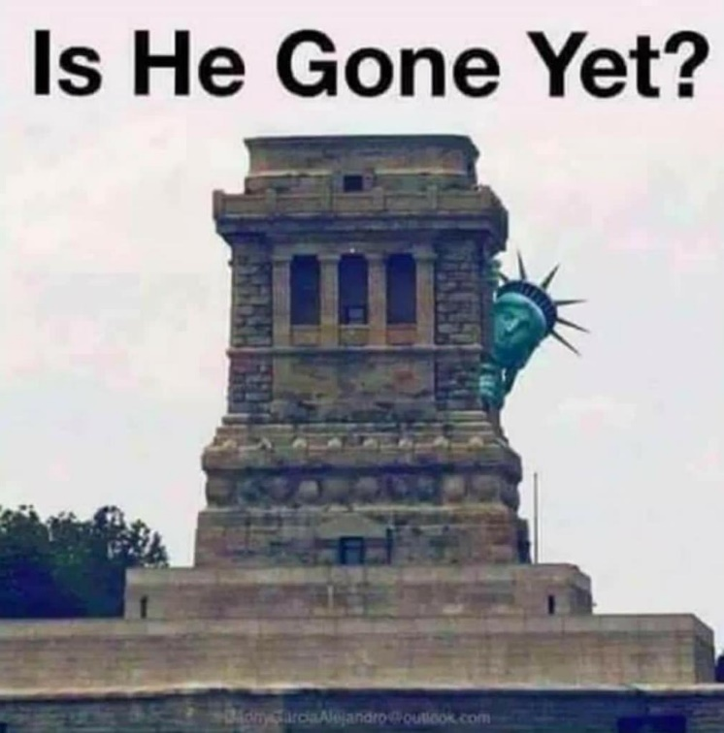
Timeline
Introduction
Admin
Tests period 1: Any resits or first tries?
Planner
Vocab Unit 6
Preparation Oral exam
Grammar: Comparisson
Work on your own
Oral exam
From your book

Slide 2
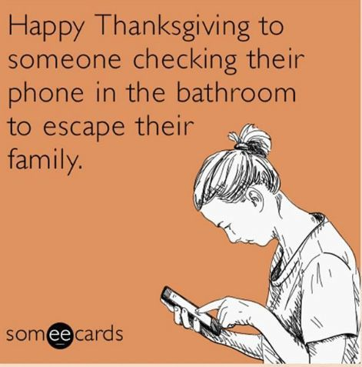
Admin
Tests Period 1
Listening
SO Unit 5
Reading
Any resits or first tries?
Planner Period 2
Vocab Unit 6
A2 (Blz. 275-276)
B1 (Blz. 276)
B2 (Blz. 276)

Slide 3
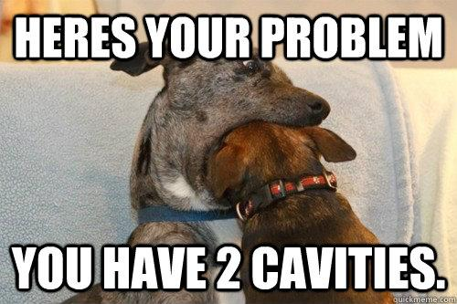
Preparation Oral Exam
Main information
Time
Level 2: 4 – 6 minutes
Level 3: 5 – 7 minutes
Level 4: 6 – 8 minutes
Topic: Your internship
Materials
Powerpoint
Pictures
Other things
When
Choose a date
Delayed = 1 demerit (1 minpunt)
What to do
Make mind map
Make powerpoint
Create wordlist
Ask each other for help

Slide 4
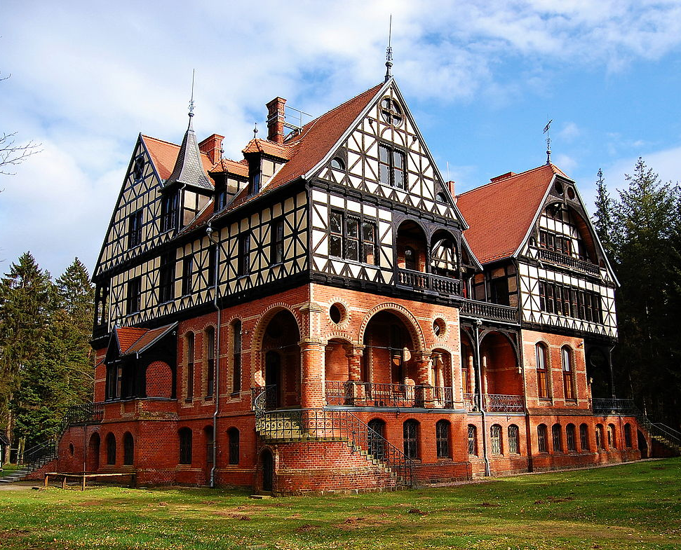
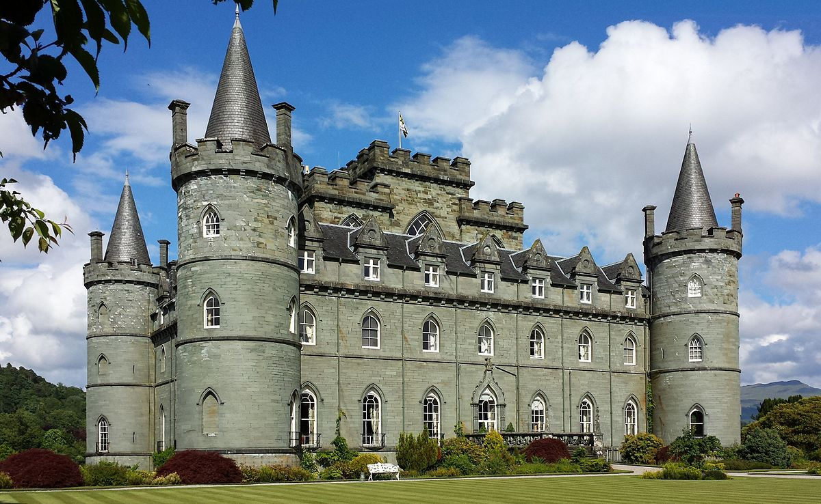
Grammar: Comparisson
BIG BIGGER BIGGEST
Comparisson: Vergelijken
Watch the clip on YouTube – you can find it in Eduarte
Make exercises in clip on separate sheet
Exercises in the book belonging to this subject: 87, 88, 89 (259 -260)

Slide 5
Work on your own

