Slide 1
Week 5 - Thursday
Online class

Slide 2
VET – week 4

Slide 3
lieke, lotte, femke, olivier and soumeiya won the vet for last week’s challenge they scored: 25/26 points Perfect translations and excellent group work! Congratulations!
Neck And neck with: - Emma, Sofie, Stan and Floris 24/26

Slide 4
ankie, islam, maeva and sander won the vet for last week’s challenge they scored 24,5/26 points virtually perfect translations and Excellent group work! Congratulations!

Slide 5
GPS

Slide 6
A-group: magazines 3, 4 & 5 - Nouns - past simple - present and past continuous B-group: magazines 3 & 4 - sentence structure - revision of grammar tenses
Abel, Gabriela, Islam & Jelle nog in een groep. Zie instructies hierna.

Slide 7
A-group: magazines 3, 4 & 5 - Nouns - past simple - present and past continuous B-group: magazines 3 & 4 - sentence structure - revision of grammar tenses
Giel, Harris, Jorn, Meike, Femke, Max en Lieke nog in een groep. Zie instructies hierna.

Slide 8
Groups in gps: Grammar A – 10585NK Grammar B – 10587NK Grammar level test – 10616NK gps-taalenrekenen.nl/

Slide 9
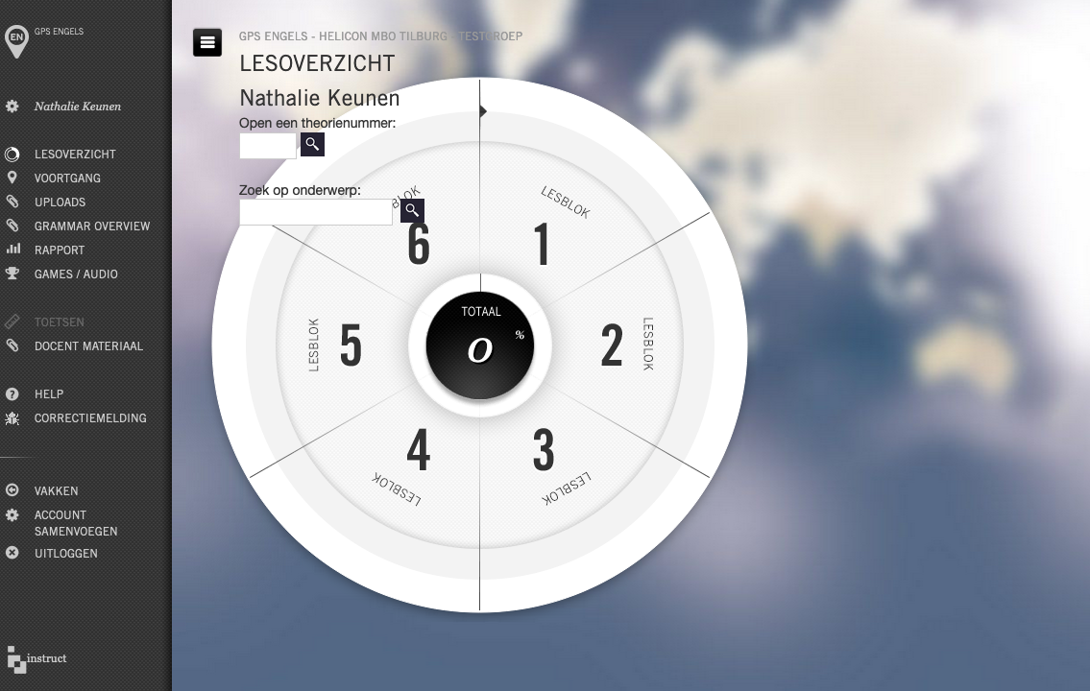
i

Slide 10
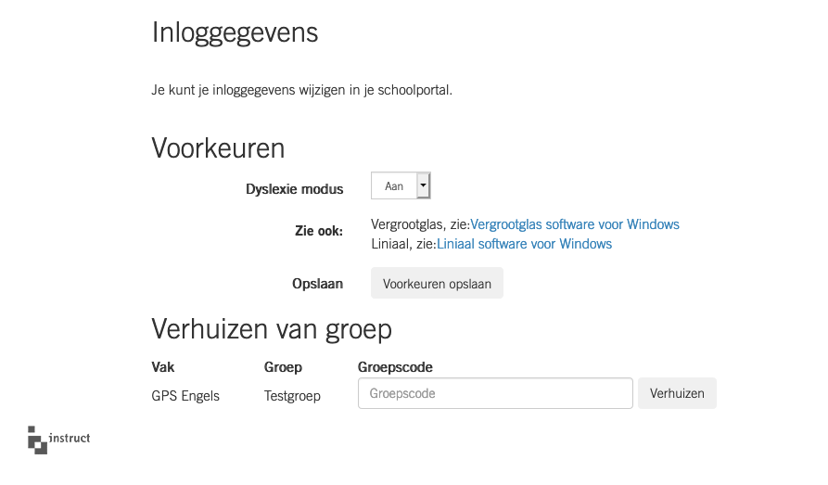
I – altijd met een hoofdletter

Slide 11
Groups in gps: Grammar A – 10585NK Grammar B – 10587NK Grammar level test – 10616NK

Slide 12
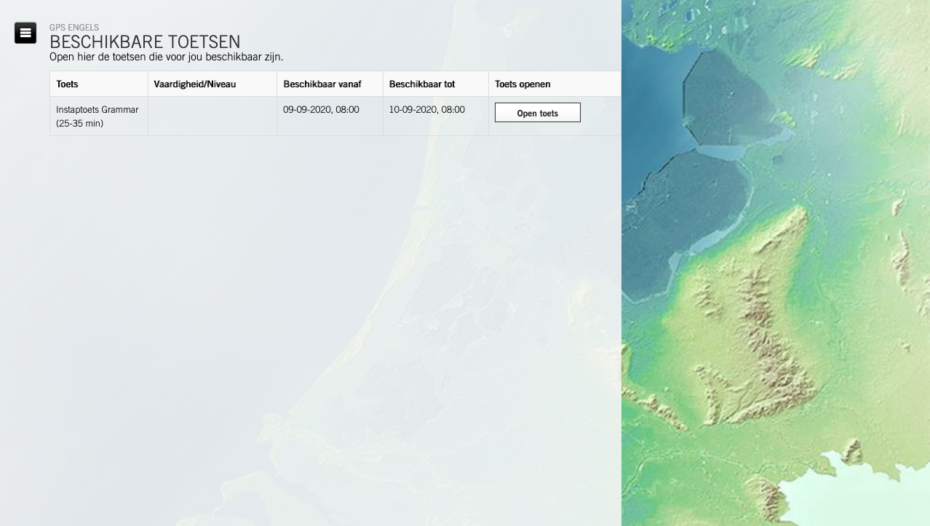
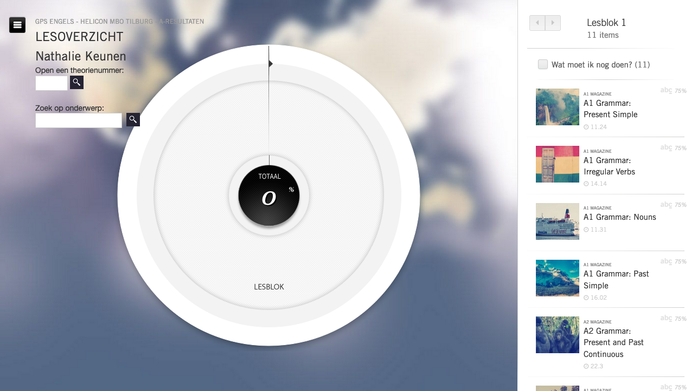
To/too/two

Slide 13
Enjoy!

