Slide 1
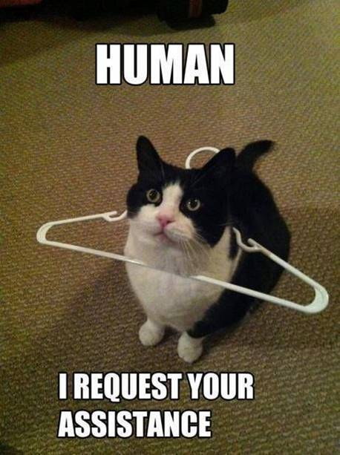
Timeline
Check homework
Vocab Unit 1
Grammar: Present Simple & Present Continuous
Studiemeter
Homework

Slide 2
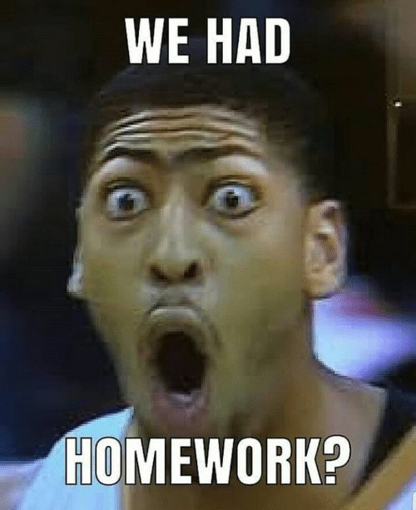
Check homework
To do for this week
Toa test – did you manage?
Practice reading at:
A2: 16 (24-25)
B1: 49 (56-57)
B2: 72 (80-81)
Check your answers
Use answersheets
Will discuss later

Slide 3
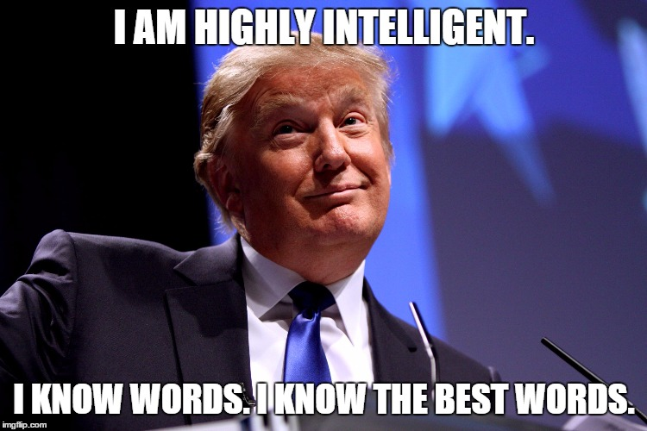
Vocab Unit 5
Vocab
Book (p. 285)
A2
B1
B2
Any volunteers to read out loud?
Expressions
Studiemeter

Slide 4
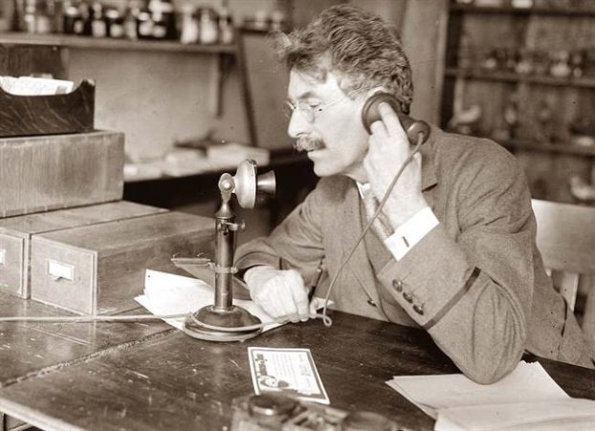
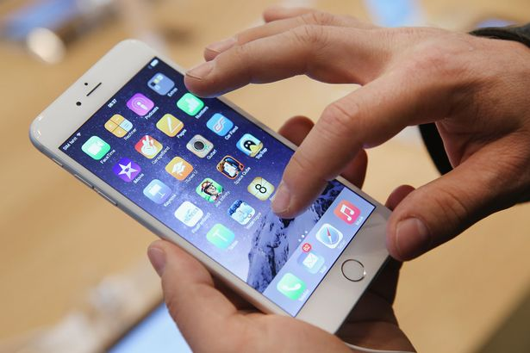
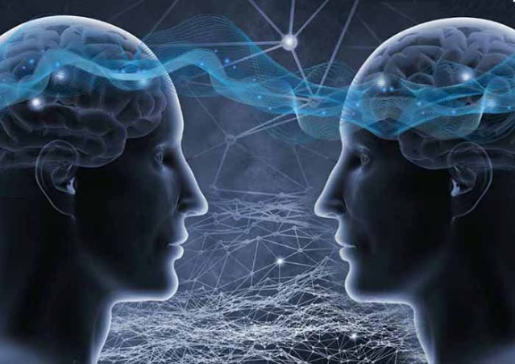
Present Simple and Present Continuous
Past Present Future

Slide 5
Present Simple and Present Continuous
Present
Simple OR Continuous

Slide 6
Present Simple and Present Continuous
Present
Simple OR Continuous
Gewoonten en Feiten OR Nu aan de gang

Slide 7
Present Simple and Present Continuous
Ik fiets
Ik ben aan het fietsen
Present
Simple OR Continuous
Gewoonten en Feiten OR Nu aan de gang

Slide 8
Present Simple
Assignment A
Fill in the correct form of the verb (ww) in the gaps.
We always (sprint) _____ when we see pie.
He (hide) _____ from zombies in his closet at the moment.
The Avengers (stop) _____ evil from happening.
Make this assignment on your own
You have 2 minutes to make this assignment

Slide 9
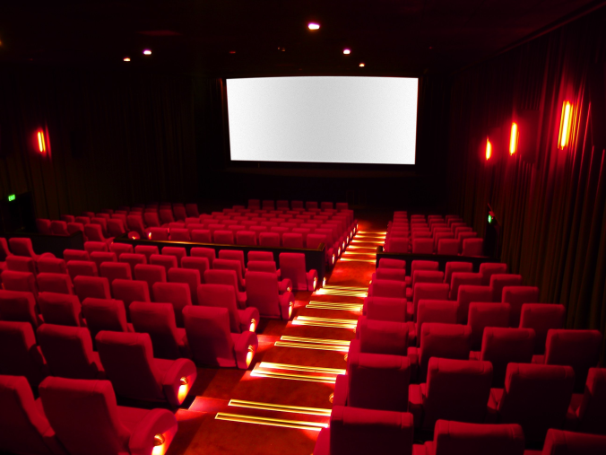
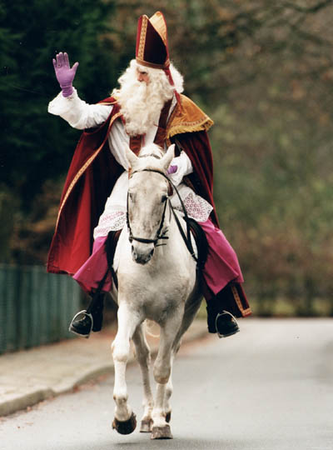
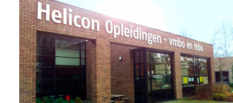
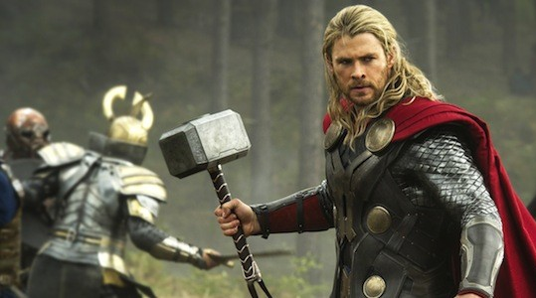
Present Simple

Slide 10
Present Simple
When
Gewoontes of feiten
Nooit
Altijd
Regelmatig
Signifier
Never
Always
Often
Sometimes
Usually
Every week
Frequently
Rule
WW or WW + S (SHIT –rule)
How
I work
You work
She/ He/ It works
We work
They work

Slide 11
Present Simple
Exemptions to the rule for She / He / It – ONLY LEVEL 4 STUDENTS
Do en Go = ww + es
She goes to school by bus.
The dog does a dodo in the park.
WW eindigt op sisklank = ww + es
He watches all football matches.
She kisses her girlfriend.
WW eindigt op medeklinker + y = y wordt ies
The waiter carries a tray with drinks.
The priest marries the happy couple.

Slide 12
Present Simple
Assignment B
Some verbs take a different spelling when the subject is She/ He/ It. Give the correct spelling for these words.
Catch
Enjoy
Go
Carry
Fly
Pay
Make this assignment on your own
You have 3 minutes to make this assignment

Slide 13
Present Simple
Assignment B
Some verbs take a different spelling when the subject is She/ He/ It. Give the correct spelling for these words.
Catch Catches
Enjoy
Go
Carry
Fly
Pay
Make this assignment on your own
You have 3 minutes to make this assignment

Slide 14
Present Simple
Assignment B
Some verbs take a different spelling when the subject is She/ He/ It. Give the correct spelling for these words.
Catch Catches
Enjoy Enjoys
Go
Carry
Fly
Pay
Make this assignment on your own
You have 3 minutes to make this assignment

Slide 15
Present Simple
Assignment B
Some verbs take a different spelling when the subject is She/ He/ It. Give the correct spelling for these words.
Catch Catches
Enjoy Enjoys
Go Goes
Carry
Fly
Pay
Make this assignment on your own
You have 3 minutes to make this assignment

Slide 16
Present Simple
Assignment B
Some verbs take a different spelling when the subject is She/ He/ It. Give the correct spelling for these words.
Catch Catches
Enjoy Enjoys
Go Goes
Carry Carries
Fly
Pay
Make this assignment on your own
You have 3 minutes to make this assignment

Slide 17
Present Simple
Assignment B
Some verbs take a different spelling when the subject is She/ He/ It. Give the correct spelling for these words.
Catch Catches
Enjoy Enjoys
Go Goes
Carry Carries
Fly Flies
Pay
Make this assignment on your own
You have 3 minutes to make this assignment

Slide 18
Present Simple
Assignment B
Some verbs take a different spelling when the subject is She/ He/ It. Give the correct spelling for these words.
Catch Catches
Enjoy Enjoys
Go Goes
Carry Carries
Fly Flies
Pay Pays
Make this assignment on your own
You have 3 minutes to make this assignment

Slide 19
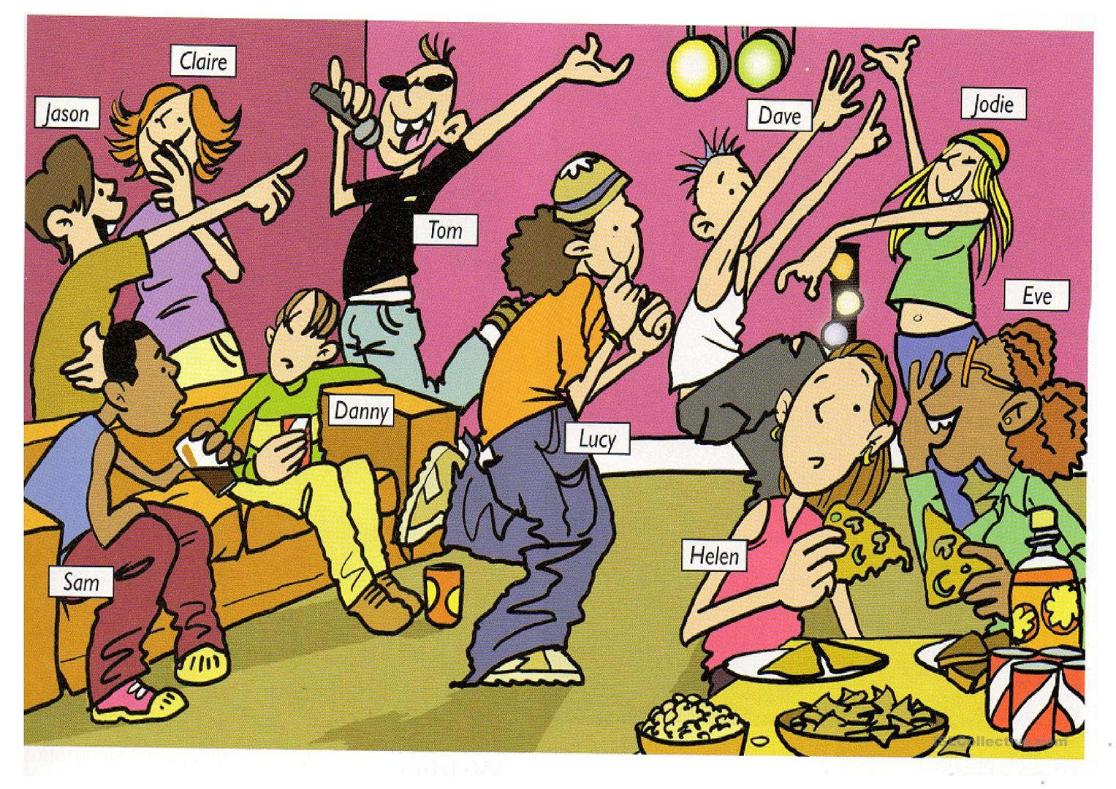
Present Continuous

Slide 20
Present Continuous
When
Als iets nu, op dit moment, aan de gang is.
Signifier
Now
Right now
At the moment
Look!
Currently
Rule
Am / are / is + ww + ing
How
I am working
You are working
She/ He/ It is working
We are working
They are working

Slide 21
Present Continuous
Exemptions to the spelling rule – ONLY LEVEL 4 STUDENTS
WW eindigt op - e = e valt weg + ing
(Have) I am having the best time ever!
(Dance) She is dancing like crazy.
WW eindigt op klinker + medeklinker = medeklinker verdubbelen
(Grab) We are grabbing all the chips we can.
(Fog) My uncle is fogging up the room with his sigar.

Slide 22
Present Continuous
Assignment C
Circle the correct form of the Present Continuous.
Marieke am / are / is noticing how the sun is shining now.
At the moment we am / are / is answering questions.
You am / are / is making no mistakes currently.
I am / are / is talking to the classroom right now.
Macklemore is on the radio now: “This am / are / is f*cking awesome!”
Make this assignment on your own
You have 2 minutes to make this assignment

Slide 23
Present Simple and Present Continuous
Assignment D
In each sentence, underline the signifier and circle whether the present simple (PS) or the present continuous (PC) is used.
I usually go to bed before 11.30 PS / PC
She is cleaning her room right now. PS / PC
Water boils at 100 degrees Celsius. PS / PC
You cannot see him now; he is having a discussion with his boss. PS / PC
I am working at the moment. PS / PC
Make this assignment on your own
You have 2 minutes to make this assignment

Slide 24
Present Simple and Present Continuous
Assignment E and F
Make these assignments on your own or in pairs
If you are done progress to the next assignment
If you are entirely finished you can work from your book.

Slide 25
Homework next class
 | Work in class | Work at home | Studiemeter
Level 1 | Hand out in class Lesson 1 + 2: 1 – 22 (6-12) | Lesson 3 + 4: 23 – 44 (13-18) | First Aid Course English Tegenwoordige Tijd & Nu aan de gang – A1
Level 2 | Hand out in class G: 30 a+b+c (38), 87 (97) | R: 15 (23), 18 (26) V: 7 (17), 8 (17), 19 (27) G: 90 (98-99) | Can Do Online Woorden: Woordoefening 2, 3 Uitdrukkingen: Uitdrukkingen 2, 3 First Aid Course English Tegenwoordige Tijd & Nu aan de gang – A2
Level 3 | Hand out in class G: 59 a+b (66), 87 (97) | R: 48 (55), 53 (59), 54 (60) V: 39 (49), 42 (51), 51 (58) G: 90 (98-99) | Can Do Online Woorden: Woordoefening 2, 3 Uitdrukkingen: Uitdrukkingen 2, 3 First Aid Course English Tegenwoordige Tijd & Nu aan de gang – A2
Level 4 | Hand out in class G: 78 a+b+c (88), 87 (97) | R: 70 (79), 74 (83) V: 39 (49), 65 (76) G: 90 (98-99) | Can Do Online Woorden: Woordoefening 2, 3 Uitdrukkingen: Uitdrukkingen 2, 3 First Aid Course English Tegenwoordige Tijd & Nu aan de gang – A2

